Slide 1


Maths
Addition and Subtraction
Year One
Maths | Addition and Subtraction | Exploring Number Facts | Lesson 6 of 8: Related Number Facts

Slide 2
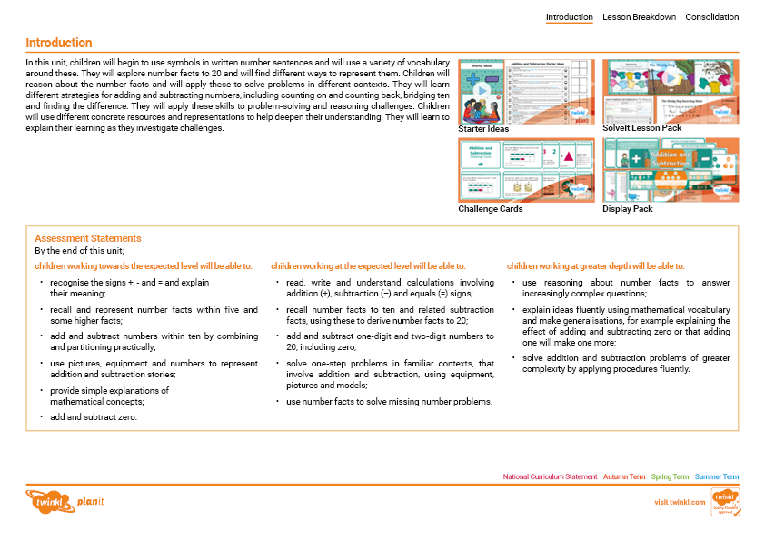
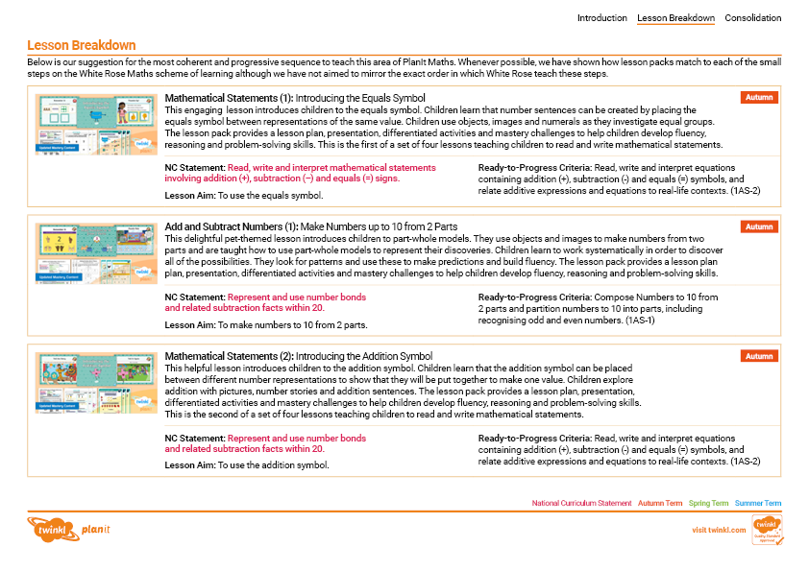
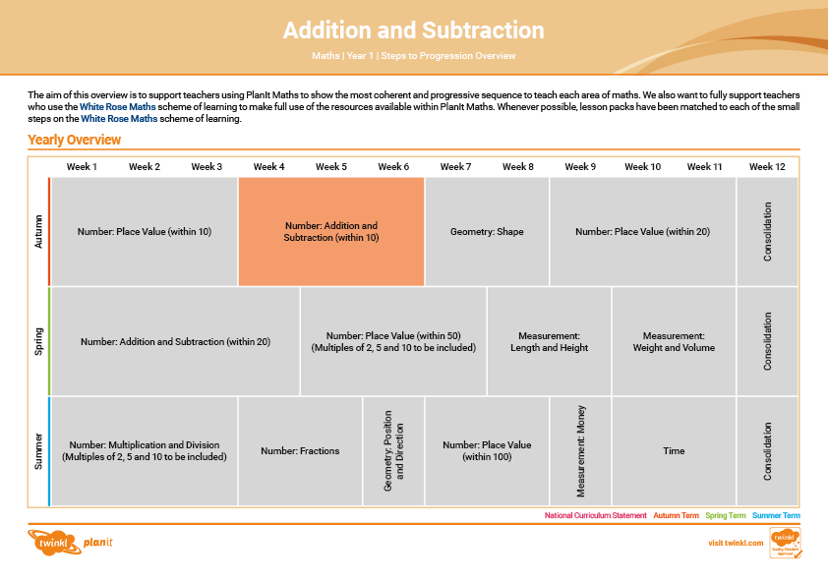

Need a coherently planned sequence of lessons to complement this resource?
See our Addition and Subtraction Steps to Progression document.
Twinkl PlanIt is our award-winning scheme of work with
over 4000 resources.

Slide 3
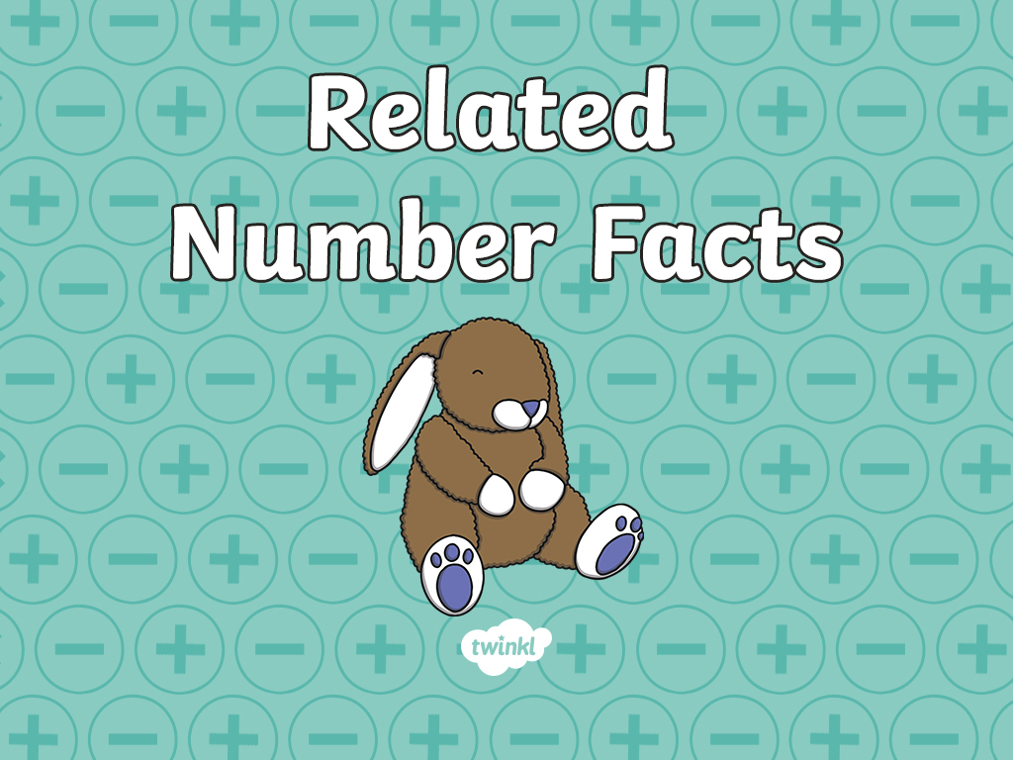

Slide 4
Aim
To make fact families using 8 calculations.
Success Criteria
I can write addition facts of fact families.
I can write subtraction facts of fact families.
I can check I have found all 8 calculations of a fact family.

Slide 5







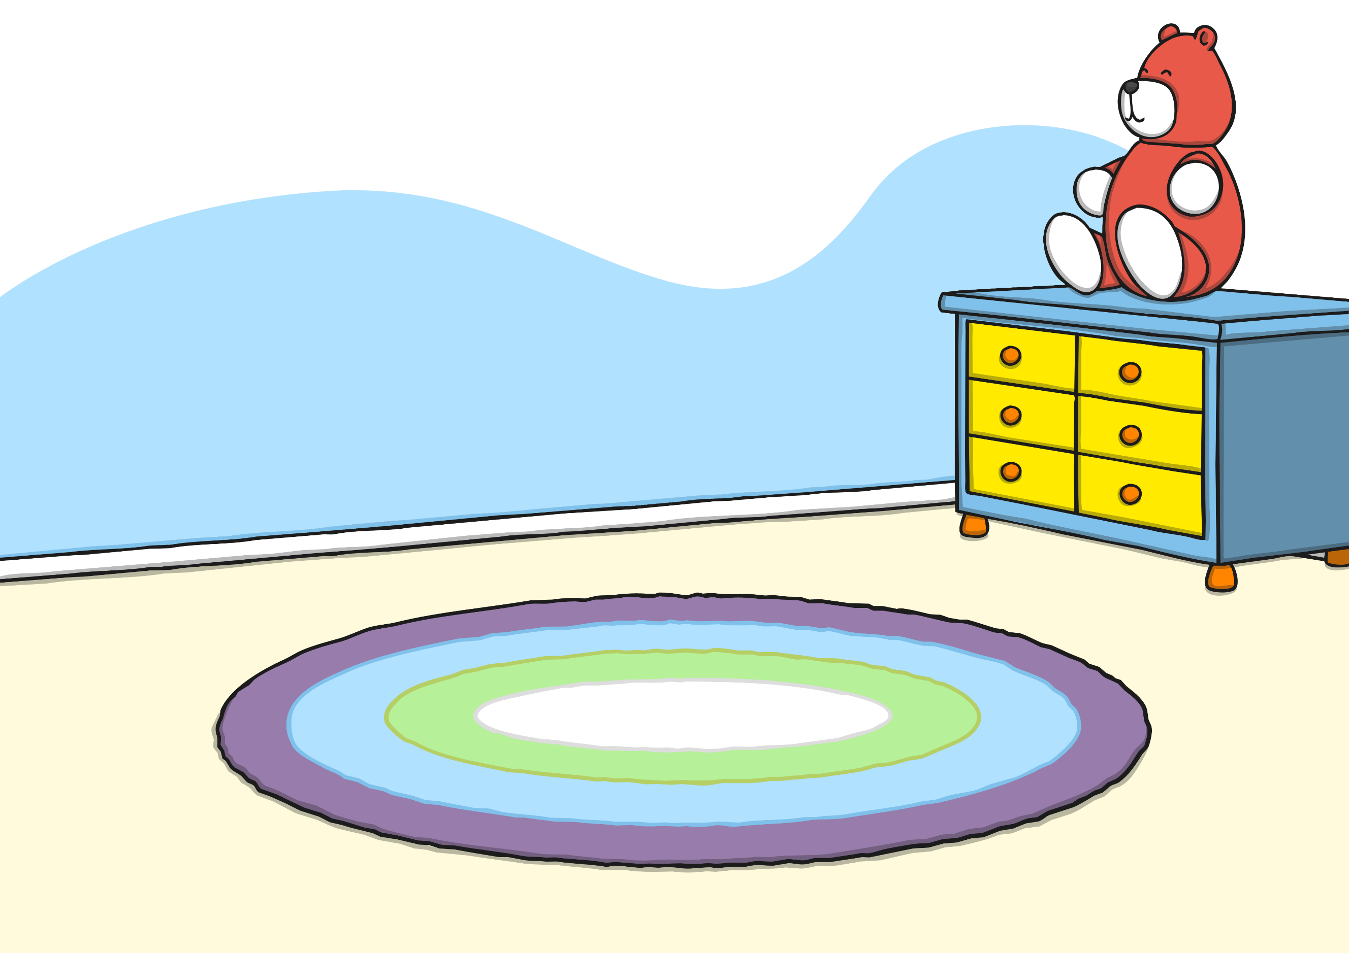

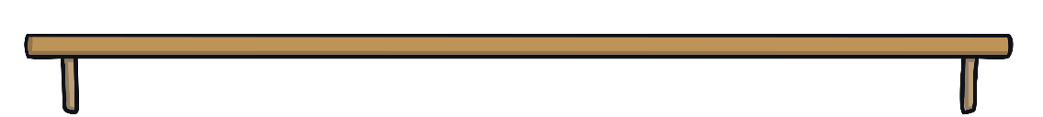
Remember It
Match the number fact to the part-whole models.
4
3
6
7
1
3
2
1
6
0
2
5
5 + 2 = 7
6 = 6 + 0
3 = 2 + 1
3 + 1 = 4

Slide 6
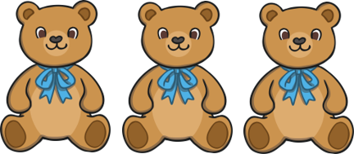
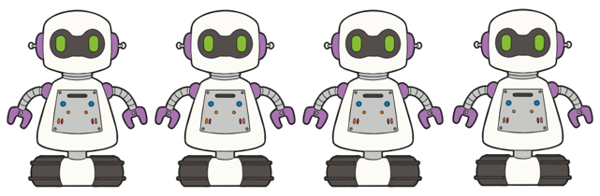
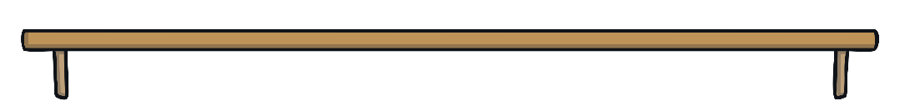


8 Facts
3 + 4 = 7
7 = 3 + 4
What does this picture show?
Can we write this another way?
Remember, the equals sign does not mean 'the answer'. The equals sign tells us that the parts on either side are balanced, or are worth
the same.
7
7
7

Slide 7
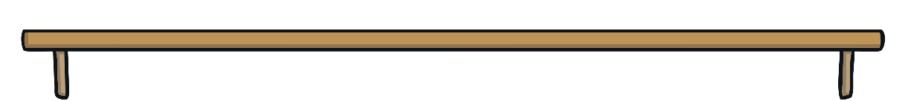


8 Facts
Can we change the order of the addition calculations?
3 + 4 = 7
7 = 3 + 4
4 + 3 = 7
7 = 4 + 3
Remember, when we add numbers, we can do it in either order and still make the same number.
Are there any subtraction facts that the number shapes can show?

Slide 8
8 Facts
Can we write that another way?
7 – 3 = 4
4 = 7 - 3
Remember, the equals sign does not mean 'the answer'. The equals sign tells us that the parts on either side are balanced, or are worth
the same.
4
4
4
4

Slide 9
8 Facts
7 – 3 = 4
4 = 7 - 3
7 – 4 = 3
3 = 7 - 4
Is there another subtraction fact that this picture shows?
Write it both ways.

Slide 10
8 Facts
3 + 4 = 7
7 = 3 + 4
4 + 3 = 7
7 = 4 + 3
7 – 4 = 3
3 = 7 – 4
7 – 3 = 4
4 = 7 – 3
We call these fact families as they are all related to each other.

Slide 11




8 Facts
Write the 8 facts for this picture.
4
2
6
6
4
2
+ =
= +
2
4
6
6
2
4
+ =
= +
6
2
4
4
6
2
− =
= −
6
4
2
2
6
4
− =
= −
Did you find them all? How can you work systematically?

Slide 12


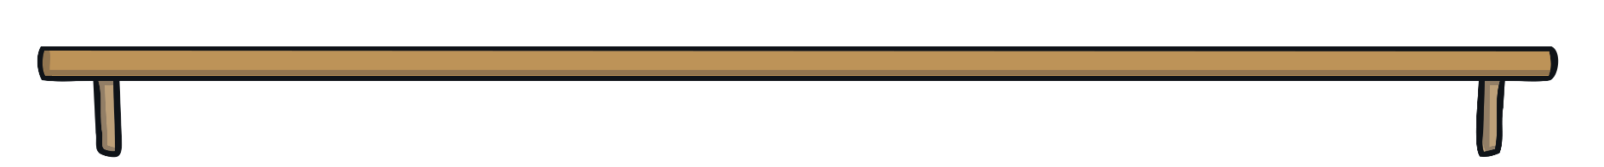
8 Facts
Write the 8 facts for this picture. This time, try to work systematically.
5
3
8
8
5
3
+ =
= +
3
5
8
8
3
5
+ =
= +
8
3
5
5
8
3
− =
= −
8
5
3
3
8
5
− =
= −
Did you find them all?

Slide 13
8 Facts
Fill in the missing numbers in these calculations.
2
7
9
9
2
7
+ =
= +
7
2
9
9
7
2
+ =
= +
9
2
7
7
9
2
− =
= −
9
7
2
2
9
7
− =
= −

Slide 14
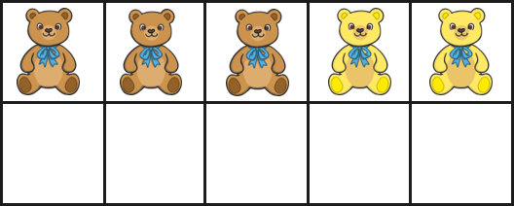
Odd One Out
Which calculation is the odd one out? Explain why.
3 + 2 = 5
5 = 2 + 3
2 + 3 = 5
5 = 3 + 2
5 − 2 = 3
3 = 5 - 2
5 = 3 − 2
5 − 3 = 2
2 = 5 − 3
3 take away 2 does not equal 5. In subtraction calculations, it should always be the whole subtract a part - not a part subtract another part.

Slide 15


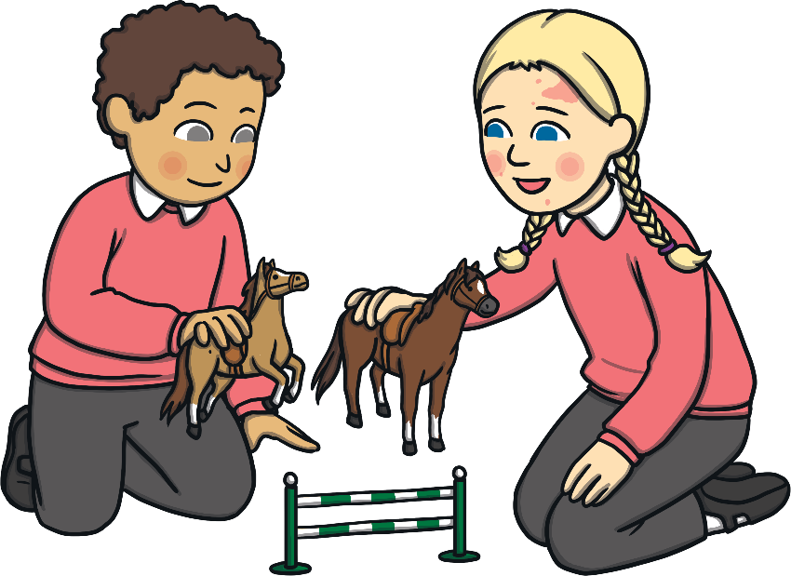
Odd One Out
Which calculation is the odd one out? Explain why.
5 + 1 = 6
6 = 5 + 1
1 + 5 = 6
1 + 6 = 5
6 = 1 + 5
6 − 5 = 1
1 = 6 − 5
6 − 1 = 5
5 = 6 − 1
1 add 6 does not equal 5. In addition calculations, it should always
be the parts added together - not a part and the whole.

Slide 16

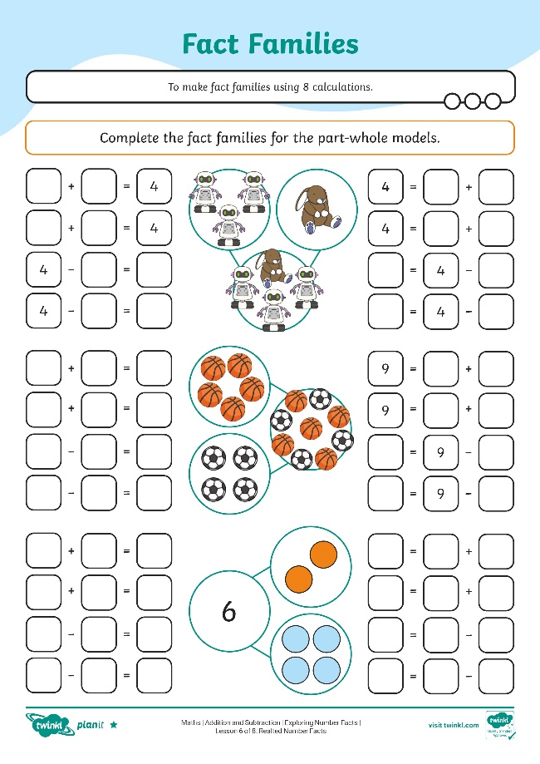
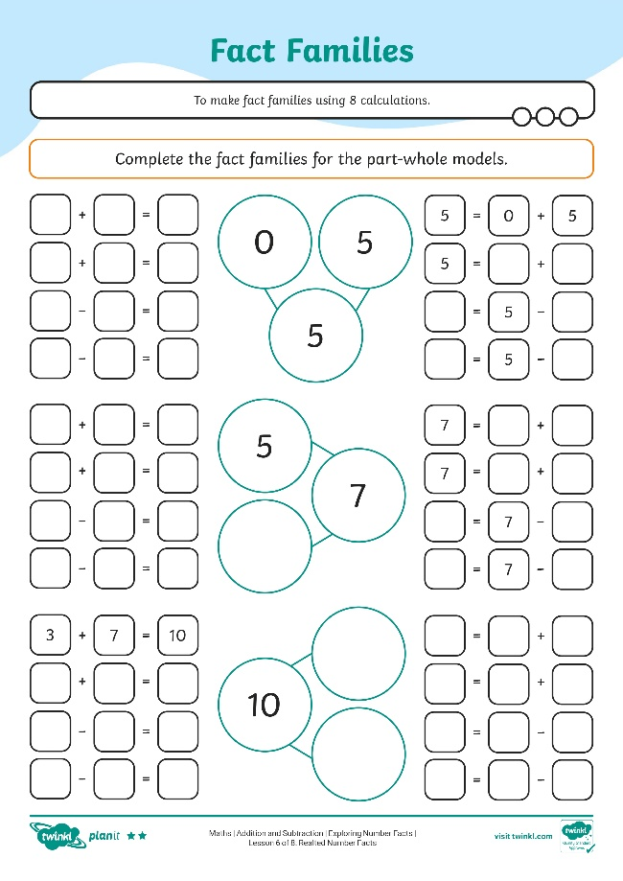
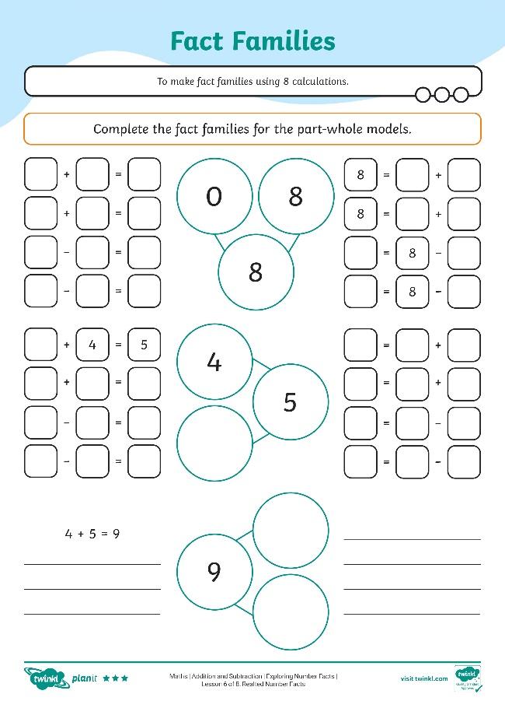

Fact Families
Complete the fact families on the activity sheets.

Slide 17
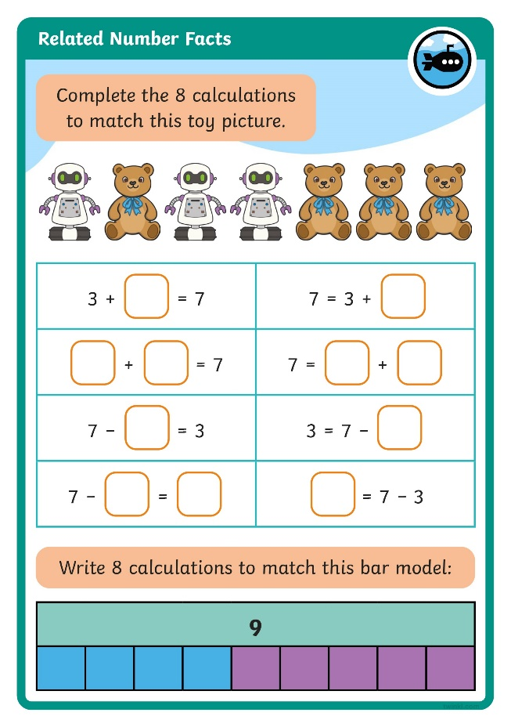
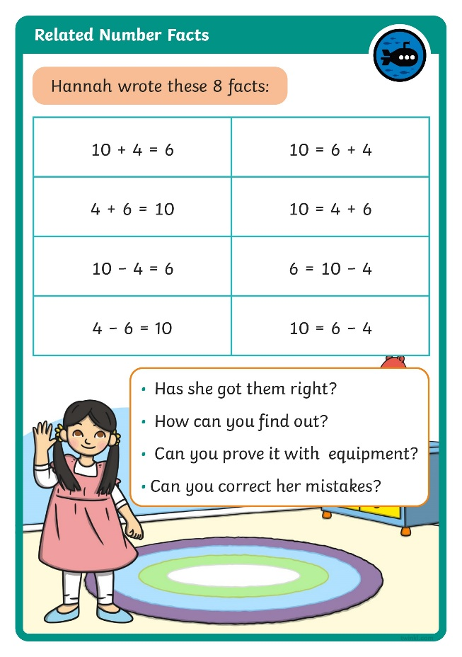

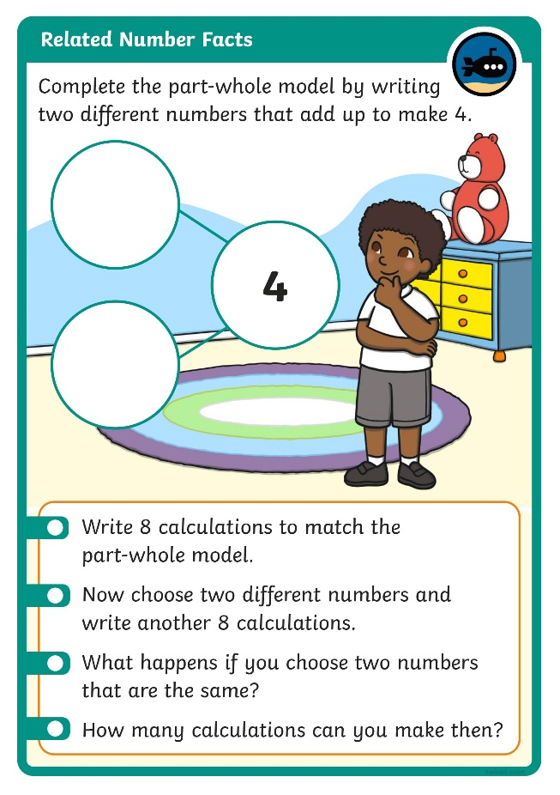
Diving into Mastery
Dive in by completing your own activity!

Slide 18
Card Shuffle
Use these cards to make 8 calculations.
4
2
6
+
−
=
4 + 2 = 6
6 = 4 + 2
2 + 4 = 6
6 = 2 + 4
6 – 4 = 2
2 = 6 – 4
6 – 2 = 4
4 = 6 – 2

Slide 19
Aim
To make fact families using 8 calculations.
Success Criteria
I can write addition facts of fact families.
I can write subtraction facts of fact families.
I can check I have found all 8 calculations of a fact family.

Slide 20
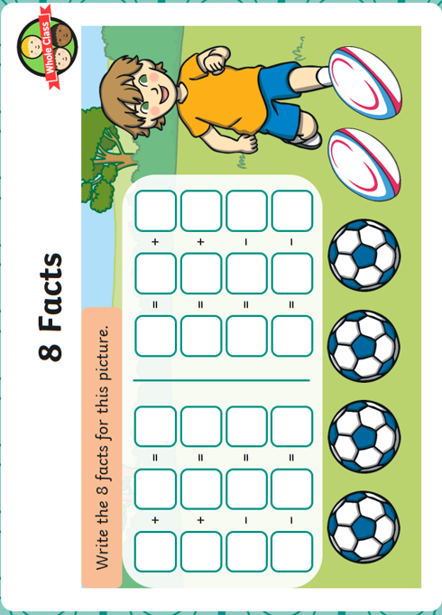

Slide 21


