Slide 1
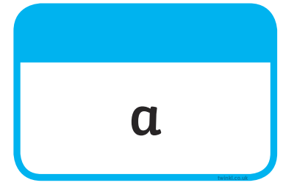







Tricky Words

Slide 2
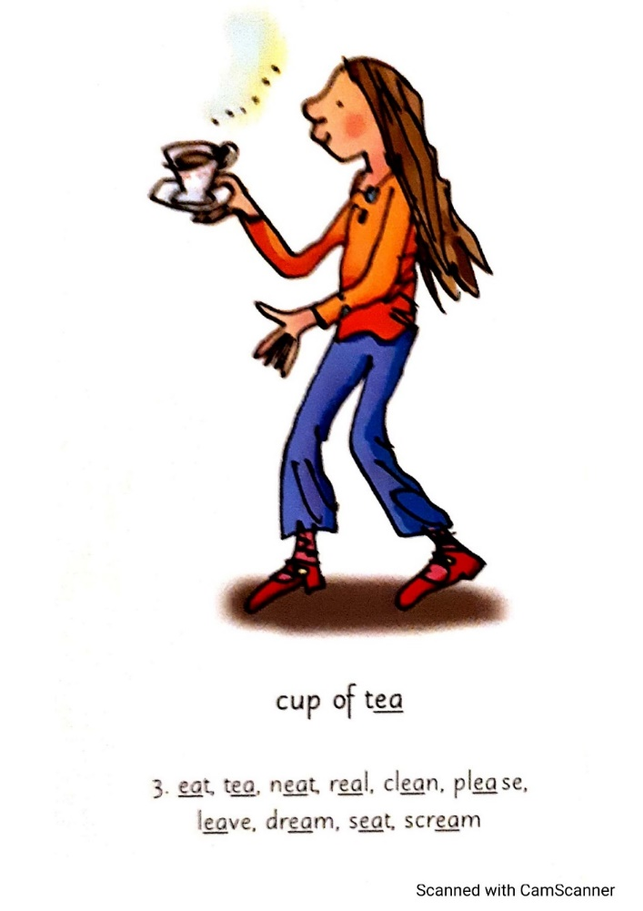
Our Set 3 phoneme for today is….ea
dream scream
eat
tea
neat
real
clean

Slide 3
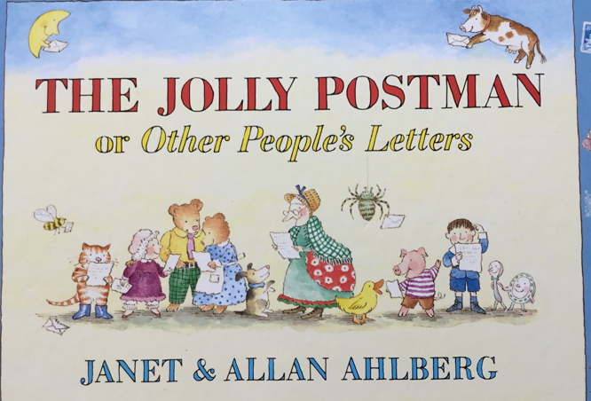
Monday 19th April
L.O. Which house belongs to which fairytale character?

Slide 4
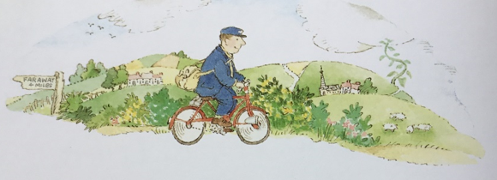
In our book ‘The Jolly Postman’, the Postman visits the houses of some well-known fairytale characters. He has letters to deliver to them.
Let’s meet the fairytale characters that the Postman visits.

Slide 5
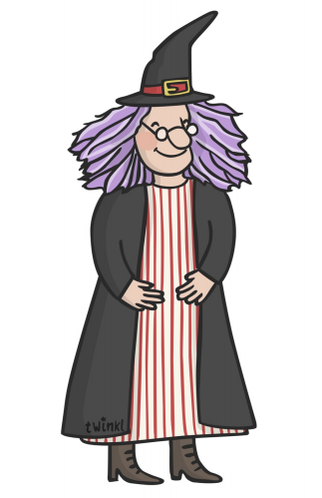
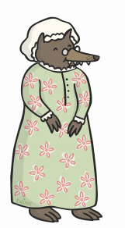
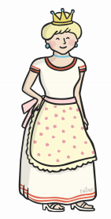

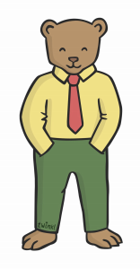

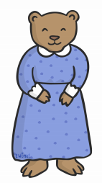

Can you name these characters?
What traditional stories are they from?

Slide 6
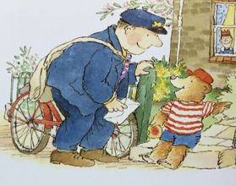
Let’s look at the houses the Jolly Postman visits.
Can you guess who lives there?
Can you explain why?

Slide 7
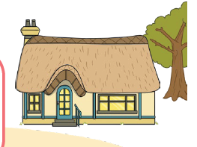
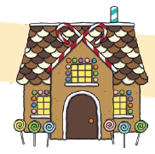
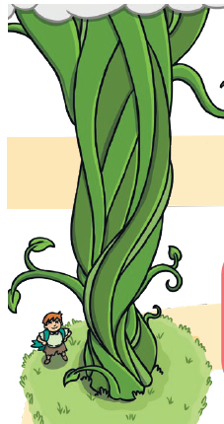
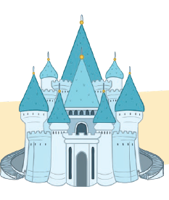

Slide 8
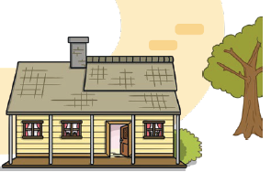
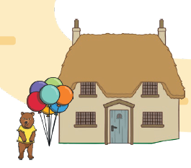

Slide 9
Your Task
Opt. 1
Cut and stick the character picture with their house. Can you have a go at writing the name of the character?
Opt. 2
Write a sentence, next to the house. Say who lives there and explain why using the word ‘because’.
e.g. I think this is the three bears house because it is in the woods.

