Slide 1


Slide 2
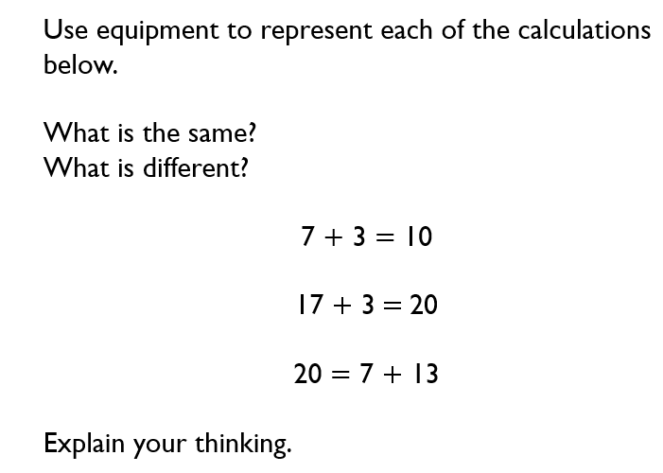
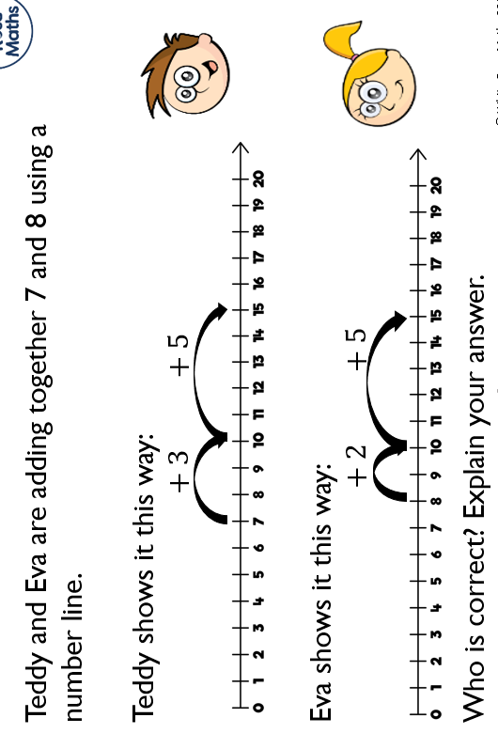
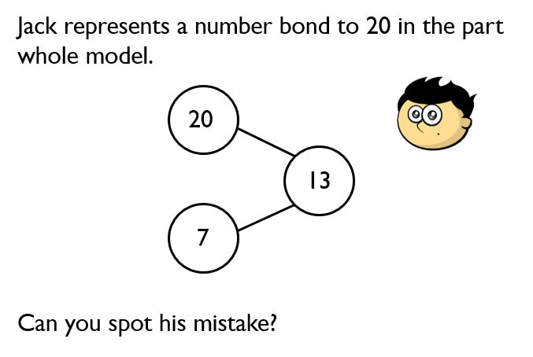

Slide 4


1) What comes next? 11, 12, 13, ___
2) 1 ten and 7 ones = ____
3) Can you count from 15 to 20?
4) How many straws?

Slide 5
1) What comes next? 11, 12, 13, ___
2) 1 ten and 7 ones = ____
3) Can you count from 15 to 20?
4) How many straws?
14
17
15, 16, 17, 18, 19, 20
12

Slide 7


Counting on
10 +
What number is this?
14
8 +
What number is this?
13

Slide 8


Have a think
There were 8 ants out for a walk.
Then 4 more joined in.
How many ants were out for a walk?
8 + 4 = 12

Slide 9
Counting on from 10
There were 9 ants out for a walk.
Then 5 more joined in.
How many ants were out for a walk?
1
2
3
4
5
6
7
8
9
10
11
12
13
14
15
16
17
18
19
20

Slide 10
Have a go at questions 1 and 2 on the worksheet

Slide 11
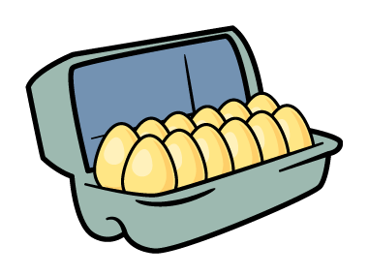
Counting on
Eva found 12 eggs.
Her mum bought 6 more.
How many eggs do they have now?
1
2
3
4
5
6
6
7
8
9
10
11
12
13
14
15
16
17
18
19
20

Slide 12


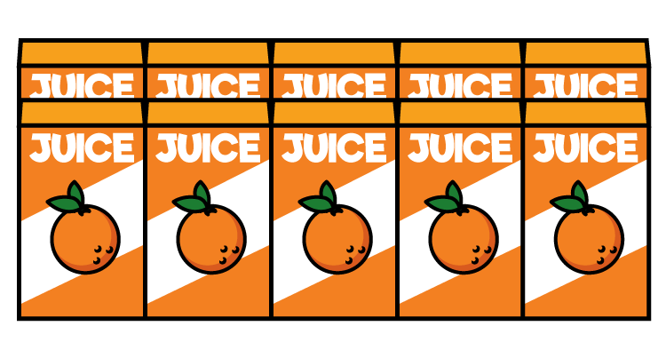
Have a think
Counting on
The shop had 4 juice boxes.
They ordered 12 more.
How many juice boxes do they have now?
3
4
5
6
7
8
9
10
11
12
13
14
15
16
17
18

Slide 13
Have a think
Counting on
The shop had 4 juice boxes.
They ordered 12 more.
How many juice boxes do they have now?
1
2
3
4
5
6
7
8
9
10
11
12
3
4
5
6
7
8
9
10
11
12
13
14
15
16
17
18

Slide 14
Have a think
Counting on
The shop had 4 juice boxes.
They ordered 12 more.
How many juice boxes do they have now?
1
2
3
4
3
4
5
6
7
8
9
10
11
12
13
14
15
16
17
18

Slide 15
Have a go at questions 3 and 4 on the worksheet

