Slide 1


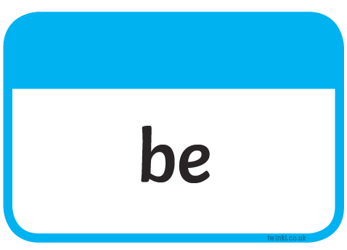
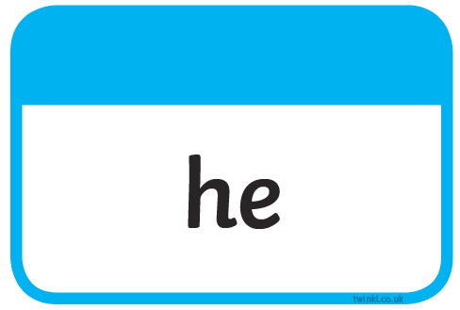





Slide 2
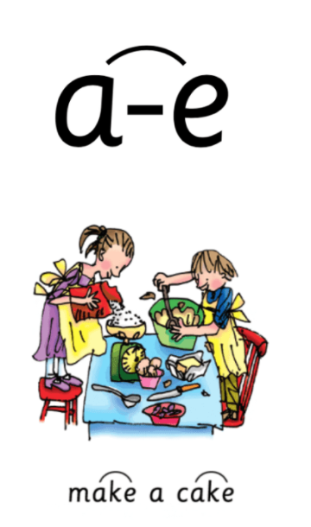
Our Set 3 phoneme for today is….a_e
brave shake
cake
name
take
late

Slide 3
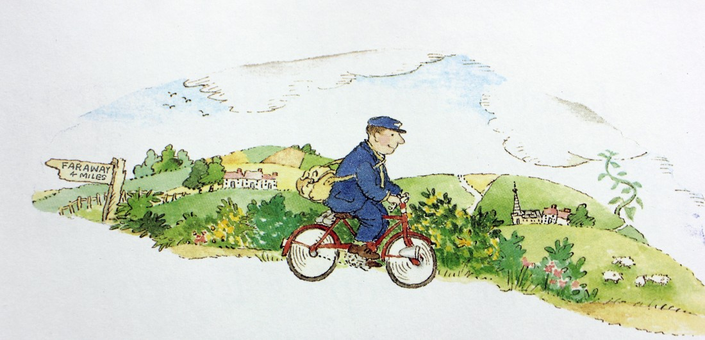
Wednesday 21st April
L.O. To write a letter

Slide 4
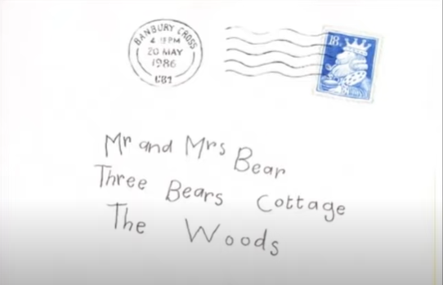
In the story The Jolly Postman delivers a letter to The Three Bears.
Who do you think might have written this letter? Read the story The Jolly Postman by Janet and Allen Ahlberg to find out.

Slide 5
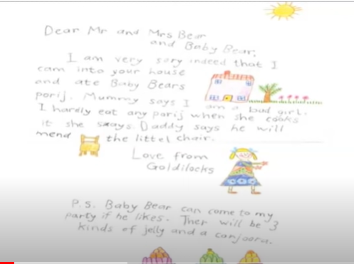
That’s right it is a letter from Goldilocks.

Slide 6
Your Task
Today you are going to pretend that you are Baby Bear and write a reply to Goldilocks.
Talk to a partner
Do you think Baby Bear will forgive Goldilocks?
Do you think Baby Bear will want to go to the party?
What questions do you think Baby Bear would ask Goldilocks?

Slide 7
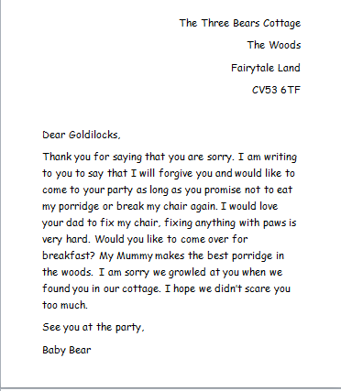
Remember to use the features of a letter. Here is an example letter.
Address of the person writing the letter.
Name of person you are writing to.
Explain why you are writing the letter.
Include a question.
The name of person writing the letter.
Say goodbye. This is an informal letter and therefore you do not need to use yours sincerely.

Slide 8
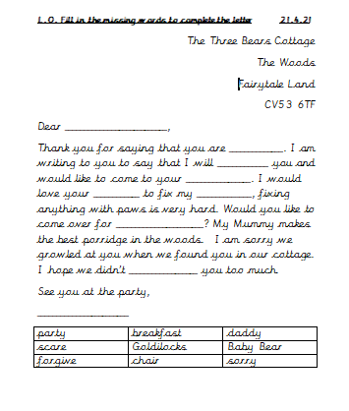
Option 1
Option 2
Write a letter using the letter example to help you.
Remember to use capital letters and full stops.
Try to include a question.

