Slide 1


Maths
Addition and Subtraction
Year One
Maths | Addition and Subtraction | Gaps in Calculations | Lesson 3 of 3: Find Missing Numbers in Addition and Subtraction up to 20

Slide 2
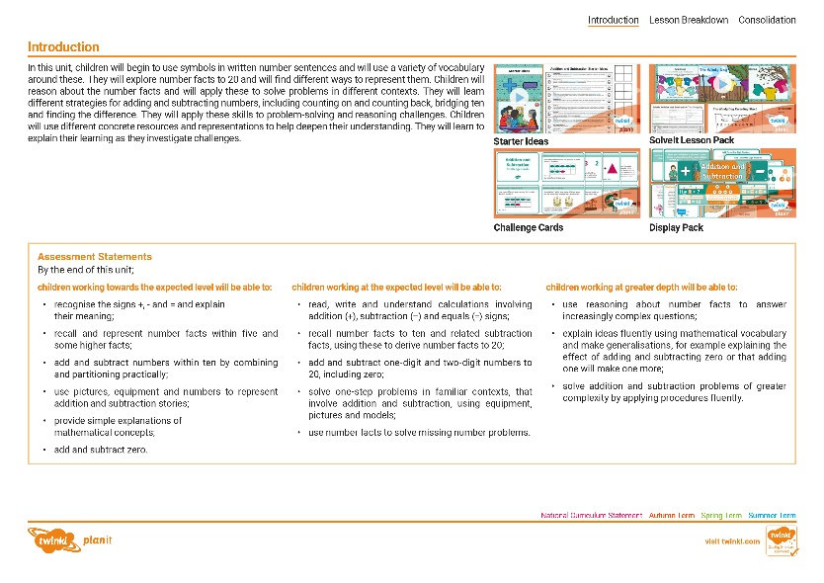
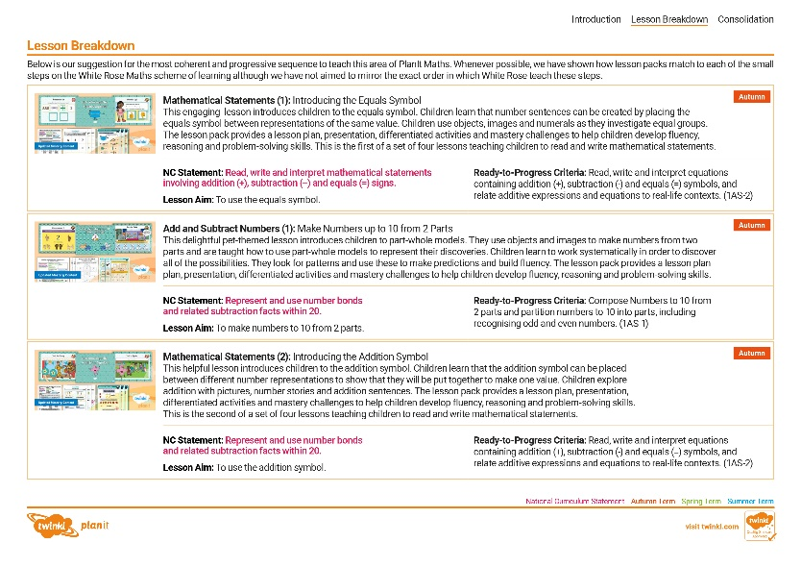
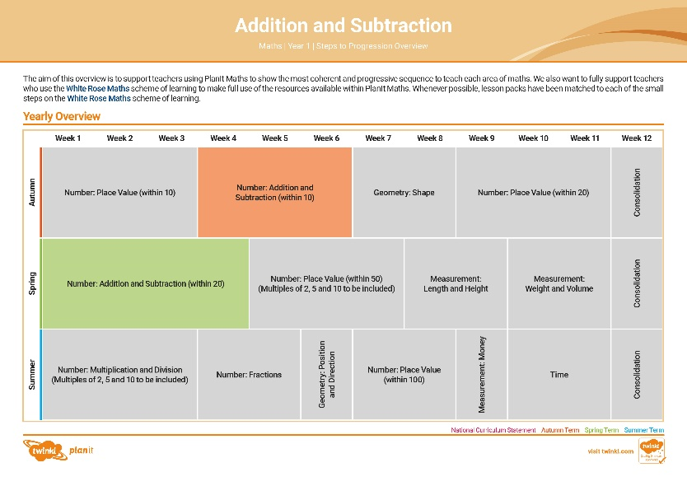

Need a coherently planned sequence of lessons to complement this resource?
See our Addition and Subtraction Steps to Progression document.
Twinkl PlanIt is our award-winning scheme of work with
over 4000 resources.

Slide 3
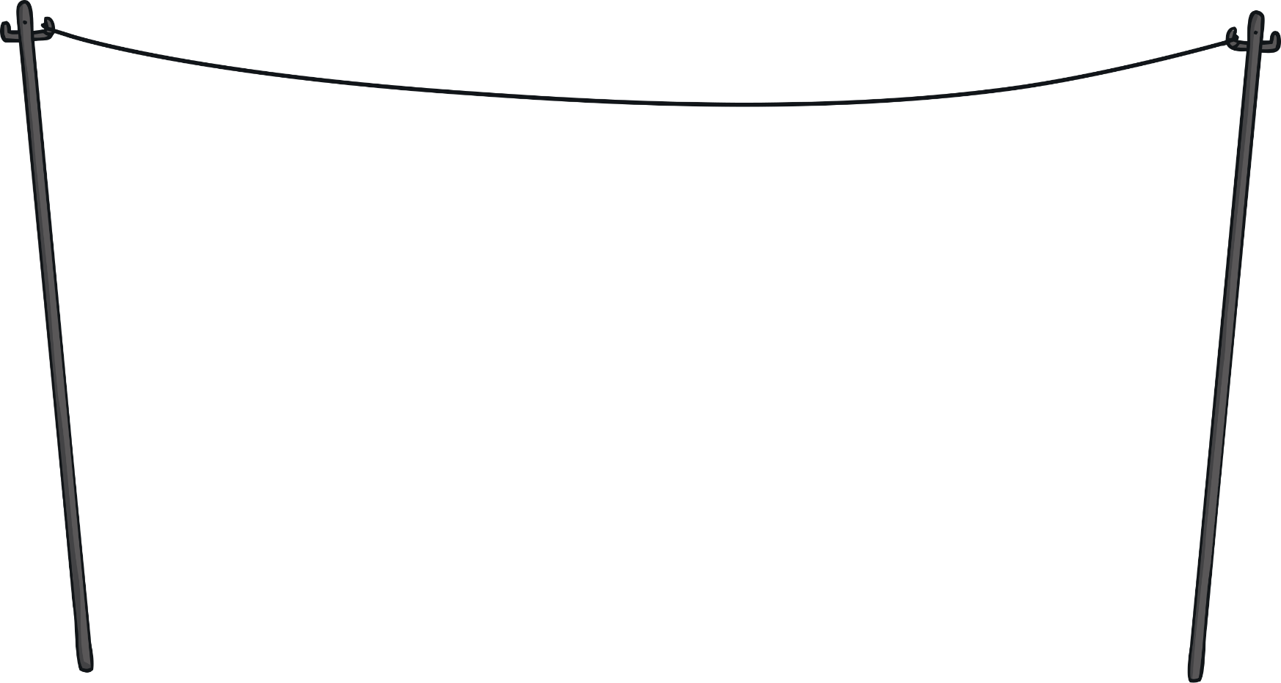



Slide 4
Aim
To solve missing number problems using addition and subtraction.
Success Criteria
I can use number facts to solve missing number problems.
I can explain my thinking with equipment.

Slide 5

Remember It
Match the pairs that make 20.
15
15
1
5
20
12
8
8
9
4
10
14
9
11
6
14
19
19
12
1
11
4
16
16
10
10
10
6
0
0
5
20

Slide 6


A Bit of a Puzzle
Meet Theo. He loves puzzles and he loves thinking!
He’s very determined when it comes to solving problems.

Slide 7


A Bit of a Puzzle
Can you solve his puzzle this time?
? – 13 = 2
Get some counters. I need to take away 13 and end up with 2.
Here are the 13 I have taken away.
Here are the 2 I have left.

Slide 8
A Bit of a Puzzle
Can you solve his puzzle this time?
– 13 = 2
15
?
If I put them back together again, I can find out how many I started with.
I started with 15.

Slide 9
A Bit of a Puzzle
Can you solve his puzzle this time?
? – 5 = 13
Get some counters. I need to take away 5 and end up with 13.
Here are the 5 I have taken away.
Here are the 13 I have left.

Slide 10
A Bit of a Puzzle
Can you solve his puzzle this time?
– 5 = 13
18
?
If I put them back together again, I can find out how many I started with.
I started with 18.

Slide 11
A Bit of a Puzzle
Can you solve his puzzle this time?
? – 16 = 4
Get some counters. I need to take away 16 and end up with 4.
Here are the 16 I have taken away.
Here are the 4 I have left.

Slide 12
A Bit of a Puzzle
Can you solve his puzzle this time?
20
– 16 = 4
?
If I put them back together again, I can find out how many I started with.
I started with 20.

Slide 13
A Bit of a Puzzle
Can you solve his puzzle this time?
15 – = 4
11
?
I had 15 counters. Now, I take away counters until I have 4 left.
I took away 11.

Slide 14
A Bit of a Puzzle
Can you solve his puzzle this time?
17 – = 11
6
?
I had 17 counters. Now, I take away counters until I have 11 left.
I took away 6.

Slide 15
A Bit of a Puzzle
Can you solve his puzzle this time?
12 + = 18
6
?
I have 12 counters. Now, I add counters until I have 18.
I added 6.

Slide 16
A Bit of a Puzzle
Can you solve his puzzle this time?
+ 8 = 17
9
?
I have 8 counters. Now, I add counters until I have 17.
I added 9.

Slide 17







Blowing Away
It’s a very windy day and some of the numbers have been
blown out of the calculations.
On the next slides, can you work out which numbers should go where?
Prove your answer with a ten-frame, equipment or number line.
5
5
3
2
3
2

Slide 18
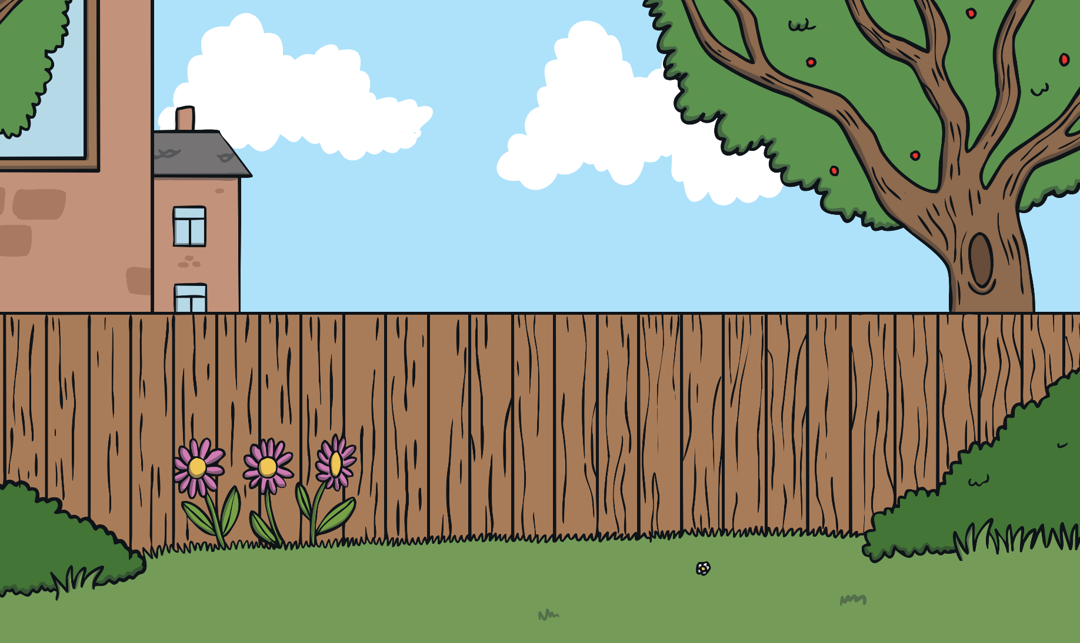
Blowing Away
14
+ 3 = 17
How can you prove your answer to your classmates?

Slide 19
Blowing Away
15
4 + = 19
How can you prove your answer to your classmates?

Slide 20
Blowing Away
12
16 − = 4
How can you prove your answer to your classmates?

Slide 21
Blowing Away
11
− 7 = 4
How can you prove your answer to your classmates?

Slide 22
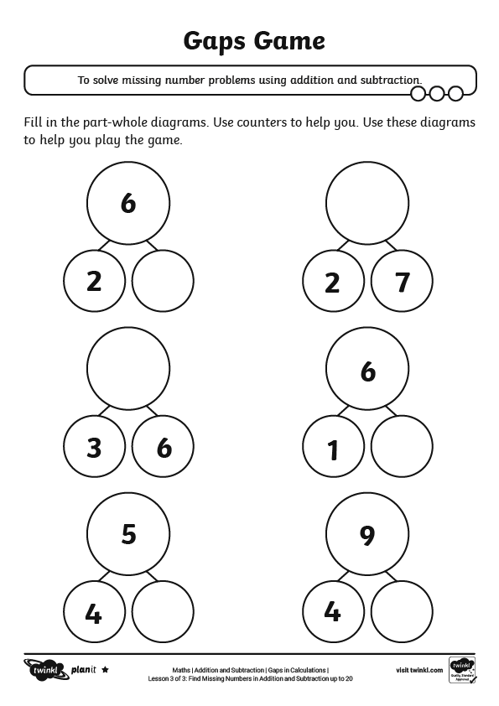
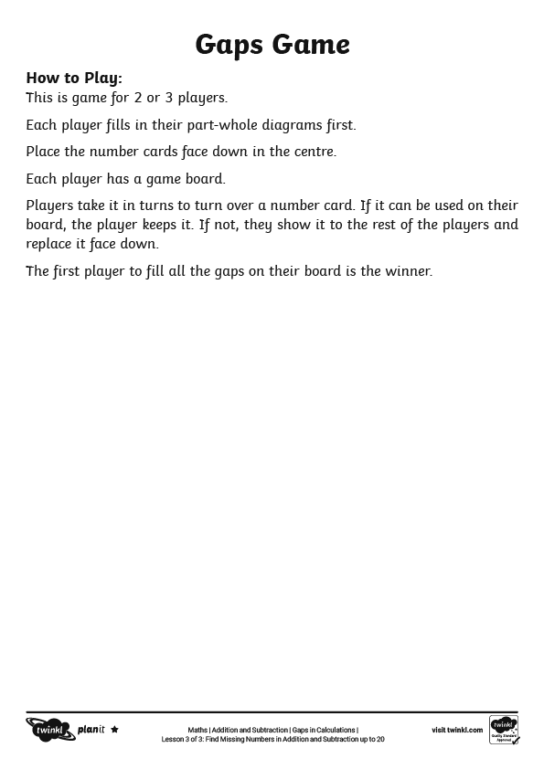
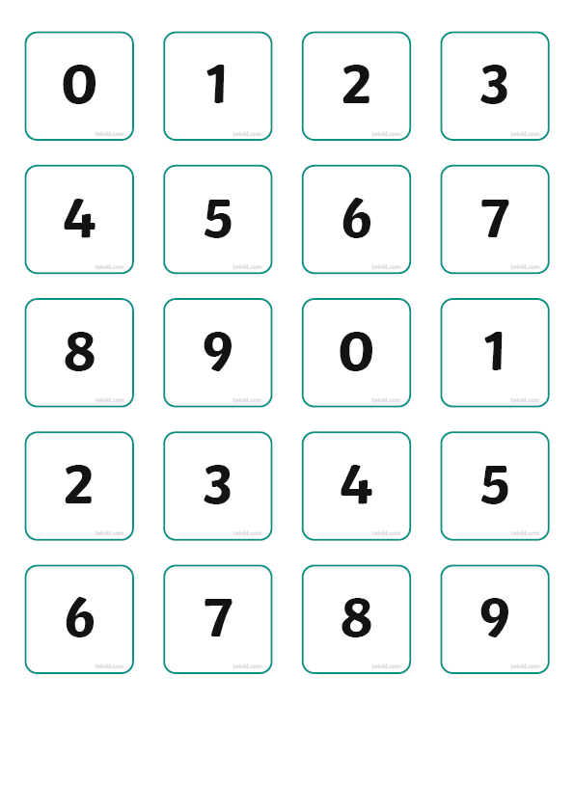
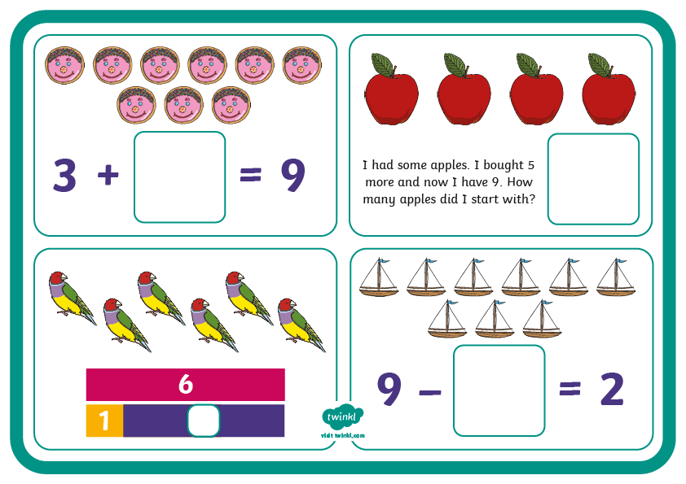
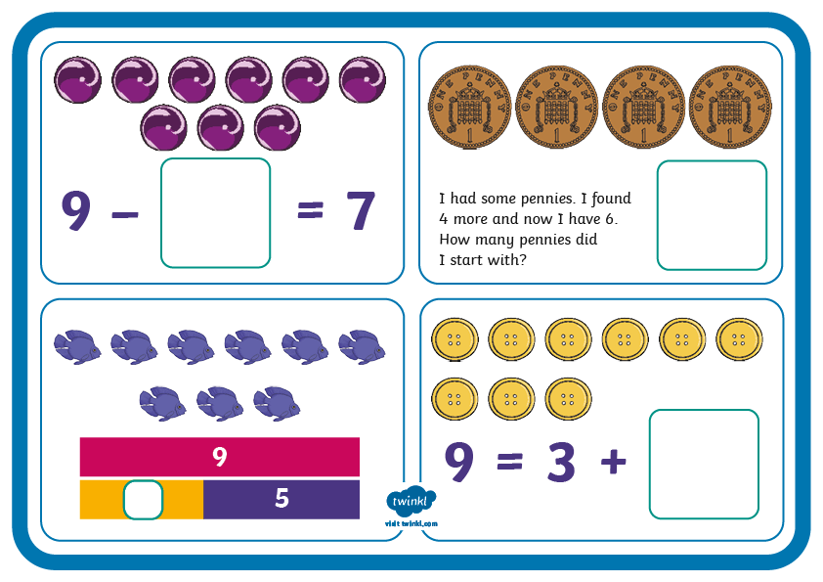
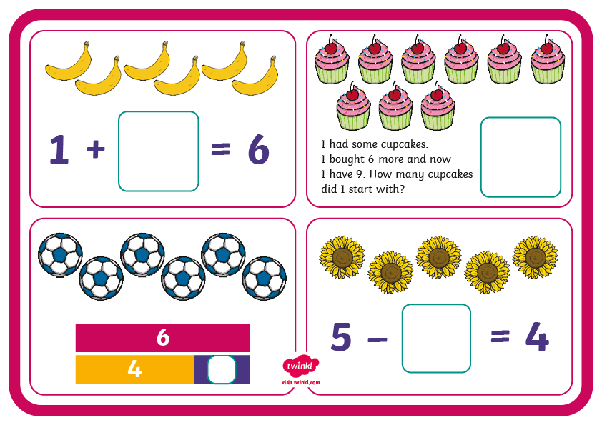
Fill That Gap
Can you fill in the gaps?

Slide 23
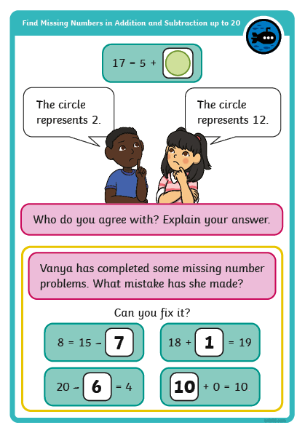
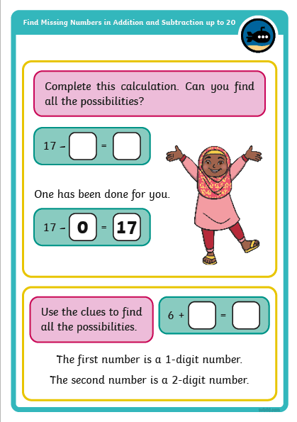

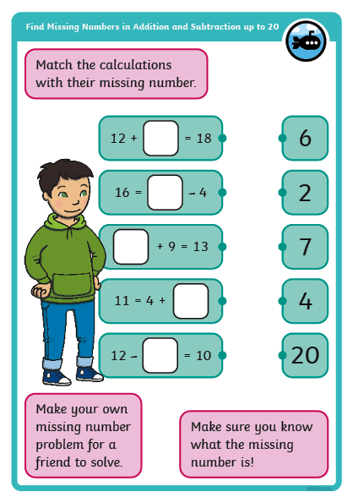
Diving into Mastery
Dive in by completing your own activity!

Slide 24
All Possibilities
0
1
2
3
4
5
6
7
17
16
15
14
13
12
11
10
+ = 17
The first number is a 1-digit number.
The second number is a 2-digit number.
How many ways can you find to solve this?
How can you prove your answer to your classmates?

Slide 25
All Possibilities
6
7
8
9
0
1
2
3
6 = −
Both missing numbers have only 1 digit.
How many ways can you find to solve this?
How can you prove your answer to your classmates?

Slide 26
All Possibilities
0
1
2
3
4
5
6
7
8
8
7
6
5
4
3
2
1
0
8 − =
How many ways can you find to solve this?
How can you prove your answer to your classmates?

Slide 27
Aim
To solve missing number problems using addition and subtraction.
Success Criteria
I can use number facts to solve missing number problems.
I can explain my thinking with equipment.

