Slide 1
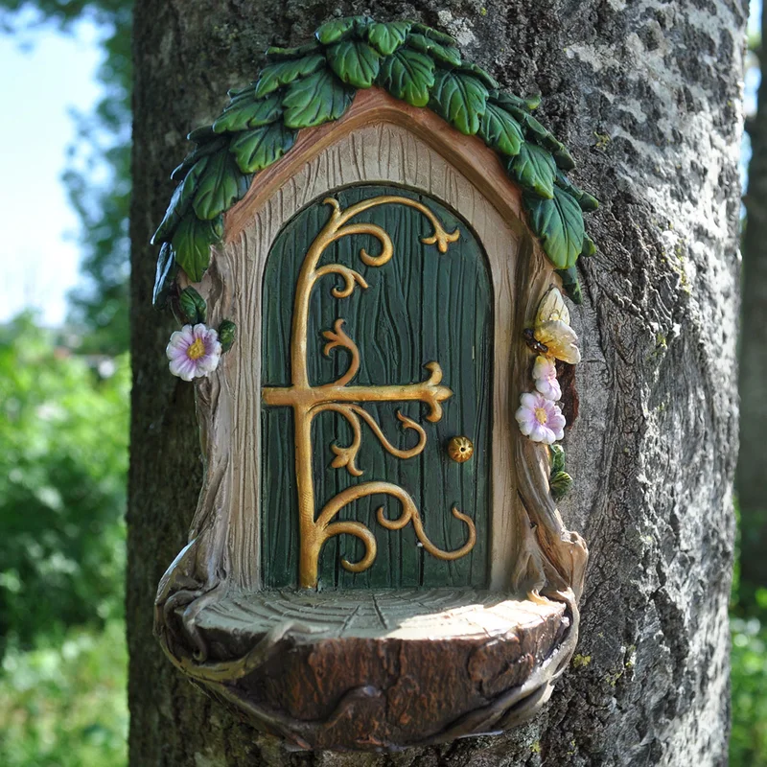
Tuesday 25th May 2021
LO: To write a story (independently) about what is behind the fairy door.
Tuesday 25th May 2021
LO: To write a story (independently) about what is behind the fairy door.
Tuesday 25th May 2021
LO: To write a story (independently) about what is behind the fairy door.

Slide 2
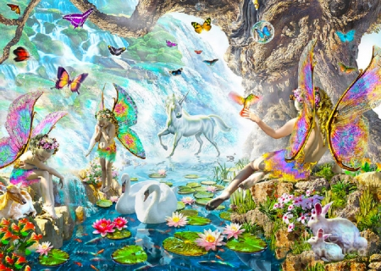
Tuesday 25th May 2021
LO: To label or write a simple sentence about this land.

