Slide 1


Maths
Addition and Subtraction
Year One
Maths | Addition and Subtraction | Recall and Use Number Facts | Lesson 1 of 2: Doubles

Slide 2
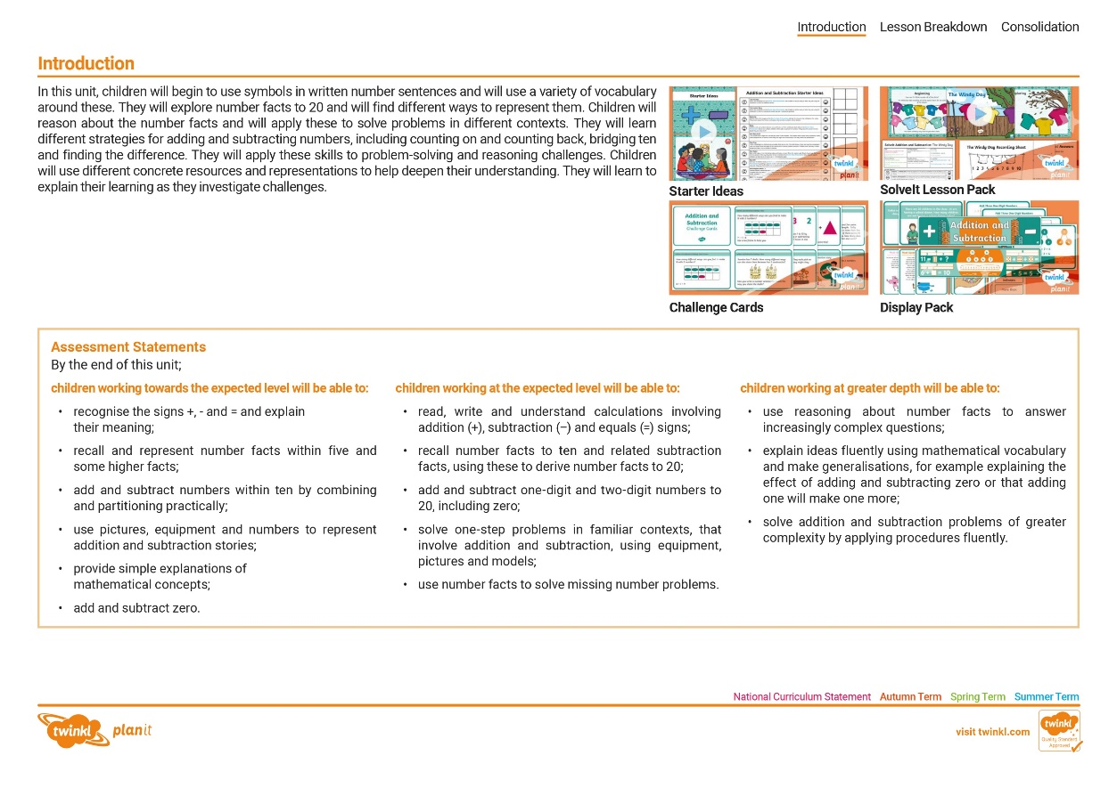
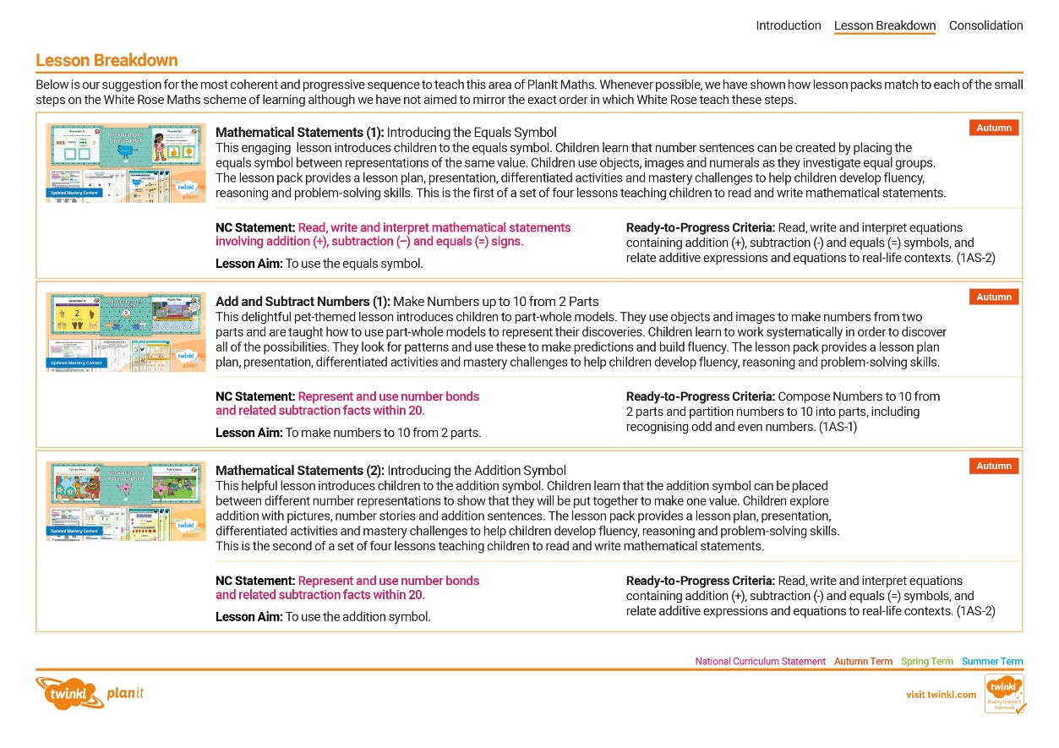
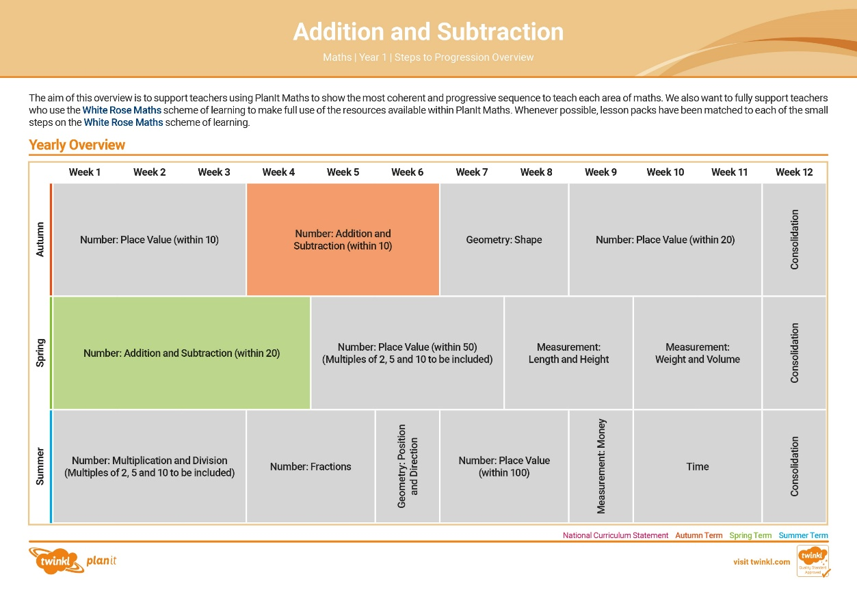

Need a coherently planned sequence of lessons to complement this resource?
See our Addition and Subtraction Steps to Progression document.
Twinkl PlanIt is our award-winning scheme of work with
over 4000 resources.

Slide 3
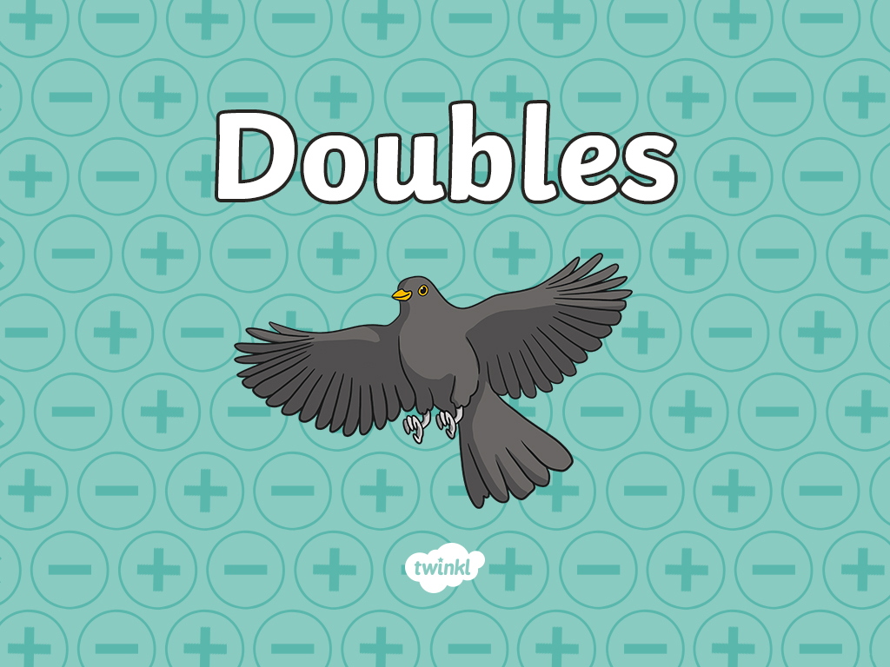

Slide 4
Aim
To find double facts within 20.
Success Criteria
I can explain what double means.
I can use equipment to double numbers.

Slide 5

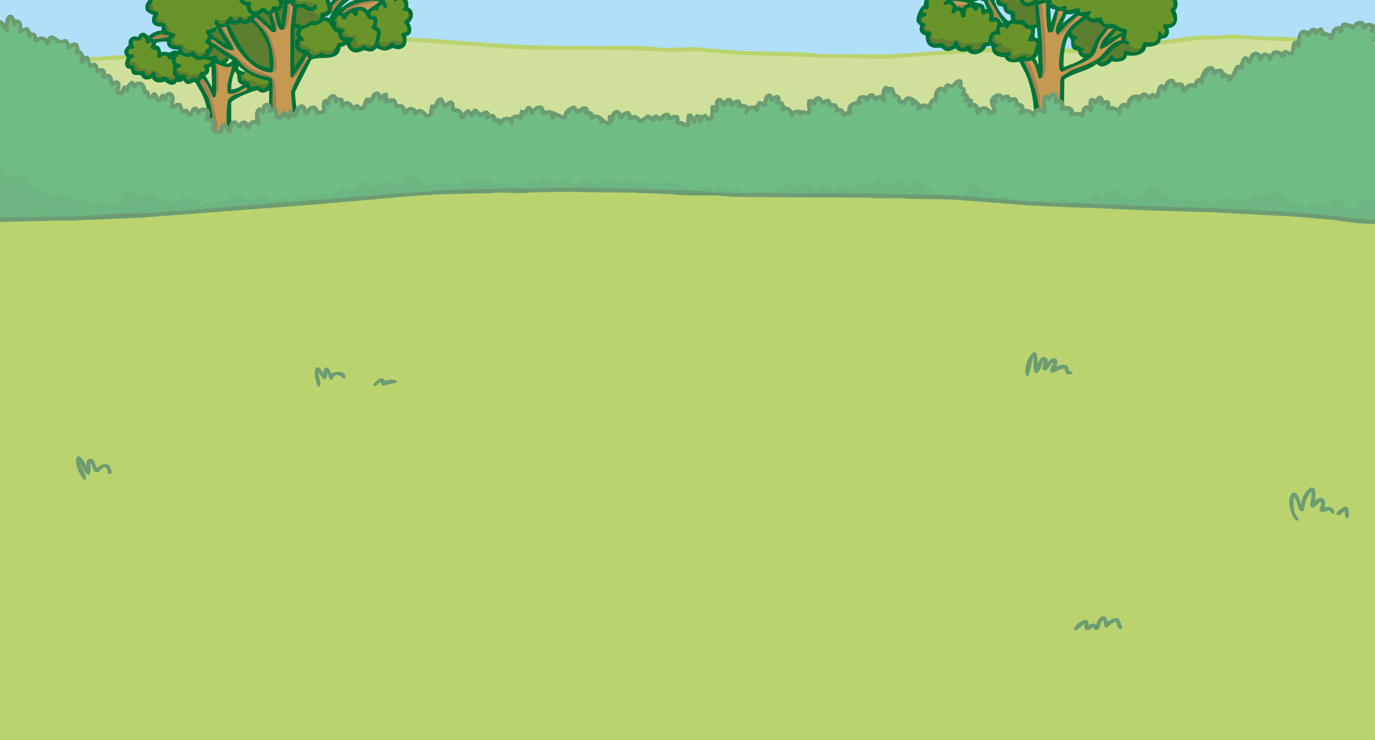
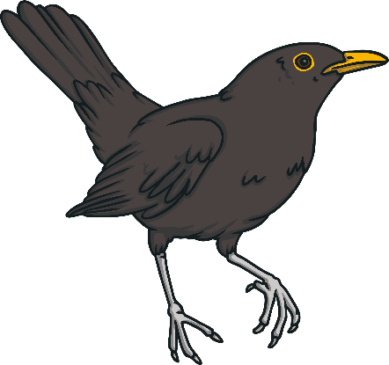
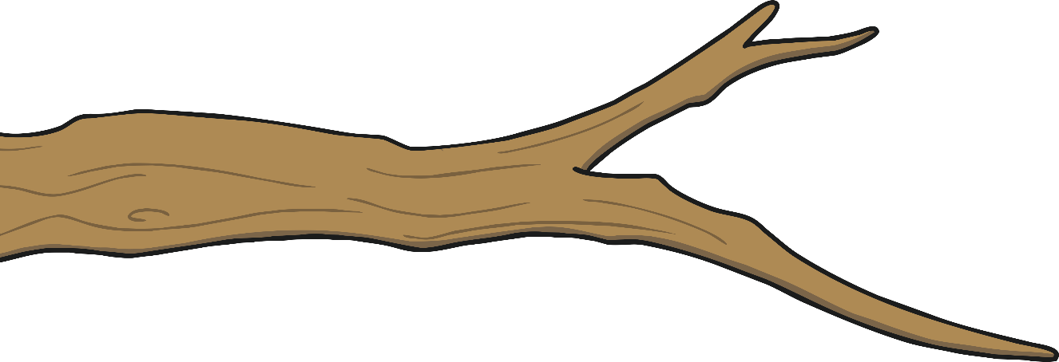
Remember It
Some birds flew off the branches.
Can you put them back in the right place?
+
16
+
10
=
20
15
=
12
+
4
=
4
5
16

Slide 6
Remember It
Some birds flew off the branches.
Can you put them back in the right place?
+
5
+
6
=
13
11
=
9
+
4
=
8
5
13

Slide 7






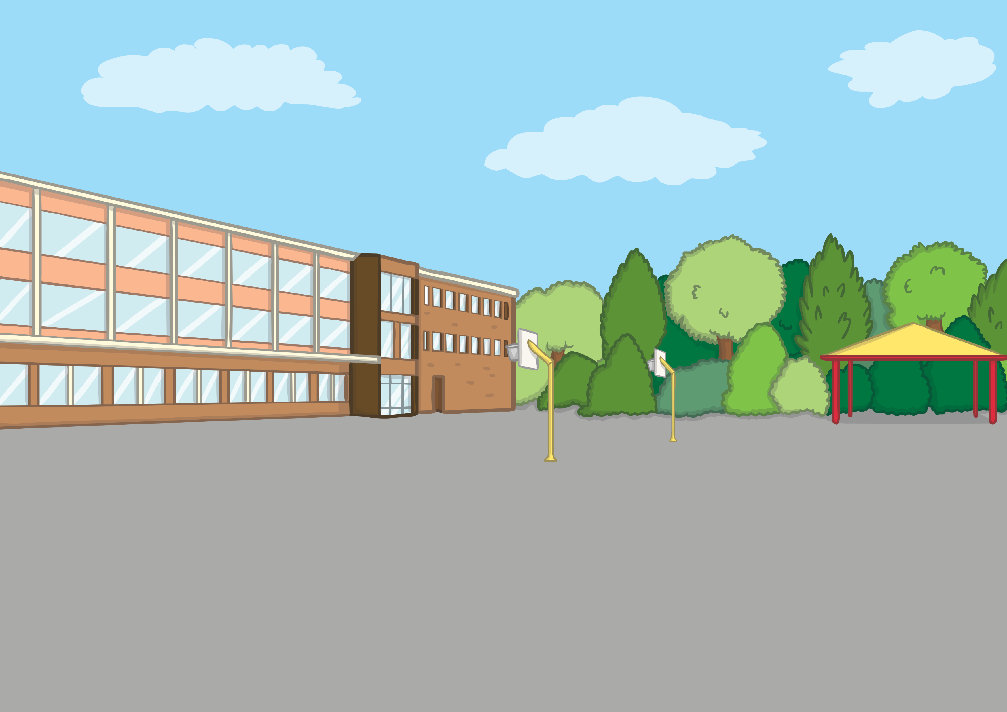

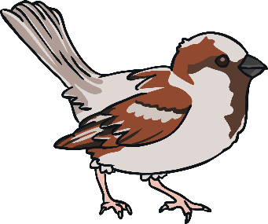
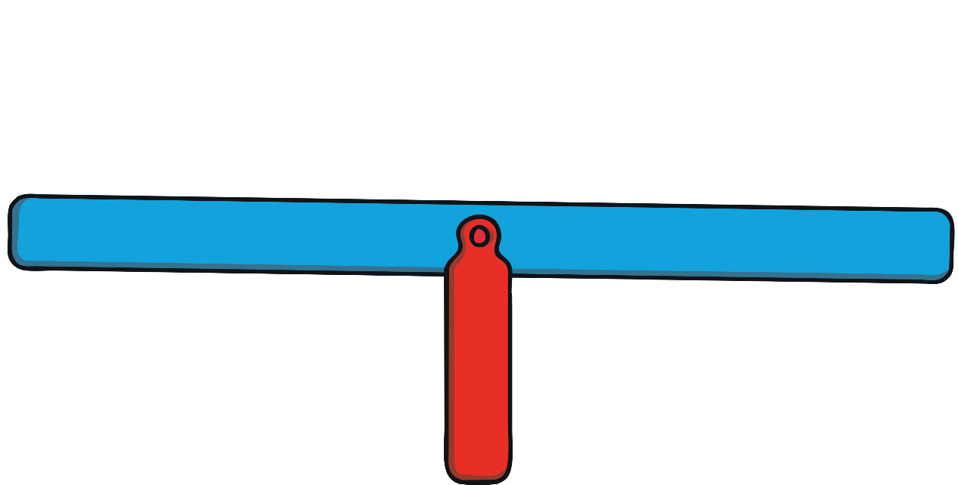

What is Double?
What do both of these scales have in common?
Each scale has the same number of birds on each end.
1 + 1 = 2
4 = 2 + 2

Slide 8


What is Double?
When both the numbers we are adding are the same, we are doubling.
3 add 3 is the same as double 3.
3 + 3 = 6

Slide 9

What is Double?
We can use ten-frames to show doubles.
4 + 4 = 8
10 = 5 + 5

Slide 10
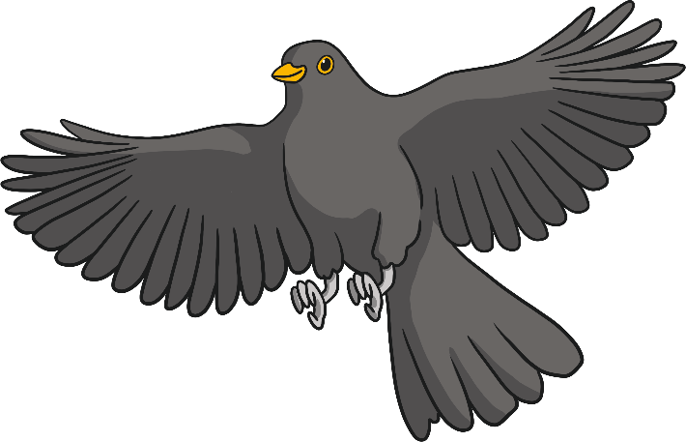
What is Double?
We can use part-whole models to represent doubles.
6
7
12
14
6
7
Double 6 is 12.
6 + 6 = 12
Double 7 is 14.
7 + 7 = 14

Slide 11
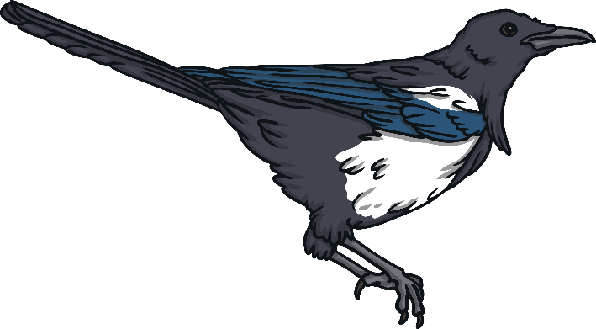
What is Double?
We can use bar models to represent doubles.
16
8 | 8
18
9 | 9
20
10 | 10
For each bar model, complete the sentence stem:
Double is .
9
18
8
16
10
20

Slide 12
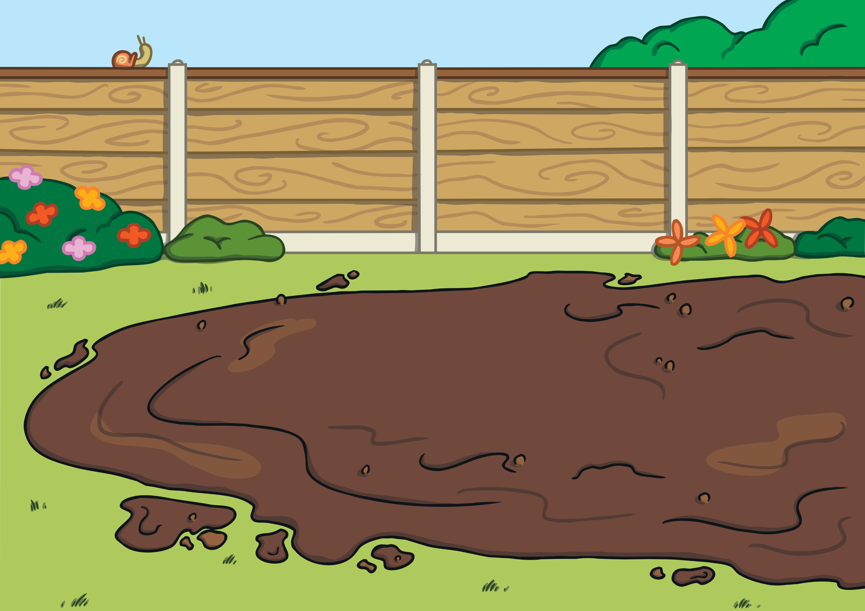


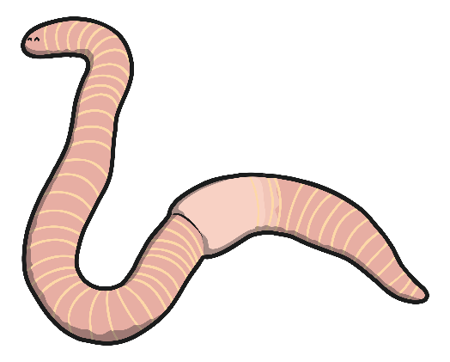
Catch the Worm
Each bird needs some worms. Help them choose the correct number
of worms by doubling. Use equipment to help you.

Slide 13

Catch the Worm
Pick the right worm for the bird. How can you check your answer?
2
6
8
4
10
I need double 3.

Slide 14
Catch the Worm
Pick the right worm for the bird. Prove it!
2
6
8
4
10
1 + 1

Slide 15
Catch the Worm
Pick the right worm for the bird. How do you know?
2
6
8
4
10
I need double 4.

Slide 16
Catch the Worm
Pick the right worm for the bird.
How many ways can you show your working?
14
12
16
18
20
7 + 7

Slide 17
Catch the Worm
Pick the right worm for the bird. Prove it!
14
12
16
18
20
I need double 9.

Slide 18
Catch the Worm
Pick the right worm for the bird. How do you know?
14
12
16
18
20
I need double 10.

Slide 19
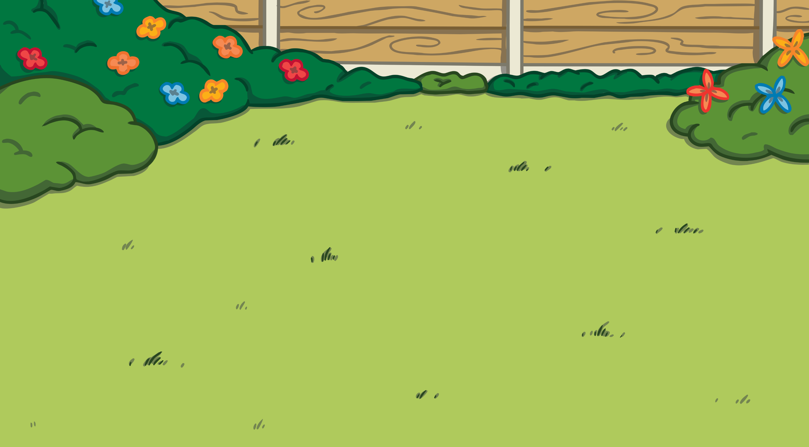
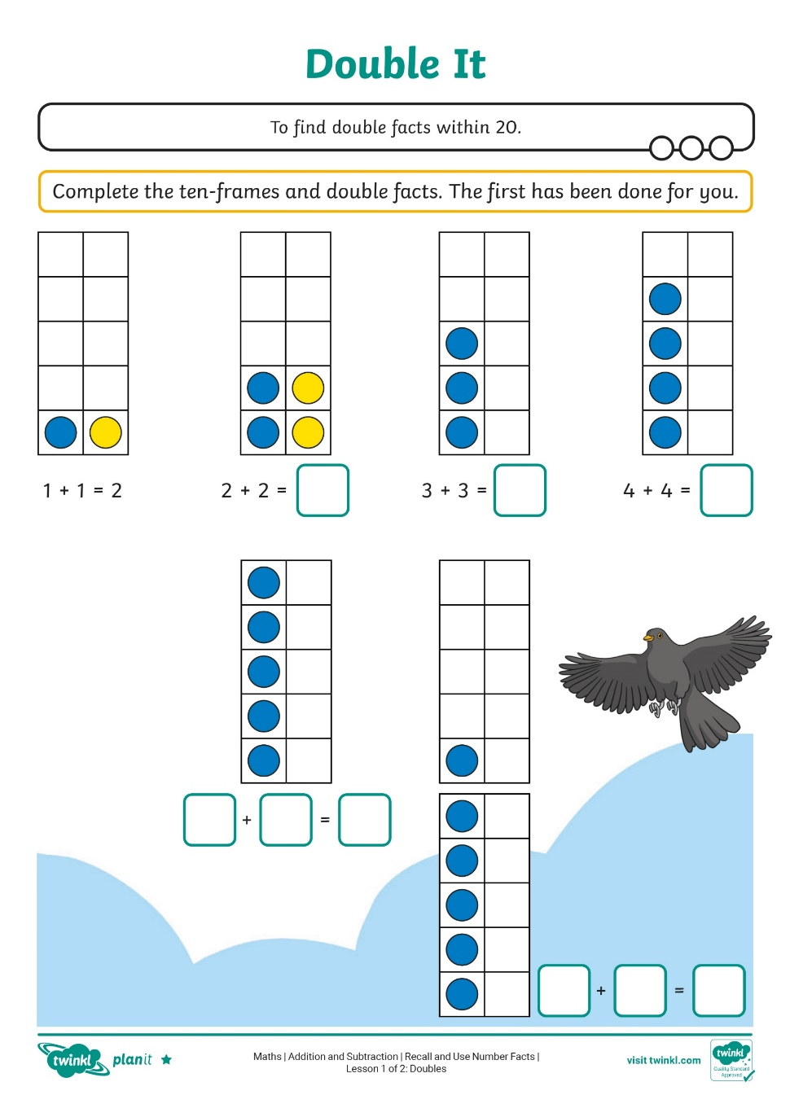
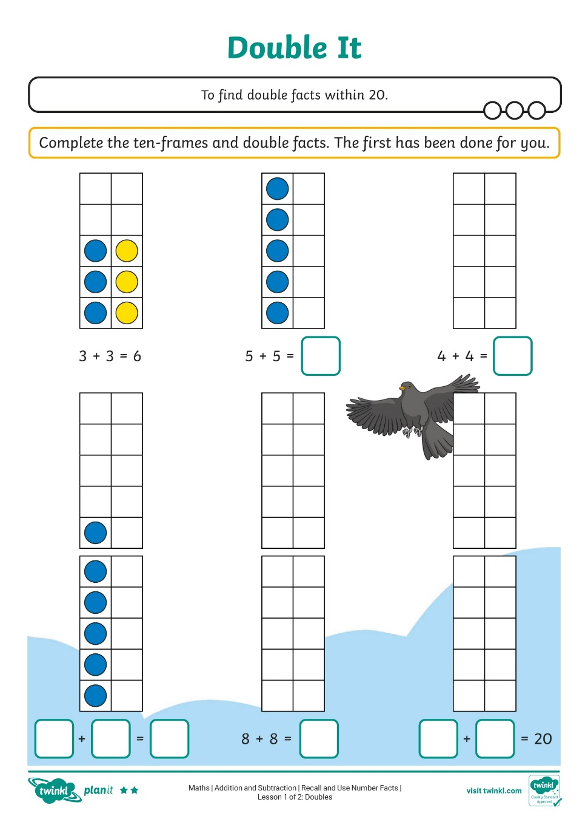
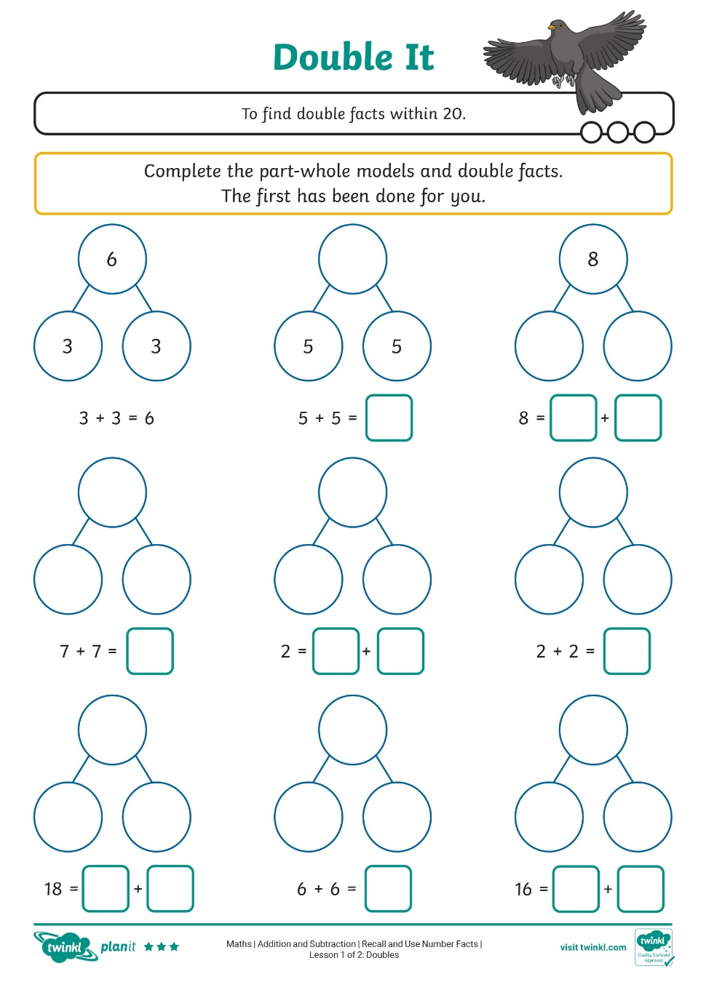

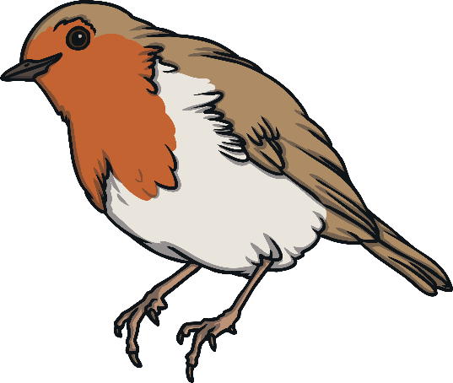
Double It
Explore doubles using ten-frames and part-whole models.

Slide 20
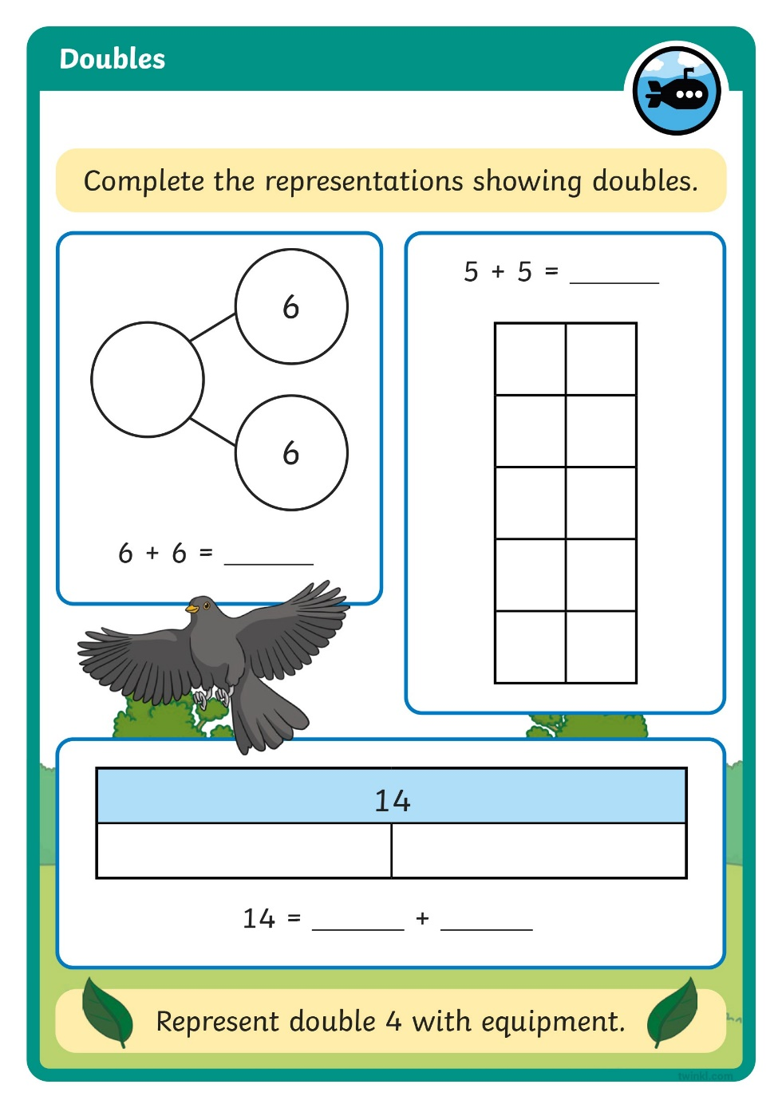
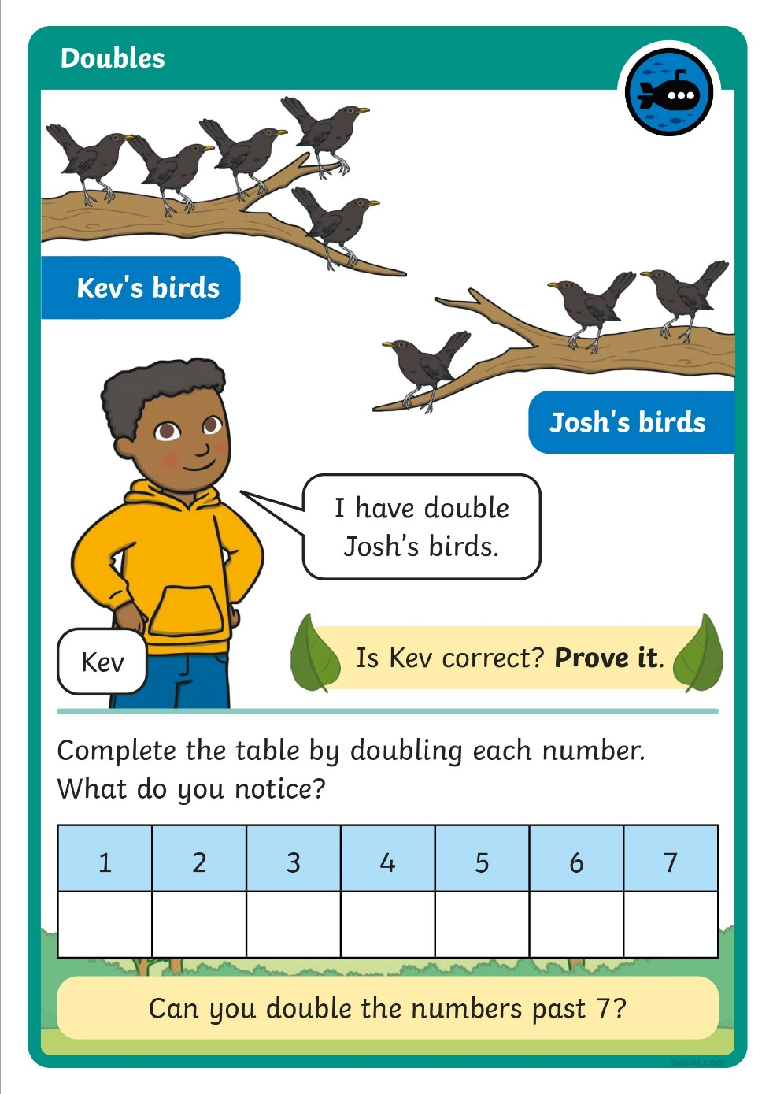

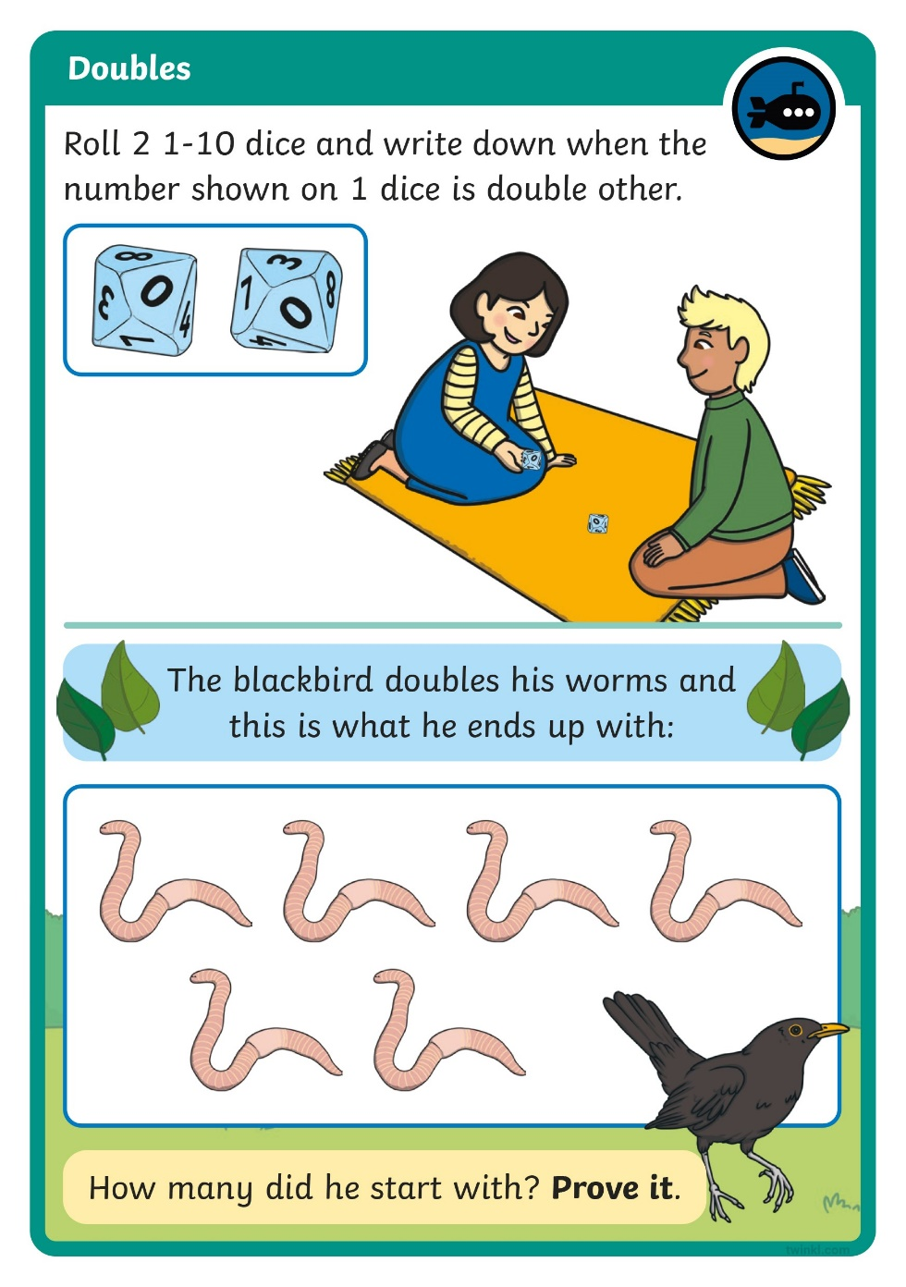
Diving into Mastery
Dive in by completing your own activity!

Slide 21




Near Doubles
3 + 4 = ?
I can use double 3 to help me solve the calculation.
How can Joel use double 3 to help? Explain to your partner.

Slide 22
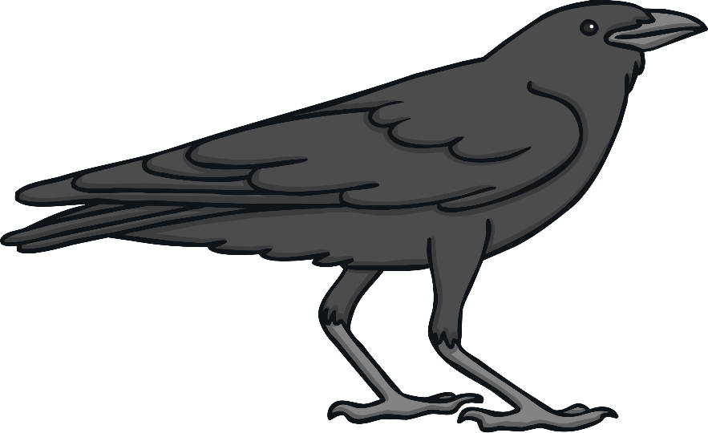
Near Doubles
3 + 3 = 6
4 is one more than 3 so my answer will be 1 more than 6.
3 + 4 = 7
3 + 3 = 6
3 + 4 = 7

Slide 23
Aim
To find double facts within 20.
Success Criteria
I can explain what double means.
I can use equipment to double numbers.

Slide 24


