Slide 1
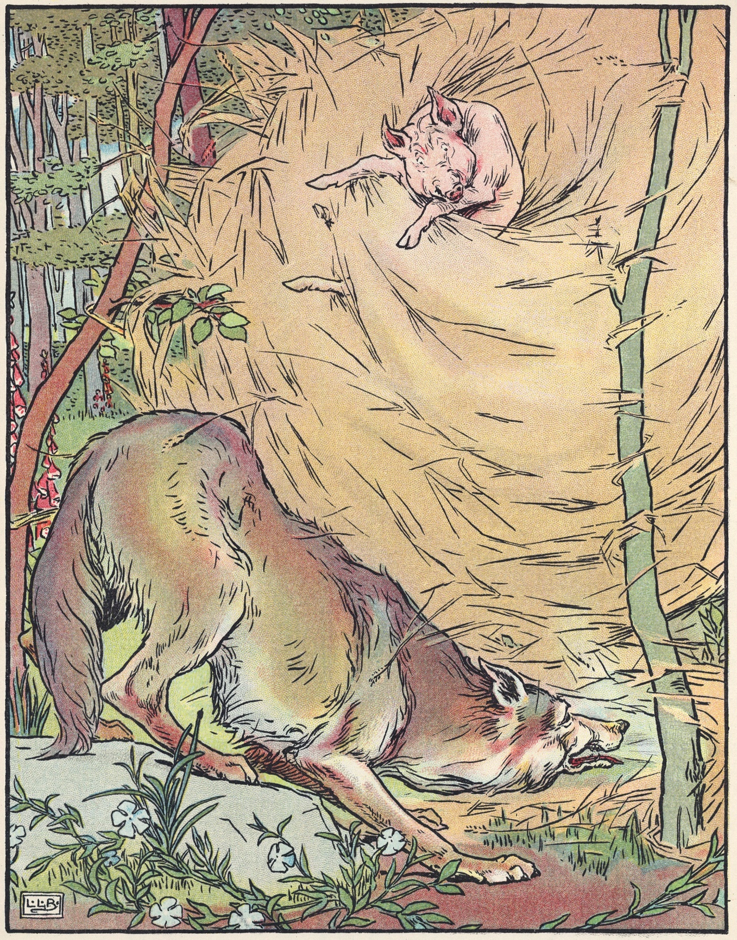
Friday 14th May
Literacy
L.O. To write your story from your plan.

Slide 2
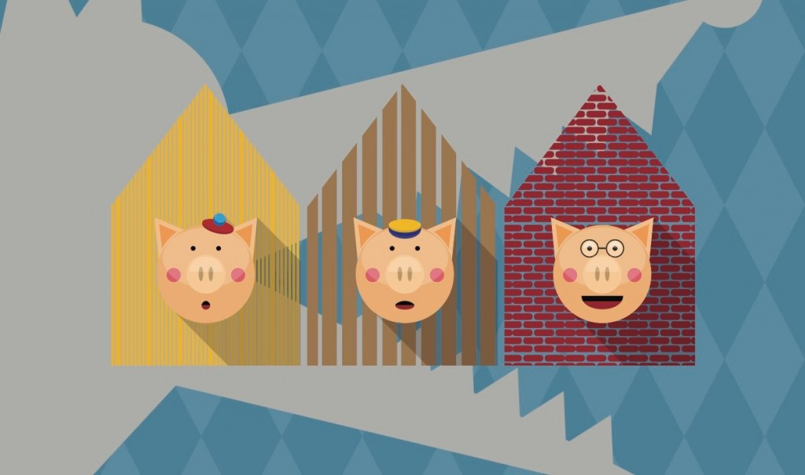
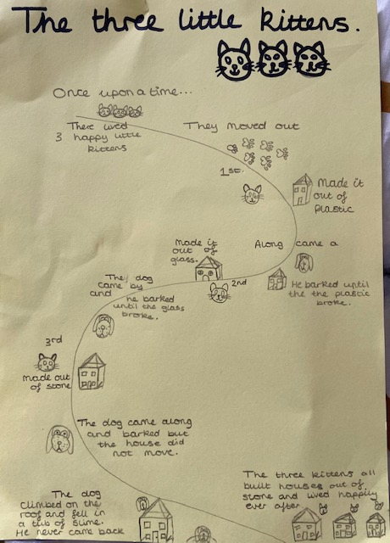
Yesterday you made a story map.
Your own story is similar to the events in ‘The Three Little Pigs’.
You have thought of different animal characters.
Today you will write up your story.

Slide 3
What story language do we often use in fairy tales?
Let’s look at some sentence openers:
Once upon a time, there was…
In a land far, far way there lived…..
Over the hills and far away there was….
Long, long ago, there was….
Early one sunny day….
Back in the days when animals could talk….

Slide 4
We often end with a well-known phrase:
…and they all lived happily ever after.
….and the big, bad (character) was never seen again.
….and as far as I know, they are still there to this very day!
…. And that was the end of the big, bad….

Slide 5
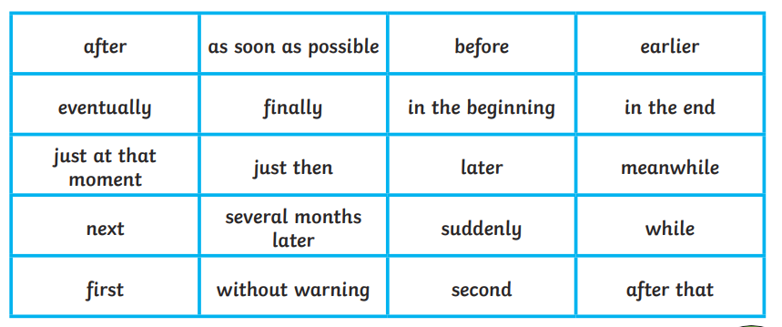
We will also need to use ‘time’ words to help us tell the events of the story.
These words and phrases are called time conjunctions.
Which ones do we know and use?

Slide 6
Let’s have a go at using time conjunctions in our own sentences.
They are often used as a sentence starter.
They often form a phrase, rather than just one word.
e.g. The very next day, he went to the house made out of plastic.
e.g. Before long, she met a fairy who was giving away some leaves.

Slide 7
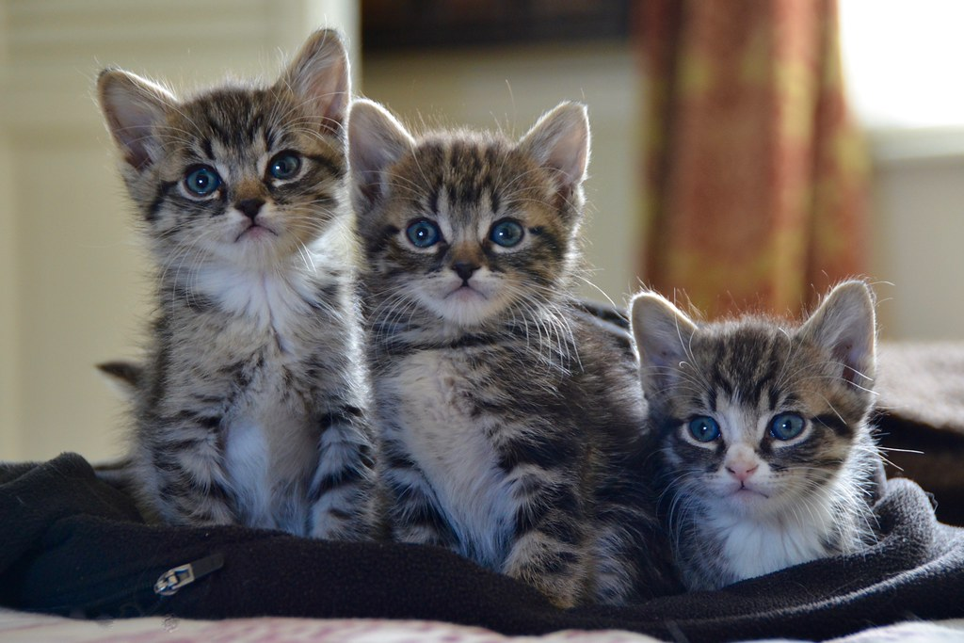
Remember to also use adjectives and describing phrases.
This makes our writing much more interesting because it gives more detail.
e.g. There were three cheeky little kittens.
e.g. They had bright eyes and stripy, fluffy fur. They loved playing together.

Slide 8
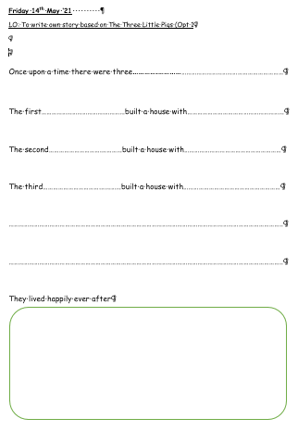
Your Task.
Opt 1
Use the template.
Complete the sentences.
Opt 2
Use the word bank to help you.
Write your own sentences.
Remember time conjunctions and adjectives.

