Slide 1

Children’s Mental Health Week 10.3.21
This year the theme for Mental Health Week is to express yourself.

Slide 2
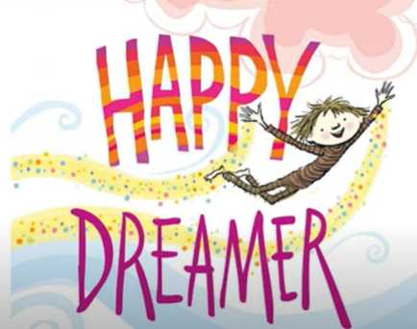
We are happiest when we express ourselves. This means that we take part in activities that make us happy and allow us to show people who we truly are.
Listen to the story ‘Happy Dreamer’ by Peter H Reynolds. This book is about a boy who understands why it is important to express yourself.
https://www.youtube.com/watch?v=edJHW-BsGnM

Slide 3
There are lots of ways you can express yourself. Here are just a few ideas.
Art
Dance
The way you dress
Music
Cooking
Singing
Acting

Slide 4
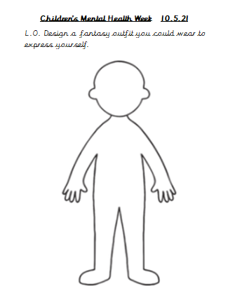
Your Task
Complete the template to design an outfit to wear to express yourself. It could be that you wear bright colours to show that you are always cheerful. Astronaut boots to show that you reach for the stars. You might wear your favourite football team’s T- shirt and a pair of tennis shorts to show that tennis is your favourite sport.

