Slide 1


Slide 4


Equal
Equal means: is the same as
=
4 4
=

Slide 5










Can you make equal groups with your hands?

Slide 6

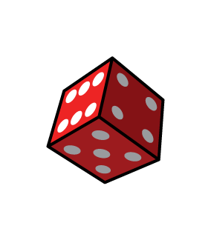





Have a think
Roll 2 dice.
Do you have equal groups or unequal groups?
Equal
Unequal

Slide 7
Have a go at this activity with a partner

Slide 8
Can you make equal groups of counters?
4
4
How many are there altogether?
4 + 4 = 8

Slide 9




Grab some blocks in each hand.
5
6
Are they equal or unequal ?
Can you make them equal ?

Slide 10

Have a think
5
5
6
Can you make them equal?
I can take one block away to make them equal!
What else would make them equal?

Slide 11
Using plates, can you make equal groups of objects?

