Slide 1


Slide 3

Let’s count in 2s :
2, 4, 6, __, ___, ___
2) Let’s count in 5s:
5, 10, 15, ___, ___, ___
3) How do you spell 10?
4) 2 tens = ____

Slide 4
Let’s count in 2s :
2, 4, 6, __, ___, ___
2) Let’s count in 5s:
5, 10, 15, ___, ___, ___
3) How do you spell 10?
4) 2 tens = ____
8
10
12
20
25
30
ten
20

Slide 6

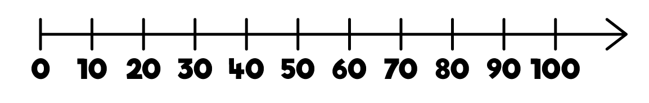
How many fish?
There are 10 fish in each tank.
There are fish.
40

Slide 7



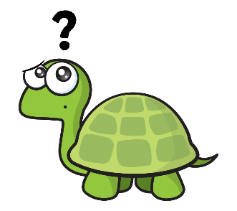
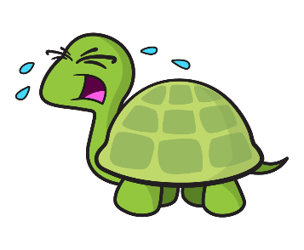
How many grapes?
Have a think
There are 10 grapes in each bunch.
10
20
30
40
50
Tiny, don’t cry. We can count in 10s!
22,23,24,25,
26…
There are grapes.
50

Slide 8
Have a go at questions 1 and 2 on the worksheet

Slide 9
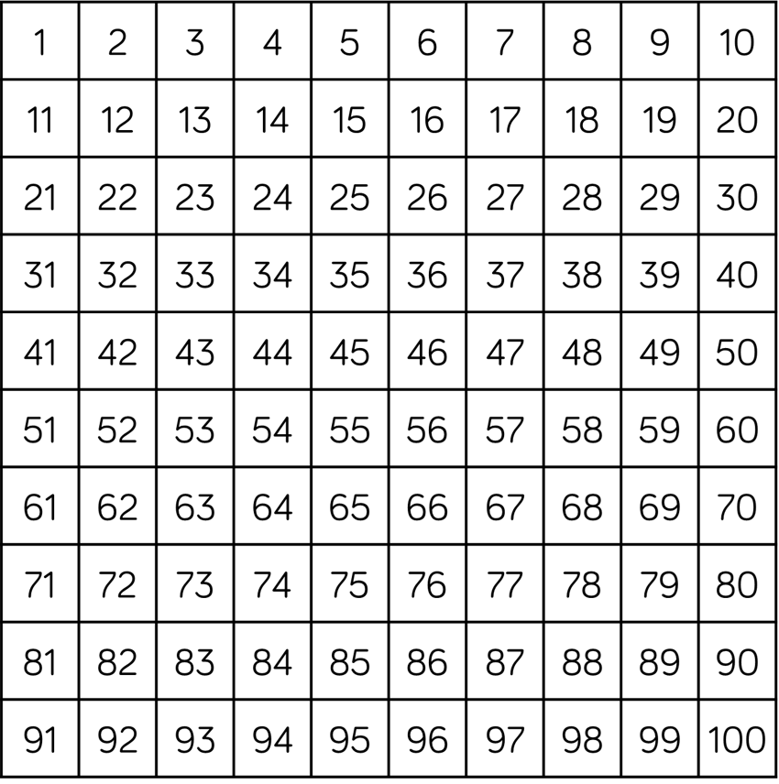

Counting in 10s

Slide 10

How many counters?
10
20
30
40
50
60
I am going to count in 10s.
There are counters.
60

Slide 11
Have a go at question 3 on the worksheet

Slide 12
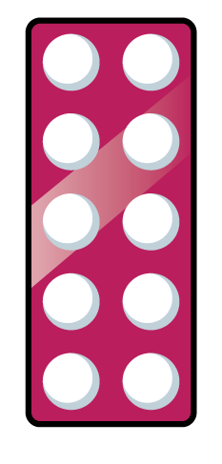
Counting in 10s
Have a think
What numbers are missing?

Slide 13

Counting backwards in 10s
Have a think
80 | 70 | 60 | 50 | 40 | 30 | 20 | 10
What numbers are missing?

Slide 14
Have a go at questions 4 and 5 on the worksheet

