Slide 1
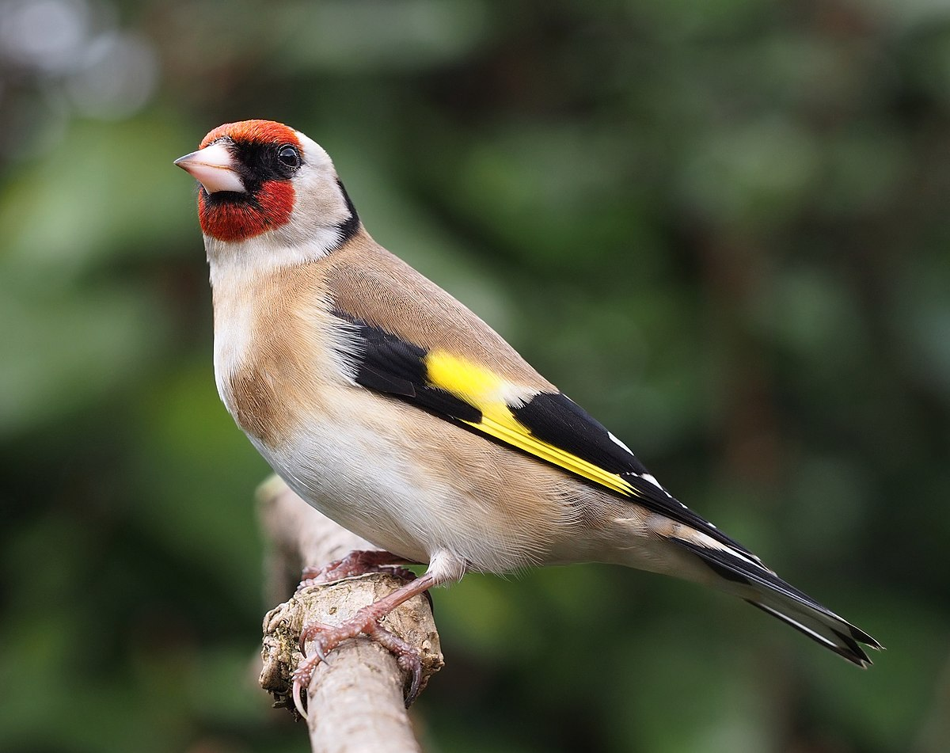
Thursday 13th May
Science
L.O. To recognise common UK birds & their life cycle.

Slide 2
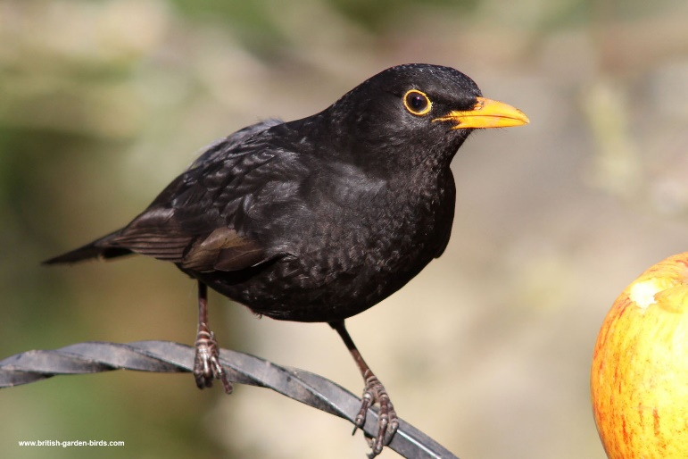
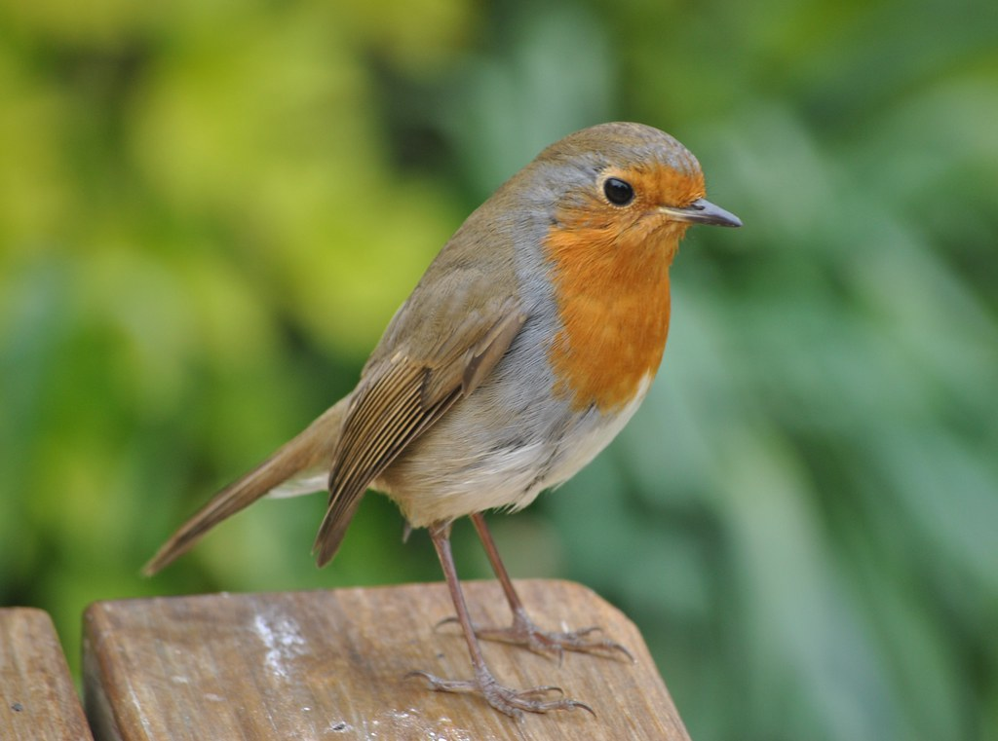
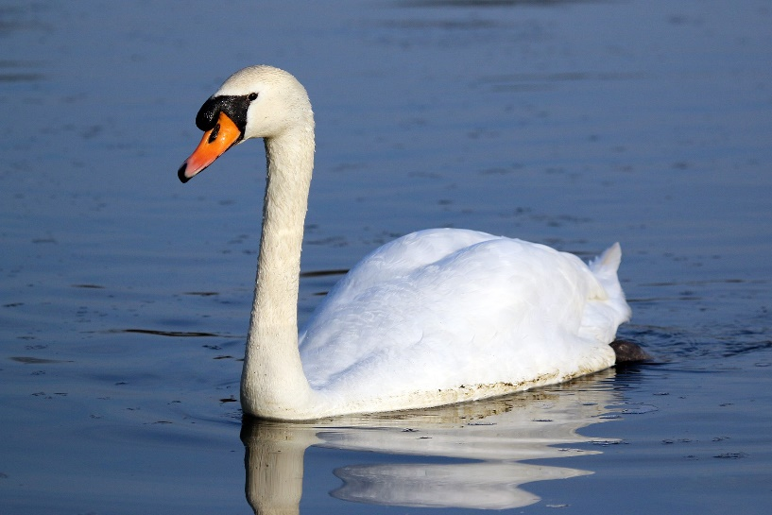
What birds can do you know that we often see in our towns, parks and gardens?

Slide 3
We will watch a video clip to learn the names and bird song of common birds we might see.
https://www.youtube.com/watch?v=IfLIYOh8qEU

Slide 4
At this time of year, Spring, birds are busy laying eggs and keeping them warm.
Let’s learn about the different stages of the bird’s life cycle.
Try to remember the names of the young birds as they grow.
https://www.youtube.com/watch?v=T9NpzTyV_iI

Slide 5
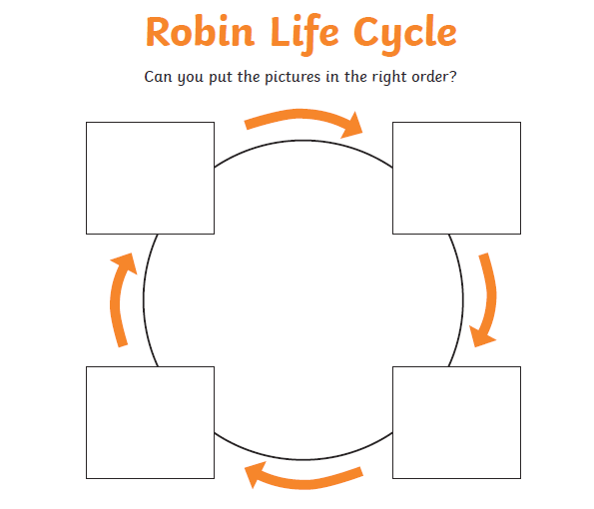
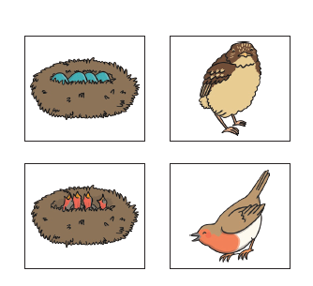
Your Task
Can you order the stages of the robin’s life cycle. Cut and stick the pictures.
Can you add the labels:
egg
hatchling
fledgling
adult bird

