Slide 1
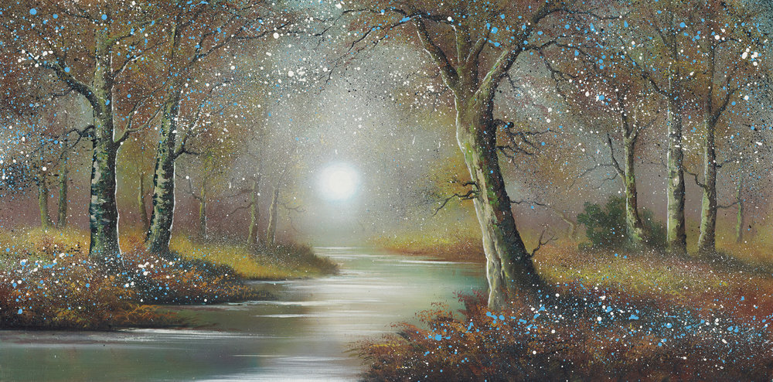
Monday 10th May
LO: Create a map of an imaginary woodland

Slide 2
Your task is to create your own enchanted woodland map
What is a map? Discuss what they are and what we use them for.
A map is a picture of a place, usually drawn from above, as if you were in the sky looking down at it. The purpose of a map is to show us where things are and how to get to them.
Have you ever used a map or seen someone else use one?

Slide 3
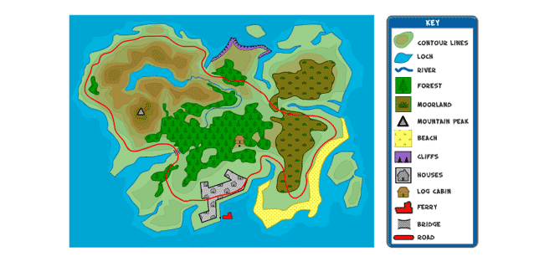
As a part of your map you will need to include a key.
A key shows a small symbol or picture of something that is on the map as well as telling you what it is.

Slide 4
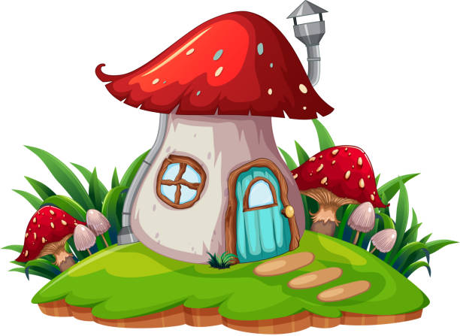


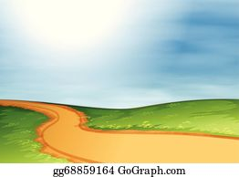

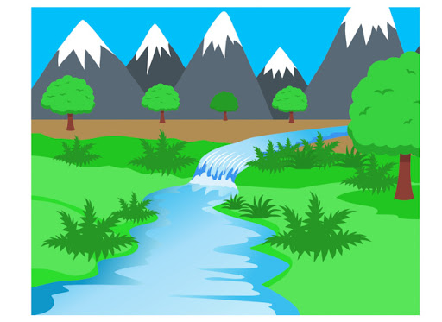

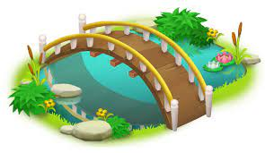
Your map is going to be of an enchanted woodland, what will you include on it?

Slide 5
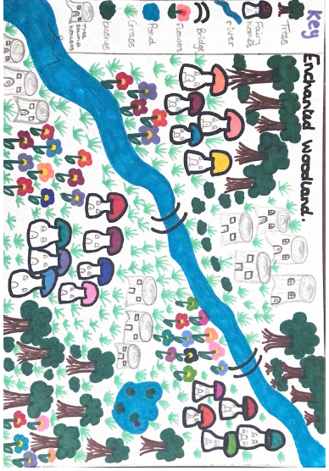
This is a picture of the Enchanted Woodland map I created

