Slide 1
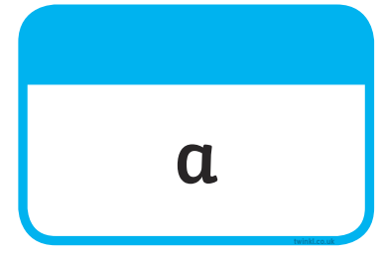







Tricky Words

Slide 2
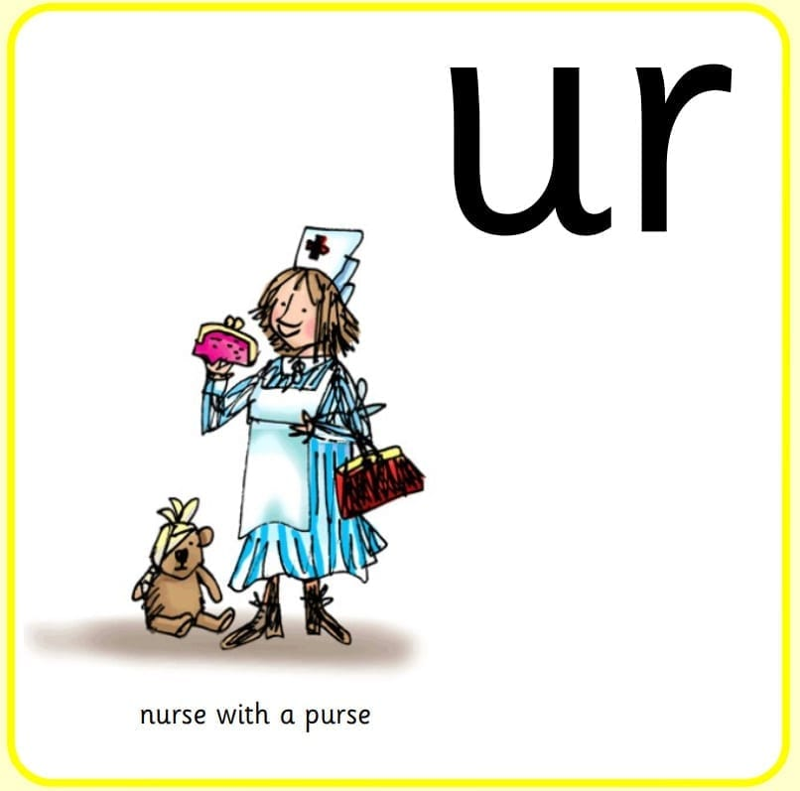
Our Set 3 phoneme for today is….ur
purse hurt
burn
turn
burn
slurp
nurse

Slide 3
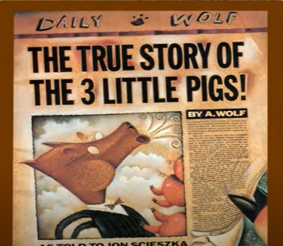
LO: To think of questions to ask the wolf
Monday 10th May 2021

Slide 4
Today we will be hearing the TRUE story of the Three Little Pigs.
We will watch the story and share our ideas about it after.
Video

Slide 5
What questions would you like to ask Mr. A. Wolf?
Say your questions out loud. What words have you used to start your questions?

Slide 6








What punctuation do we see at the end of a question?

Slide 7
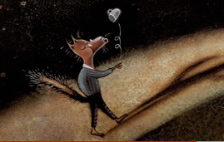
Did the wolf really go for a cup of sugar to make a cake? What questions can we ask to find out?

Slide 8
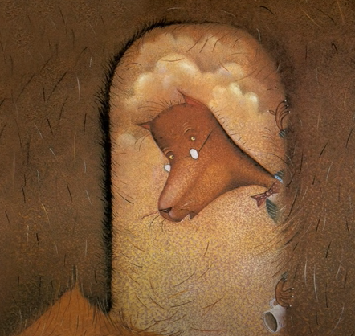
Did straw house door really just fall down? What questions can we ask to find out?

Slide 9
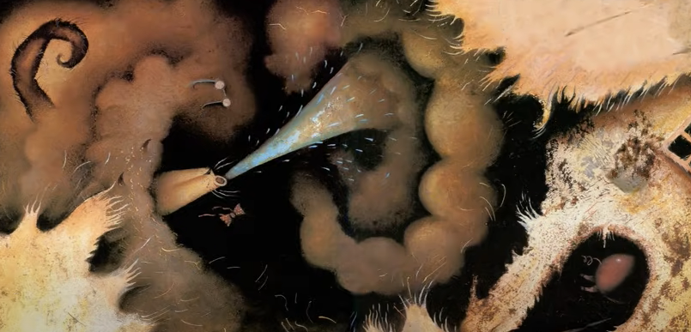
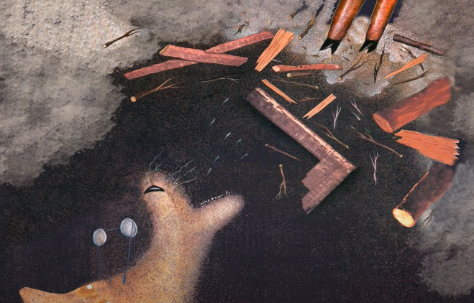
Did he really sneeze? What questions can we ask to find out?

Slide 10
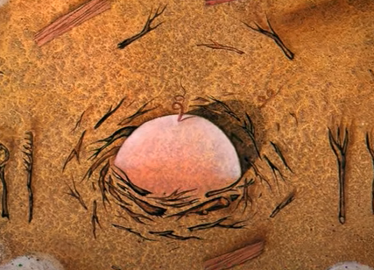
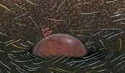
How did the little pigs really die when their houses fell down?
What questions can we ask to find out?

Slide 11
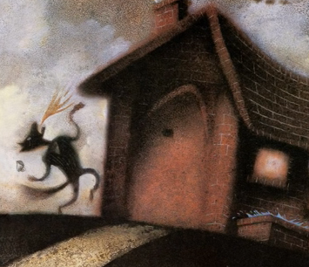
Did the third little pig really say something mean about the wolf’s granny? What questions can we ask?
And your old Granny can sit on a pin!

Slide 12
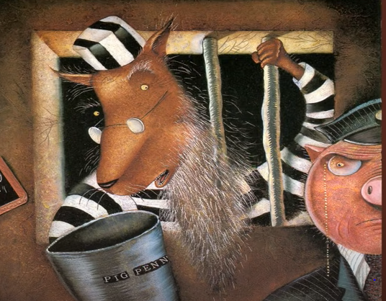
Do you think he was really framed? Did the newspapers really change his story to make him bad?
I was framed!

Slide 13
Your task today:
You will need felt tip pens and a big piece of paper.
In your group think of the questions you might ask Mr. A. Wolf about what happened that day.
Write these down using question words and finish each question with a ?
Does your group think Mr. A. Wolf is telling the truth or fibbing?

