Slide 1









Slide 2
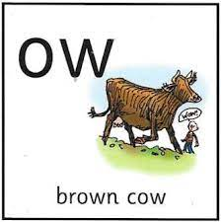
Our Set 3 phoneme for today is….ow
crowd drown
howl
how
down
brown
town

Slide 3
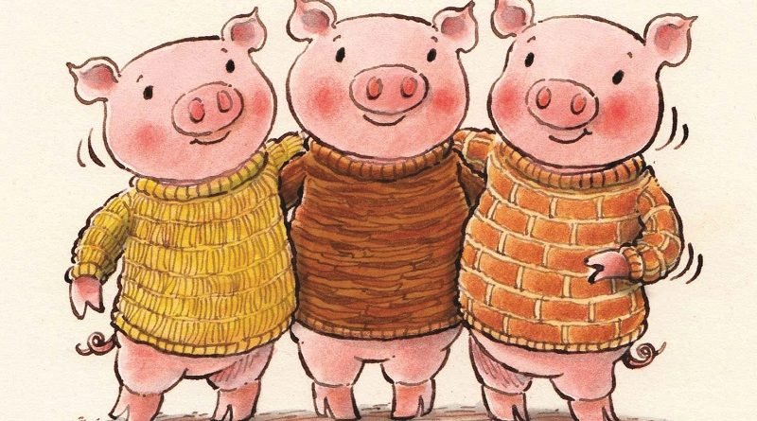
Wednesday 12th May 2021
L.O. Retell a traditional tale. (The Three Little Pigs)

Slide 4
Can you remember what happens in the story of The Three Little Pigs?
Who are the main characters?
Where is the story set?
What happens in the beginning, middle and end?
Does the story have a happy ending?
Let’s revisit the story together.

Slide 6
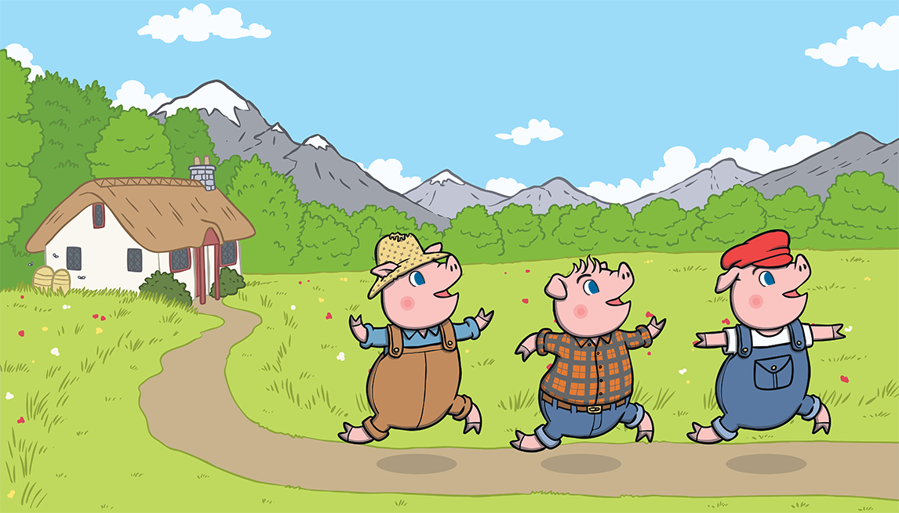
Once upon a time, there lived three little pigs.

Slide 7
One day, they decided to leave home and build houses of their own.

Slide 8
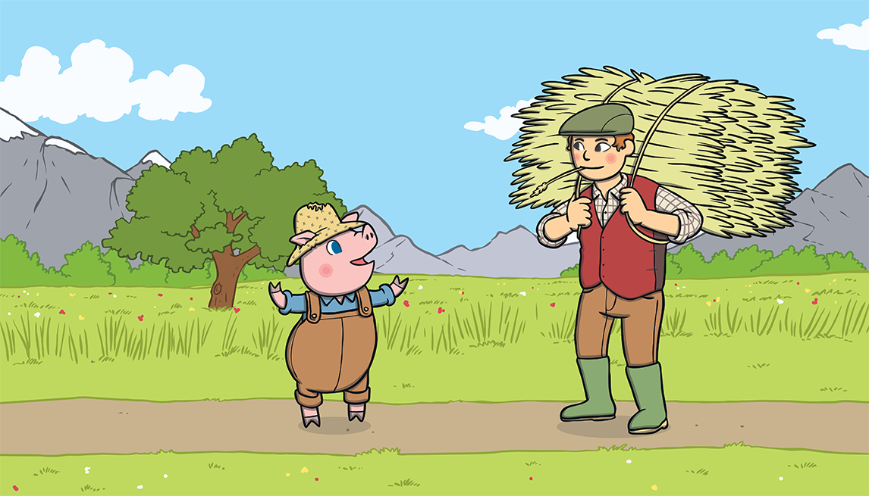
The first little pig thought that straw would make a
good house.

Slide 9
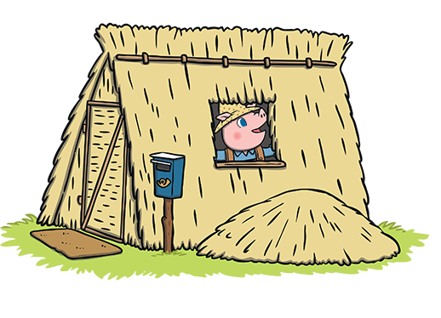
He built the house very quickly and he was very pleased with it.

Slide 10
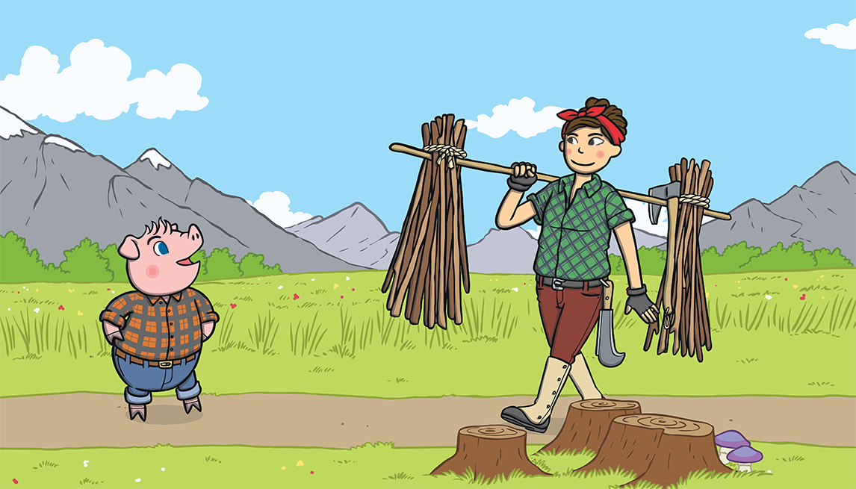
The second little pig thought that sticks would make a fine house.

Slide 11
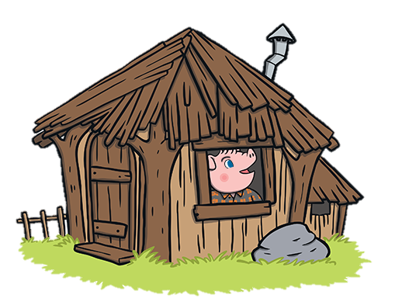
He built the house very quickly and he was very pleased with it.

Slide 12
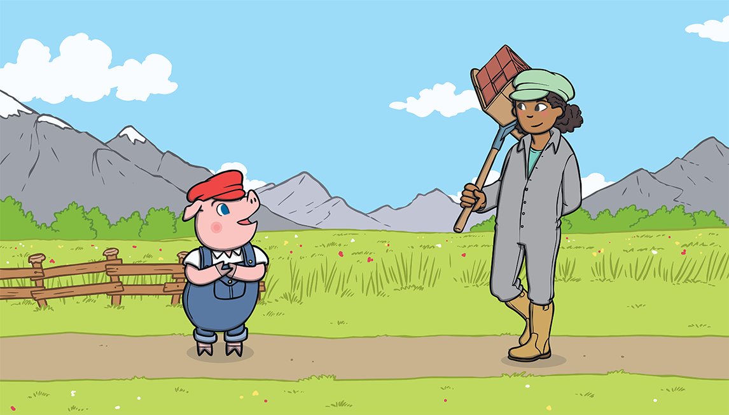
The third little pig thought that bricks would make a strong house.

Slide 13
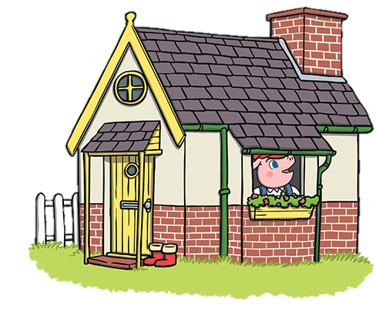
It took him a long time to build the house but he was very
pleased with it.

Slide 14
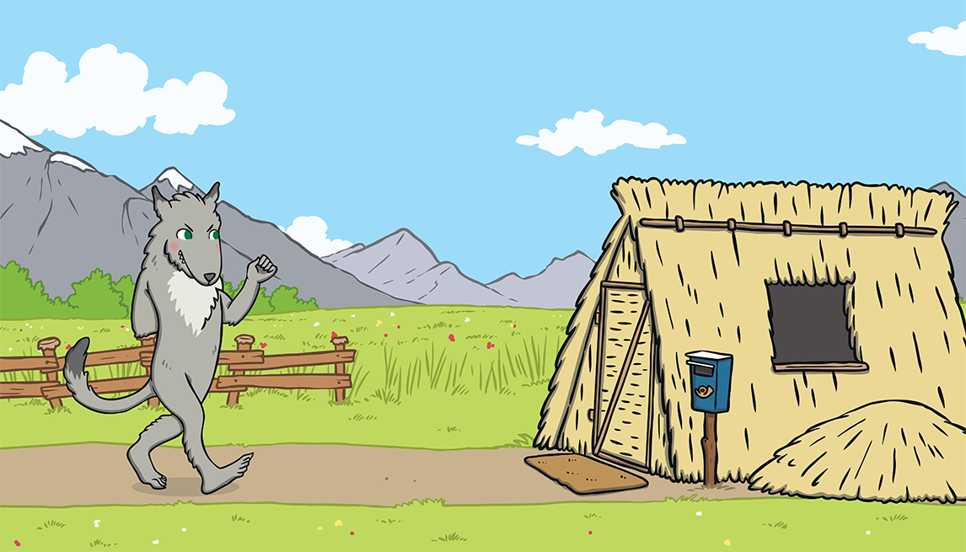
One day, a big bad wolf came along.

Slide 15
He saw the first little pig in his house of straw.

Slide 16
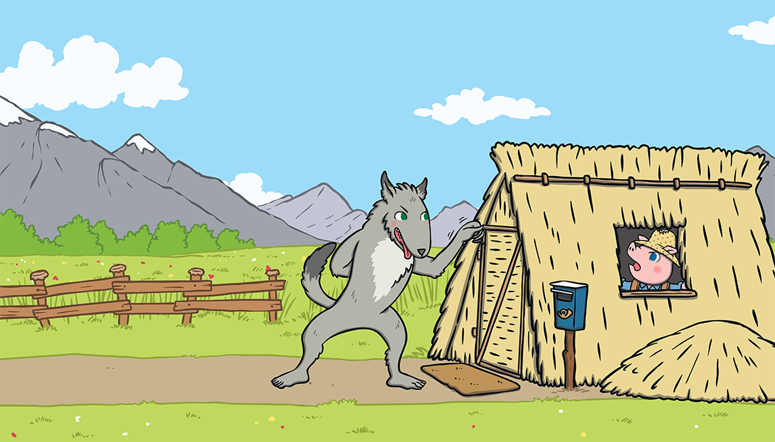
“Little pig, little pig, let me come in,” he snarled.
“Not by the hair on my chinny, chin, chin!” cried the first little pig.

Slide 17
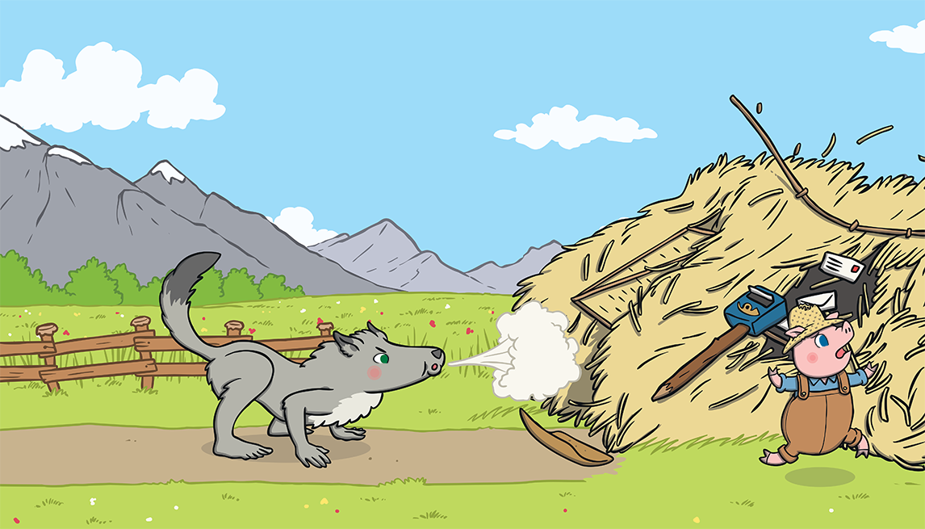
“Then I’ll huff and I’ll puff and I’ll blow your house down!” growled the big bad wolf.

Slide 18
So he huffed and he puffed and he blew the house down!

Slide 19
The first little pig escaped and ran to join his brother in the house made of sticks.

Slide 20
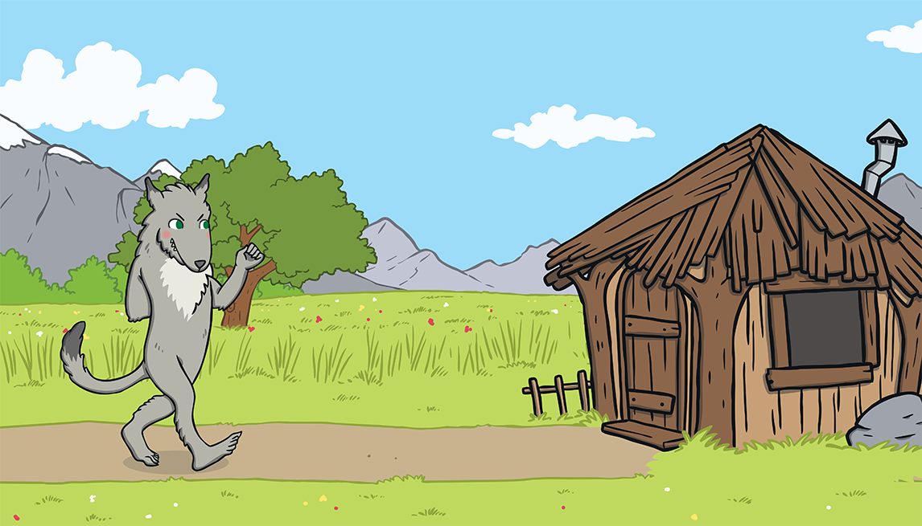
The big bad wolf followed the little pig to the house made of sticks.

Slide 21
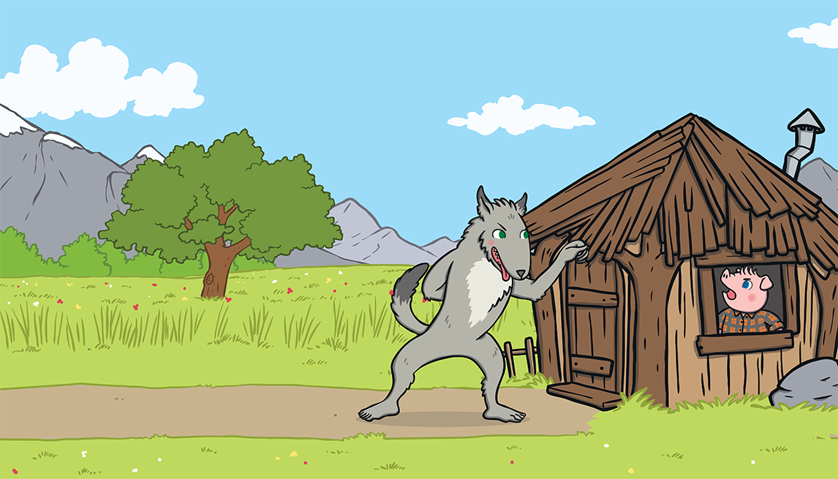
“Little pig, little pig, let me come in,” he snarled.
“Not by the hair on my chinny, chin, chin!” cried the second little pig.

Slide 22
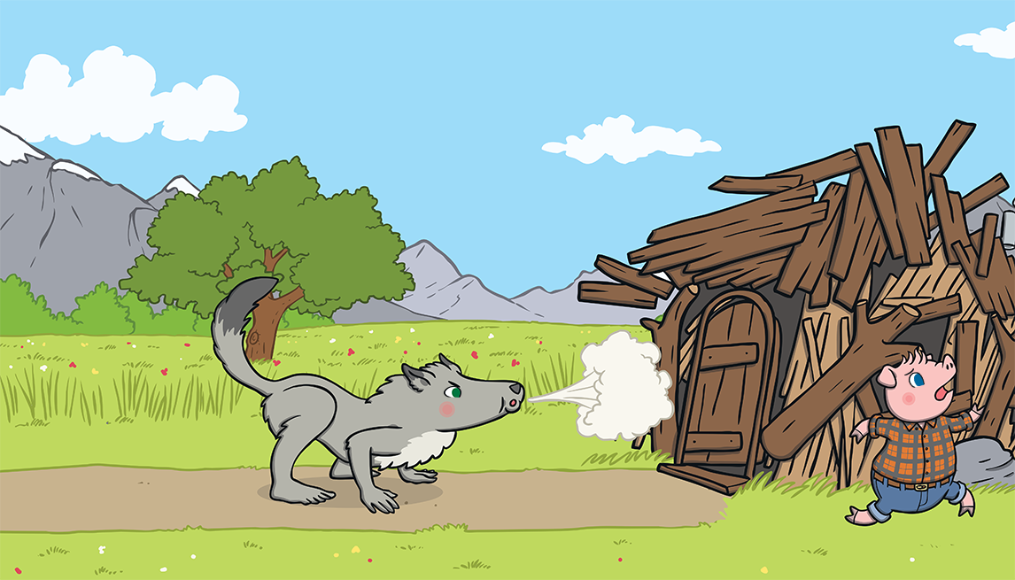
“Then I’ll huff and I’ll puff and I’ll blow your house down!” growled the big bad wolf.

Slide 23
So he huffed and he puffed and he blew the house down!

Slide 24
The two little pigs escaped and ran to join their brother in the house made of bricks.

Slide 25
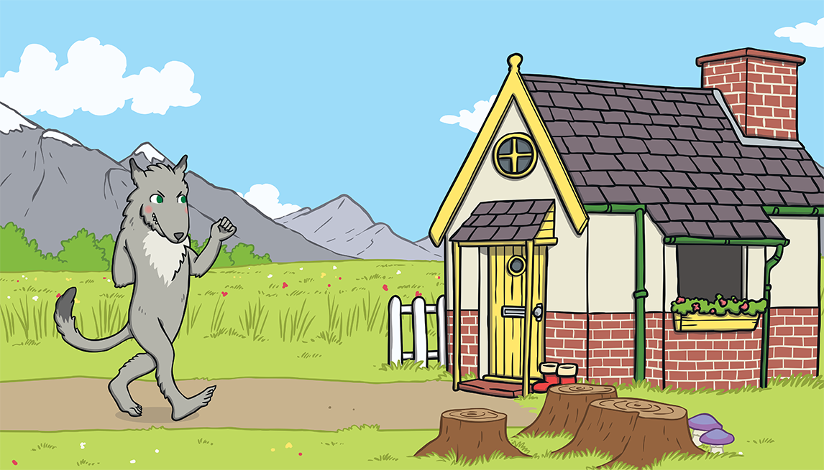
The big bad wolf followed the pigs to the house made of bricks.

Slide 26
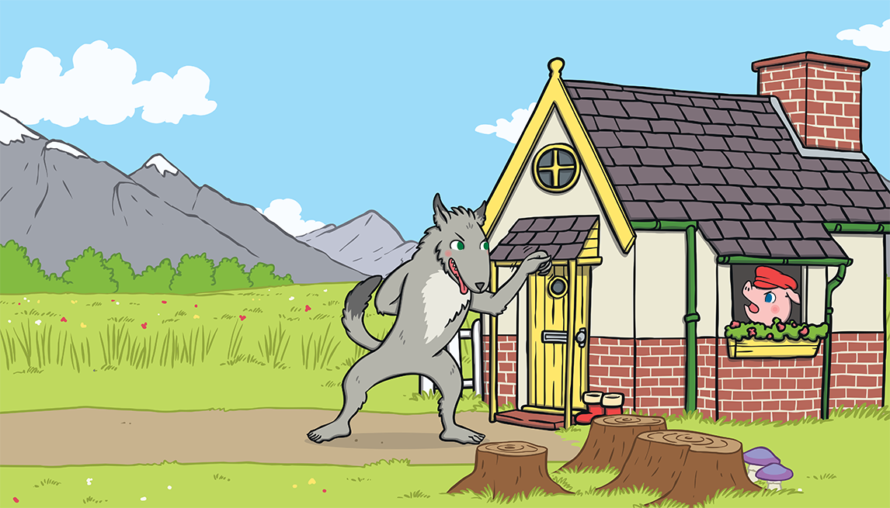
“Little pig, little pig, let me come in,” he snarled.
“Not by the hair on my chinny, chin, chin!” cried the third little pig.

Slide 27
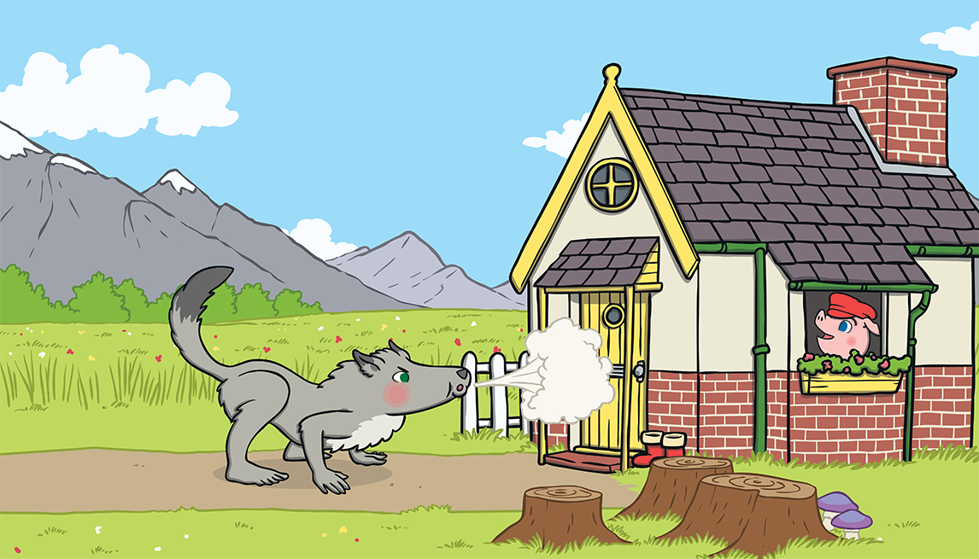
“Then I’ll huff and I’ll puff and I’ll blow your house down!” growled the big bad wolf.

Slide 28
He huffed and he puffed, but the house was too strong. He could not blow it down!

Slide 29
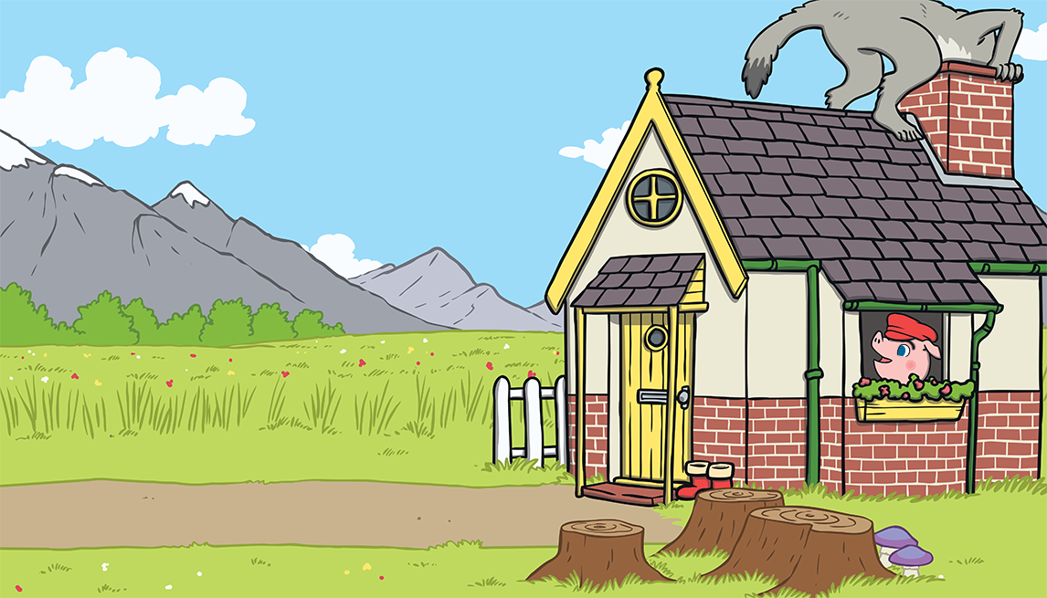
This made the big bad wolf very angry.
He climbed onto the roof of the house so he could crawl down the chimney.

Slide 30
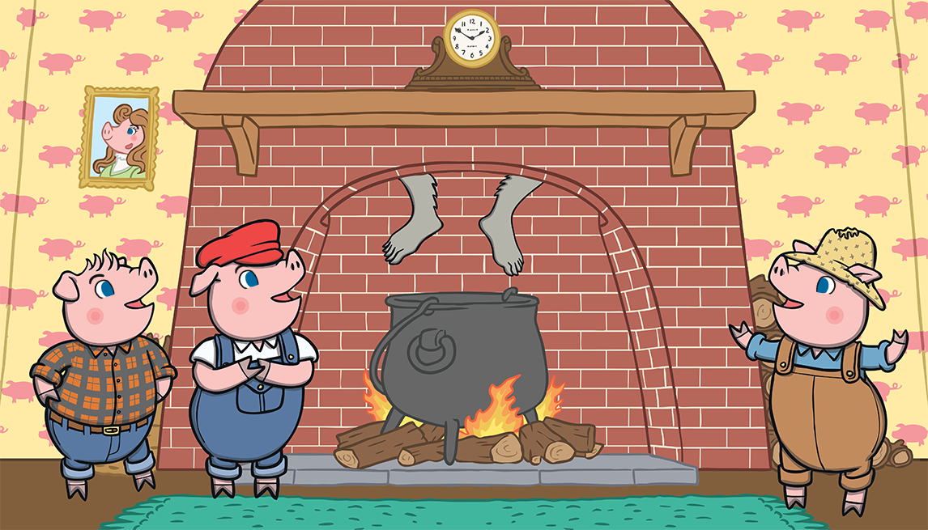
The big bad wolf was in for a big surprise!

Slide 31
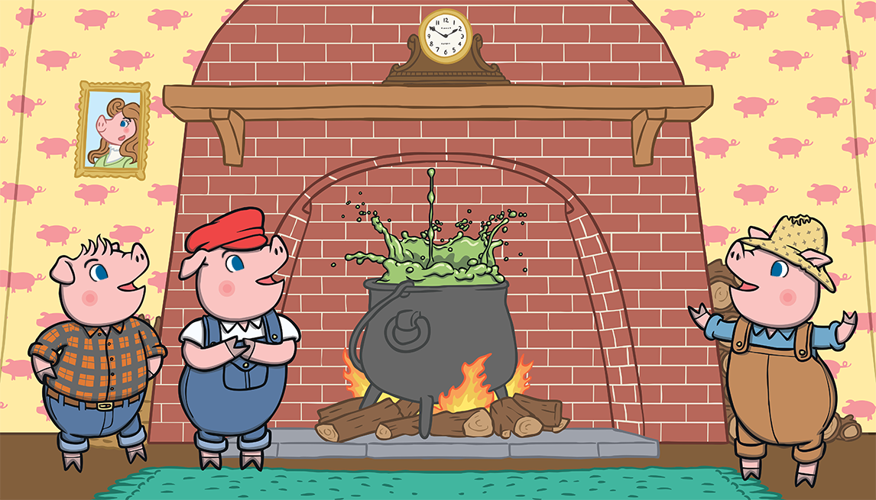
The third little pig had been cooking a big pot of stew and SPLASH! The wolf fell right into the pot!

Slide 32
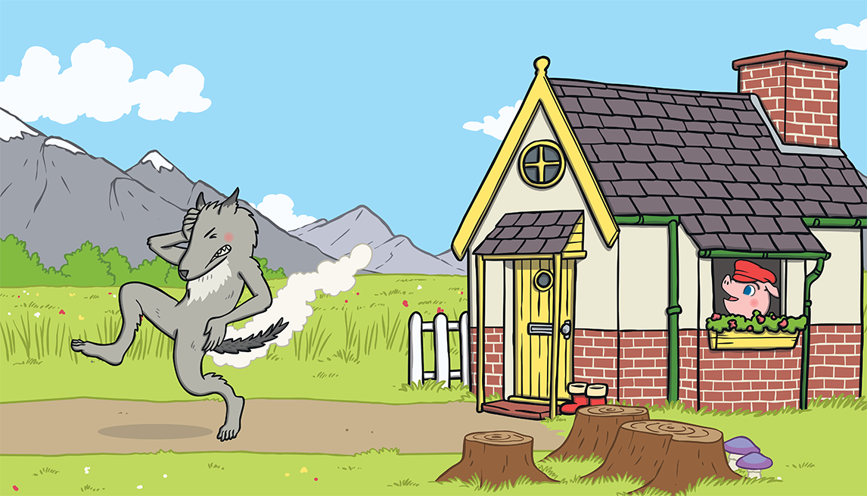
The wolf was very shocked. He jumped out of the pot and ran straight out of the house. He never came back again.

Slide 33
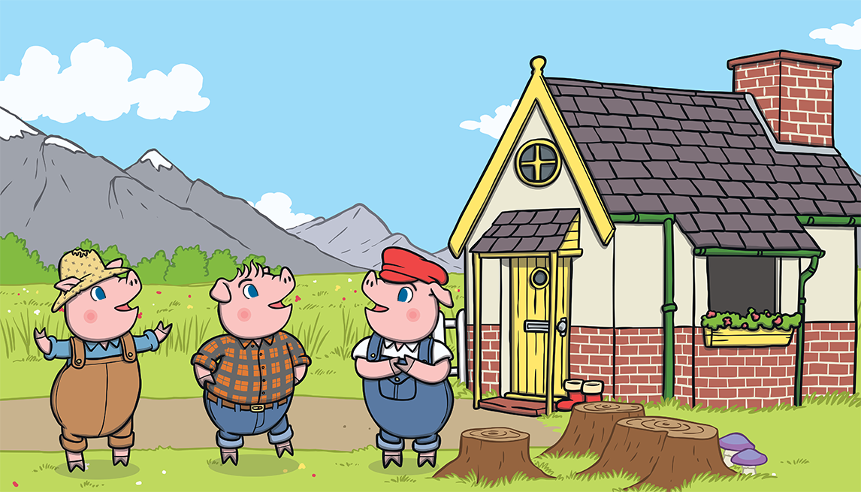
The little pigs lived happily ever after in the house made of bricks.

Slide 35
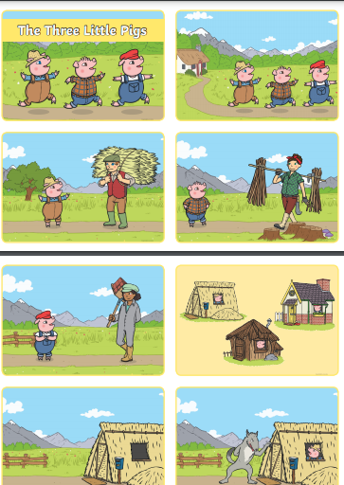
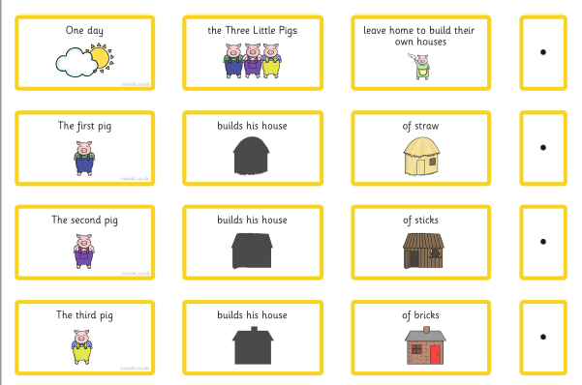
Your Task
Option 1
Option 2
Cut out, order and stick the words to make a sentence. Copy the sentences making sure that you use capital letters and full stops.
Cut out and order the pictures. Write a caption to retell the story.

