Slide 1


Slide 3

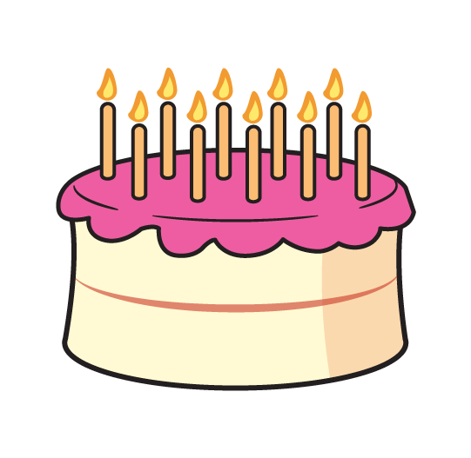
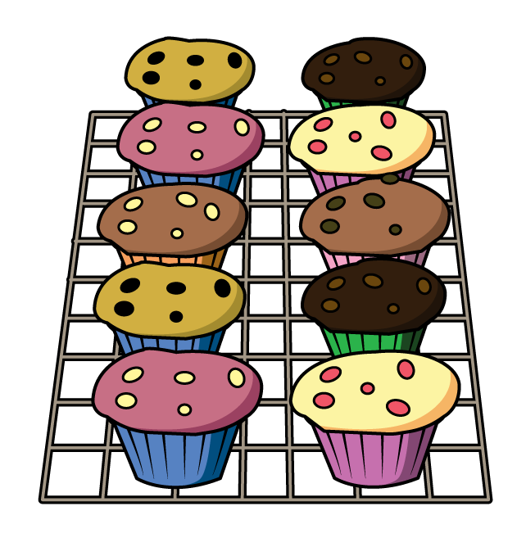
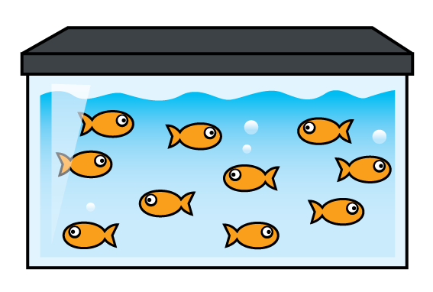
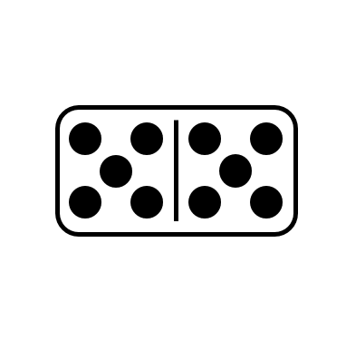
How many?
Have a think
How did you count them?

Slide 4
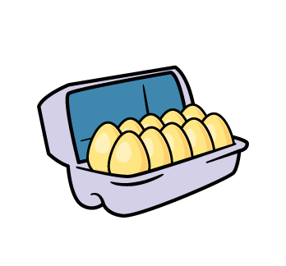





Why count in 10s?
Have a think

Slide 5
What can you find that you can count in 10s?

Slide 6



Let’s count in 10s
Have a think
1 ten = 10
2 tens = 20
3 tens = 30
4 tens = 40
I can see a
pattern!
I know that
5 tens = 50

Slide 7
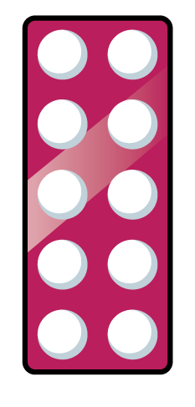
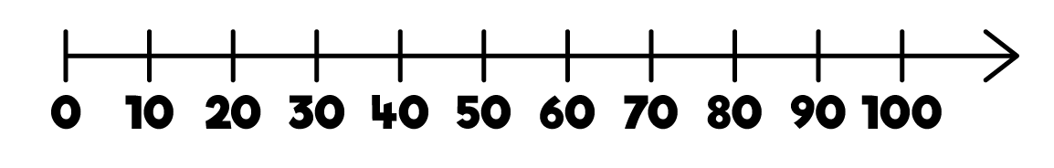
Have a think
I think I need to practice counting forwards and backwards in 10s.

Slide 8
Have a think
Will you practice with me?

Slide 9
You can go back and practice counting with Tiny!

Slide 10
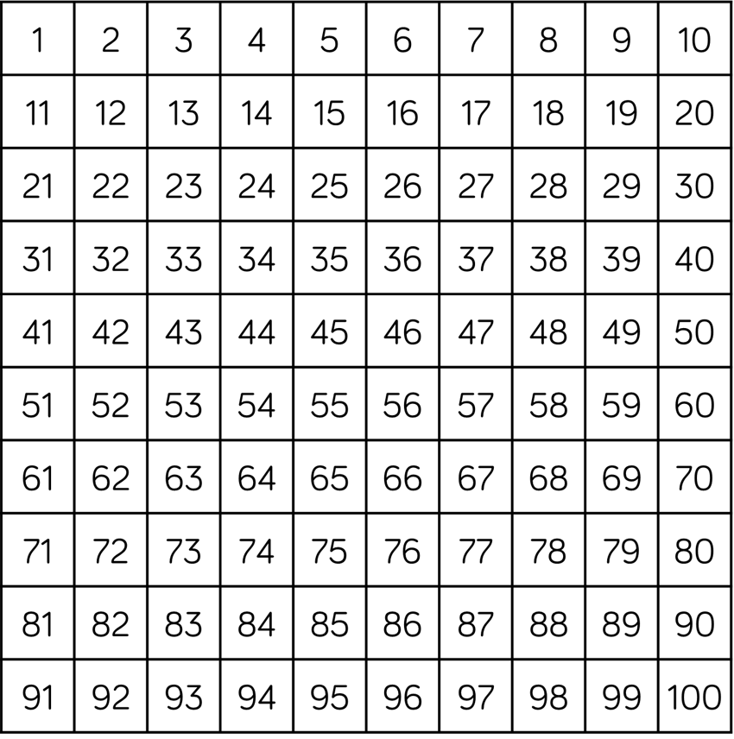
Let’s count in 10s
Have a think
I love how it
makes a column!

Slide 11

You can practice counting in 10s when you colour in a 100 chart

