Slide 1
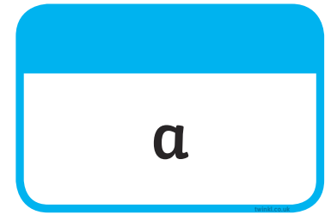







Tricky Words

Slide 2

Our Set 3 phoneme for today is….i-e
shine white
like
wide
mine
time
hide

Slide 3
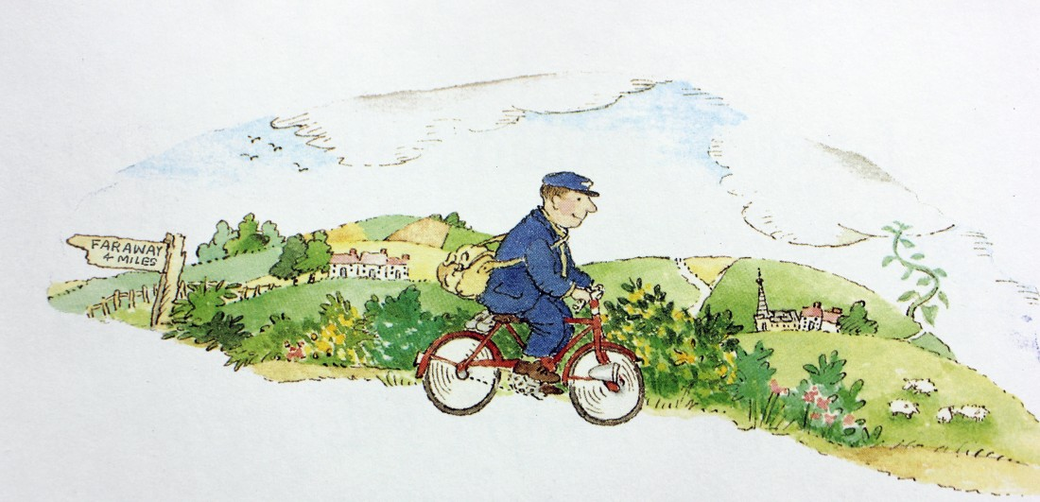
Monday 26th April
L.O. To write a postcard

Slide 4
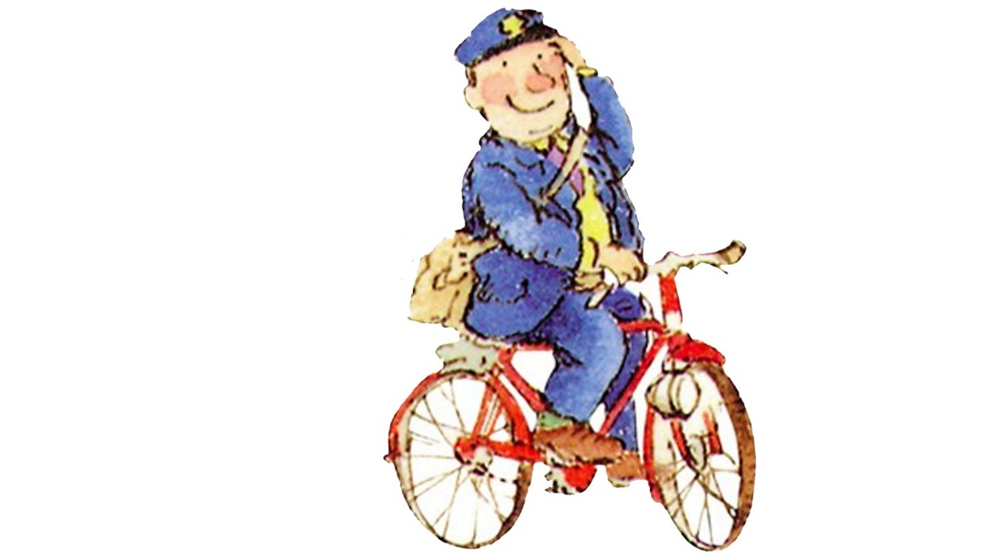
The Jolly Postman delivers letters to different fairy tale characters. He delivers a postcard to the Giant.
Story 1min52

Slide 5
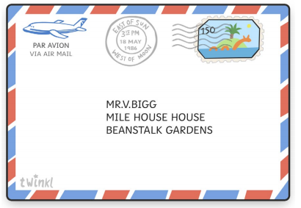
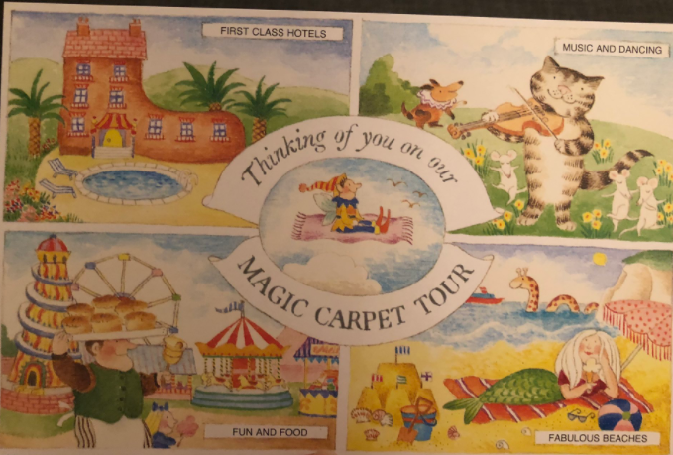

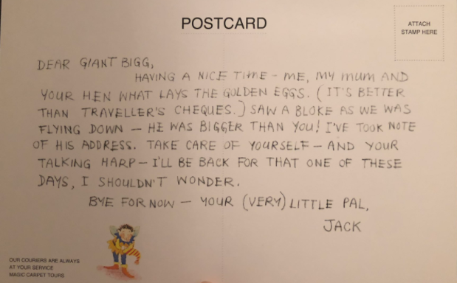
I wonder where he will go next?

Slide 6

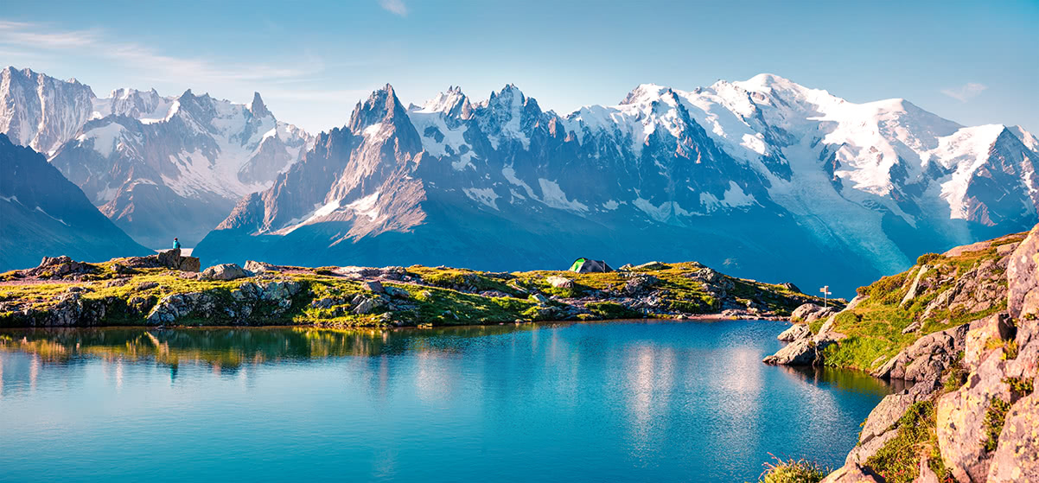
Where do you think Jack will go next?
I might go to the mountains and see a lake.

Slide 7
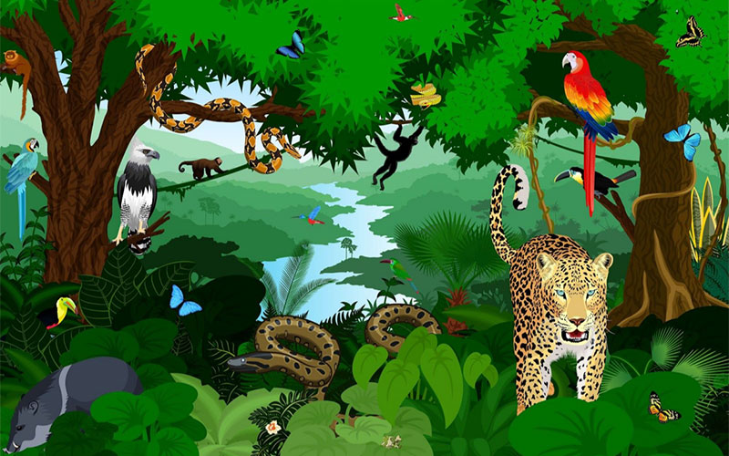
Where do you think Jack will go next?
I might go to the rainforest and see animals.

Slide 8
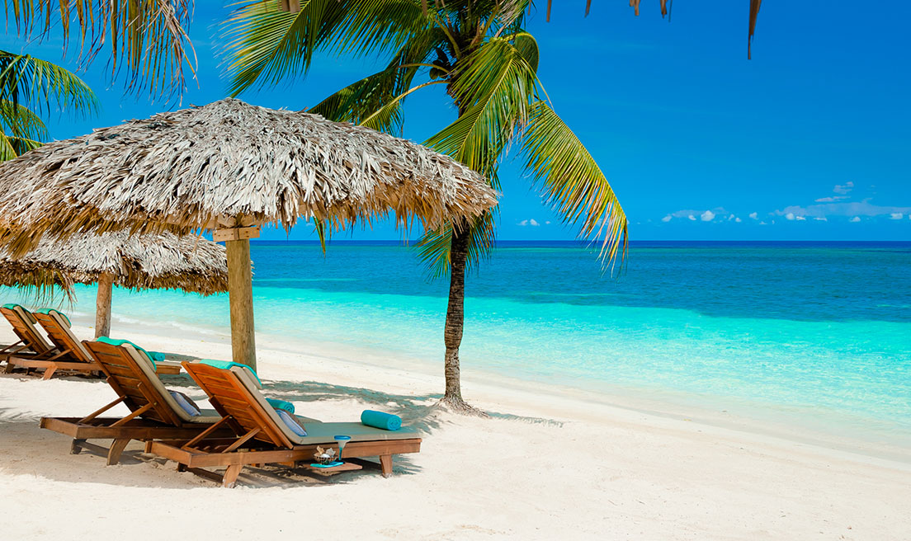
Where do you think Jack will go next?
I might go to the beach and sit in the sun

Slide 9
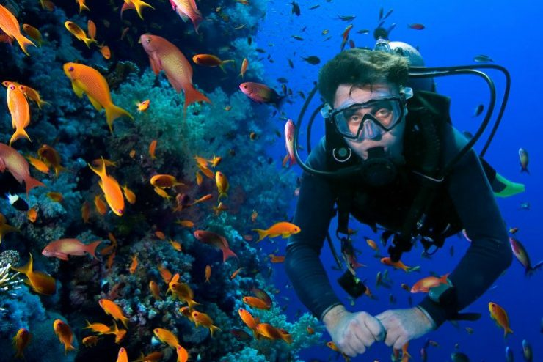
Where do you think Jack will go next?
I might go to the sea and scuba dive.

Slide 10
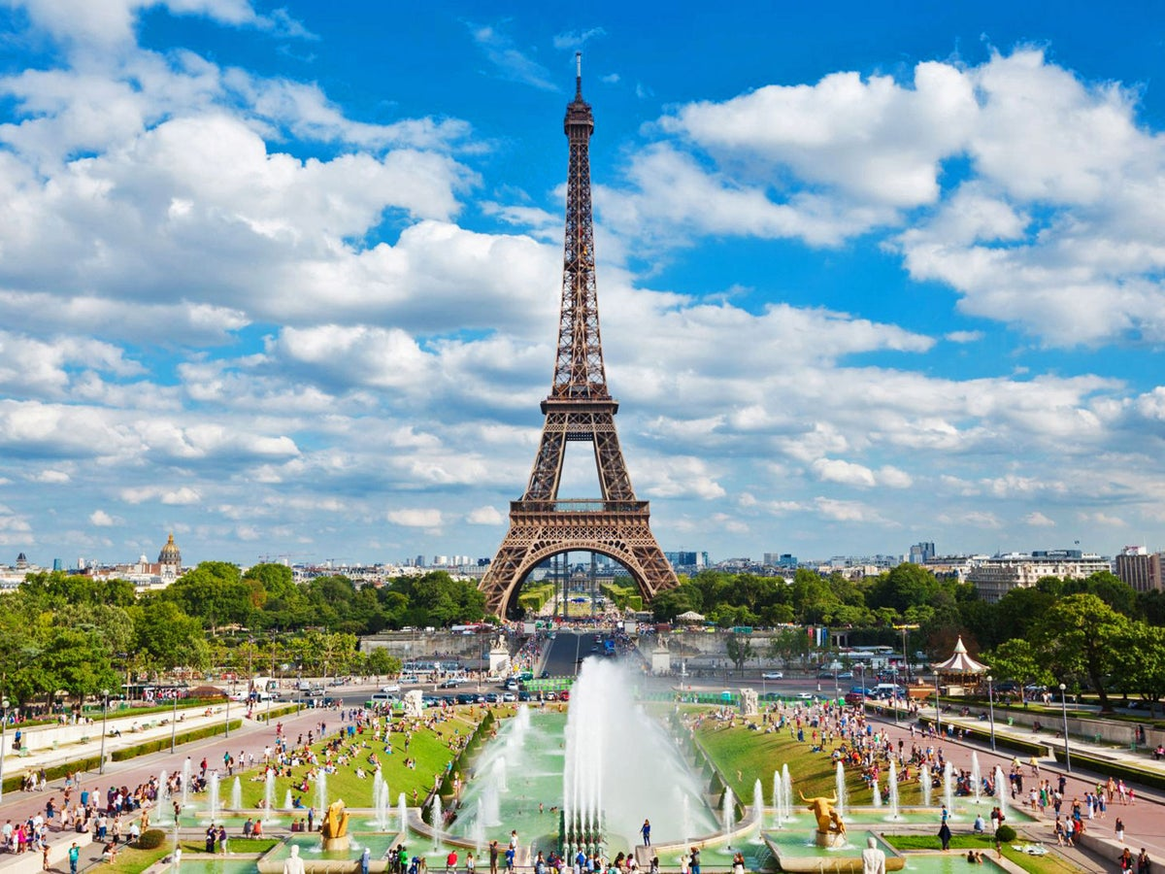
Where do you think Jack will go next?
I might go to France and see the Eiffel Tower.

Slide 11
Talk to the person next to you. Where do you want Jack to go next?
It could be one of the examples OR somewhere you have been to visit!

Slide 12
What do you think needs to be included in a postcard?
Space for a picture (on the front)
Blank lines for an address.
Space to write about your holiday.
postcard
The name and address of who you’re sending it to.
Some writing to say what you’ve been doing on your holiday.
Space in the top right corner for a stamp.

Slide 13

What might you write about in a postcard?
Maybe what Jack has done so far and what he is going to do?
Yesterday I went to the beach. Tomorrow I will go on a boat trip.

Slide 14
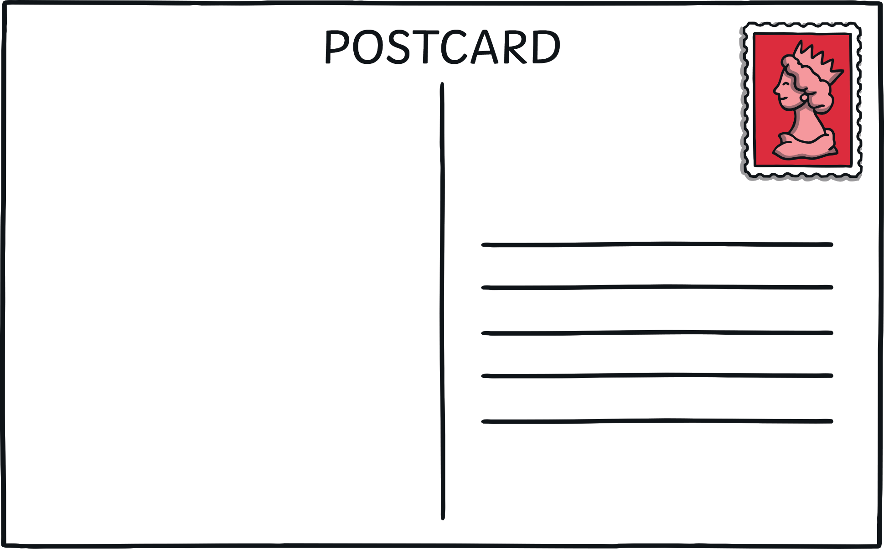
A stamp in the top right corner.
Dear Giant,
I am having lots of fun on holiday. Yesterday, I went to the beach. I made a huge sandcastle and ate lots of ice cream.
Today I went to a theme park. I went on lots of scary rides but it was lots of fun!
Tomorrow I am going to go on a boat trip. I hope we see dolphins!
From Jack x
Lines for writing the address.
Mr. V. Bigg
Mile High House
Beanstalk Gardens
Space to write about your holiday – what you have done and what you will be doing.
The name and address for who you are sending the postcard to.

Slide 15
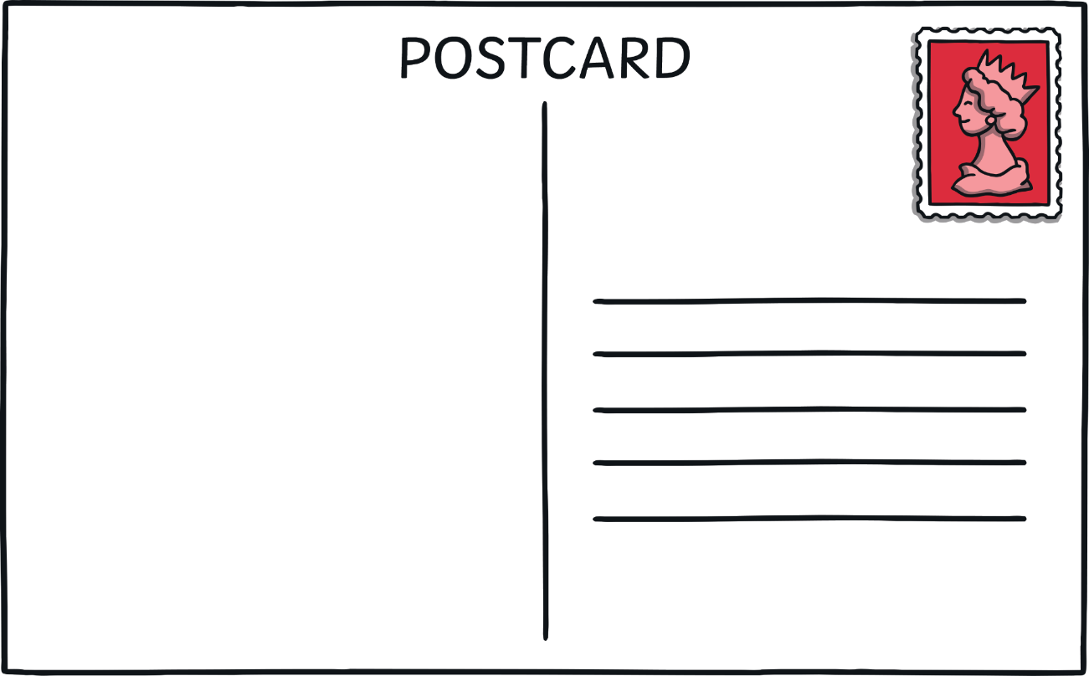
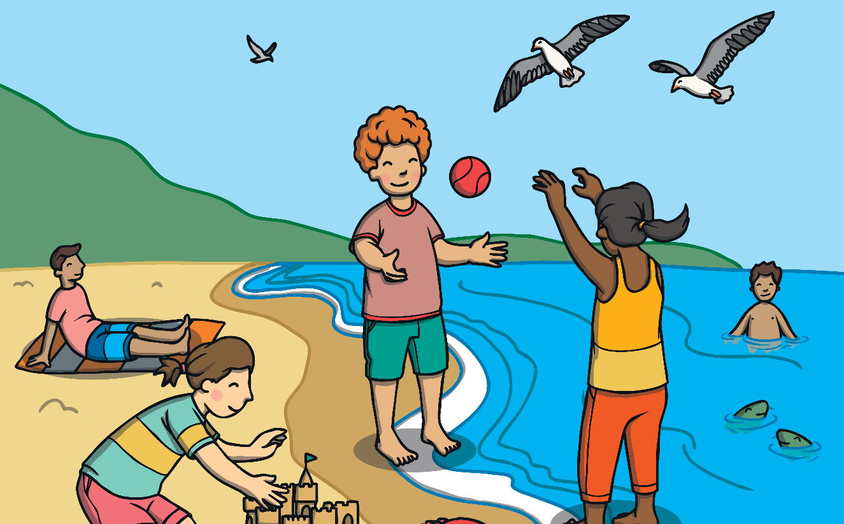
A picture on the front of your postcard showing where you are on holiday.
Dear Giant,
I am having lots of fun on holiday. Yesterday, I went to the beach. I made a huge sandcastle and ate lots of ice cream.
Today I went to a theme park. I went on lots of scary rides but it was lots of fun!
Tomorrow I am going to go on a boat trip. I hope we see dolphins!
From Jack x
Mr. V. Bigg
Mile High House
Beanstalk Gardens
HT13 4TW

Slide 16
Your Task is to write a postcard from Jack to the Giant!
Option 1 – Easy
To draw where Jack visits and write a sentence about it using the template.
Option 2 – Middle / Hard
To write a postcard using informal language to describe the holiday.
Objectives:
Both tasks will need:
- Capital letters for sentence starters and for names.
-Full stops must be used to show where sentences end.
- Try to include clear adjectives to describe places and things.

