Slide 1
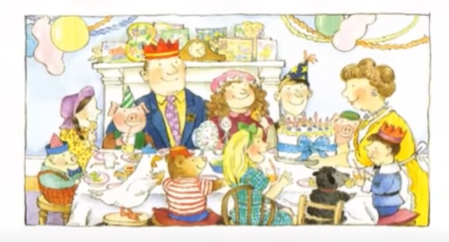
Friday 30th April 2021
L.O. To design and label a party bag.

Slide 2
Goldilocks is having a birthday party. Which characters from the story do you recognise?

Slide 3
Goldilocks wants to give her guests a party bag which have gifts in it that have been specially chosen for her guests.
What gifts do you think the story/nursery rhyme characters at her party would want?

Slide 4
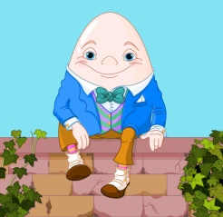
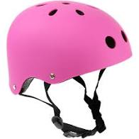
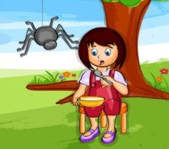
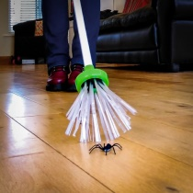
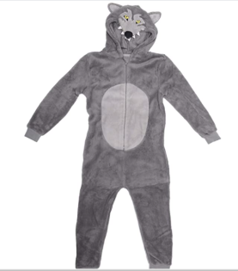
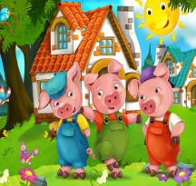
Examples –
I think Humpty Dumpty would like a crash helmet so that he can climb what he likes without getting injured.
I would choose to give Little Miss Muffet a spider catcher so that she doesn’t need to be scared of spiders anymore and can enjoy her curds and whey.
The 3 Little Pigs would be given a wolf onesie so that the Big Bad Wolf won’t recognise them when they are playing outdoors.

Slide 5
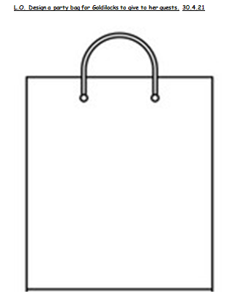
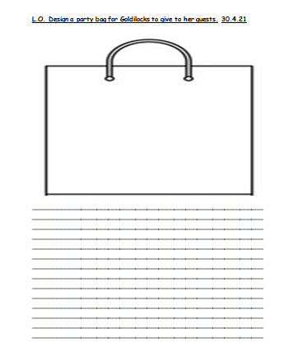
Your Task
Option 1
Draw and label the gifts.
Option 2
Draw gifts. Beneath, describe who the gifts are for and why you have chosen them.

