Slide 1
Disclaimer/s
We hope you find the information on our website and resources useful.
Animations
This resource has been designed with animations to make it as fun and engaging as possible. To view the content in the correct formatting, please view the PowerPoint in ‘slide show mode’. This takes you from desktop to presentation mode. If you view the slides out of ‘slide show mode’, you may find that some of the text and images overlap each other and/or are difficult to read.
To enter slide show mode, go to the slide show menu tab and select either from beginning or from current slide.
You may wish to delete this slide before beginning the presentation.

Slide 2
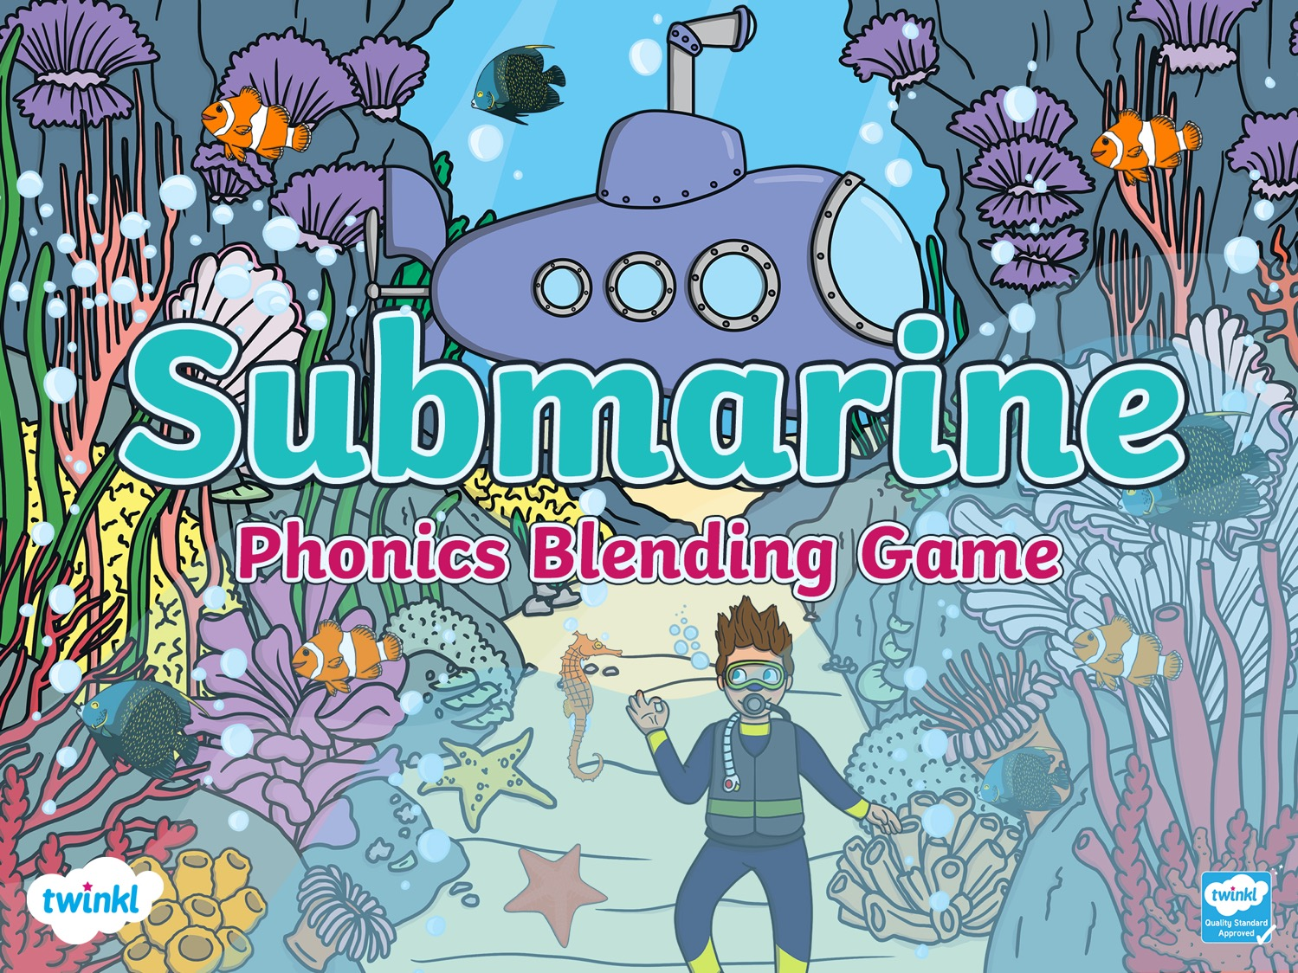

Slide 3

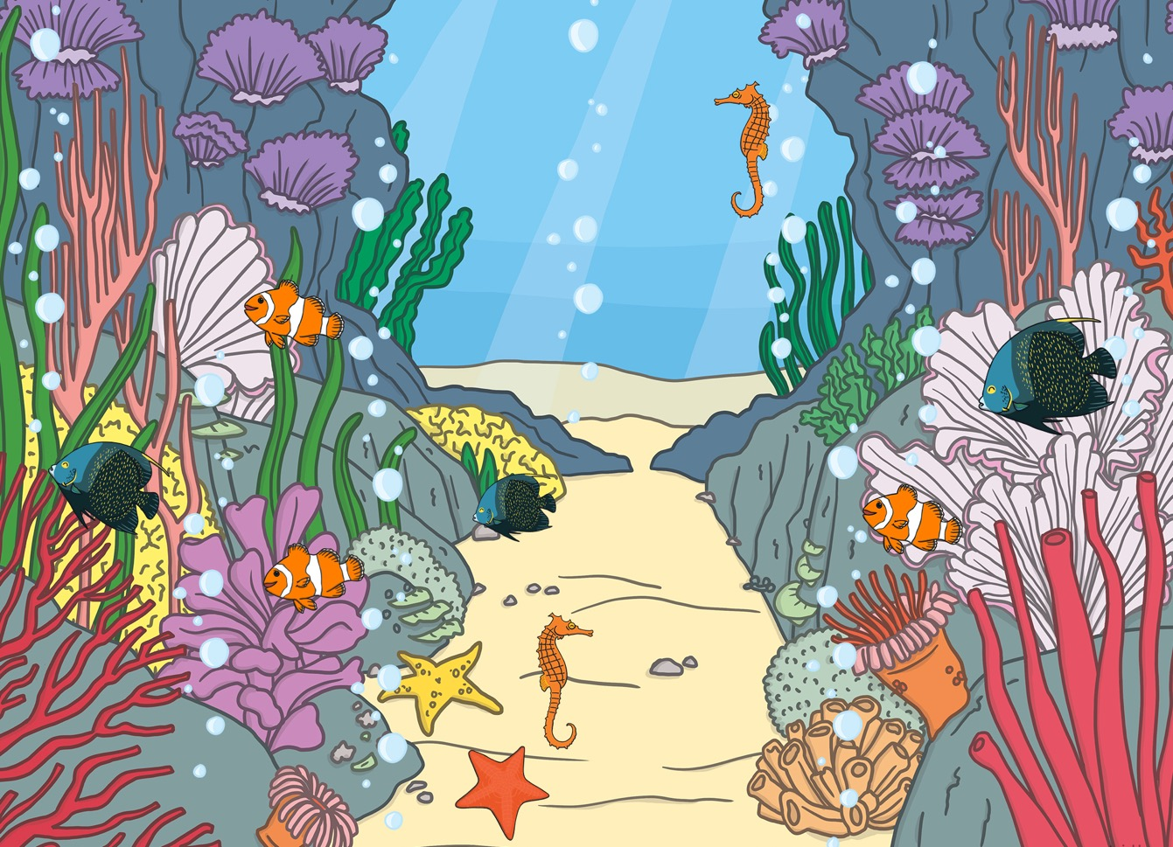
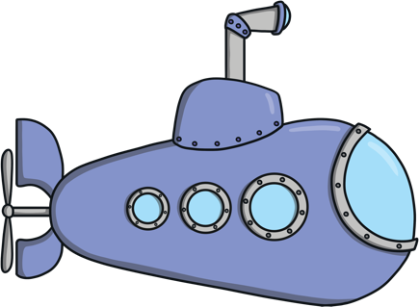






A submarine is exploring deep under the sea.
It has discovered some rare bubbles!
Can you read the sound in each bubble the submarine finds? Blend the sounds together and say the word.
Can you choose the matching picture bubble?

Slide 4





sh
ar
k

Slide 5


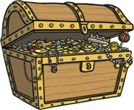
f
i
sh

Slide 6

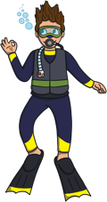

sh
e
ll

Slide 7

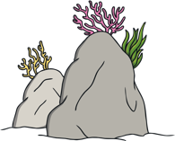

r
o
ck

Slide 8



sh
i
p

Slide 9

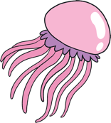

c
oi
n

Slide 10



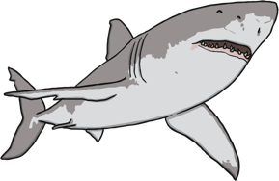



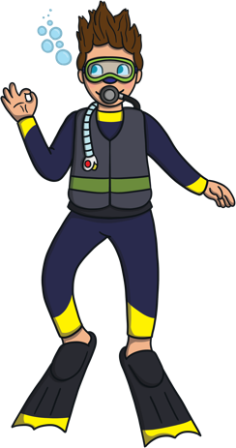






You read the sound bubbles and blended the words very carefully.
Super reading everyone!
What a lot of things we spotted on our under the sea adventure!

