Slide 1
DESCRIBE POSITION (1)

Slide 3

1) What is half of 12?
2) A ______ is one of 2 equal pieces.
half quarter
3) What is this shape called?
4) What number is missing? 15, 20, 25, ___

Slide 4
1) What is half of 12?
2) A ______ is one of 2 equal pieces.
half quarter
3) What is this shape called?
4) What number is missing? 15, 20, 25, ___
6
half
sphere
30

Slide 6
How can we describe position?
right
left
forwards
backwards

Slide 7



Which hand?
left
right
Let’s practice
left
right

Slide 8


Which hand do you write with?
Have a think
left
right

Slide 9



left
right
Have a think
Where is …?
left
The is to the of the
right
The is to the of the
right
The is to the of the

Slide 10
Have a go at questions 1 and 2 on the worksheet

Slide 11

Forwards or backwards?
Have a think
backwards
forwards

Slide 12

Which way is the ladybird going?
Forwards or backwards ?
The ladybird is going backwards.

Slide 13
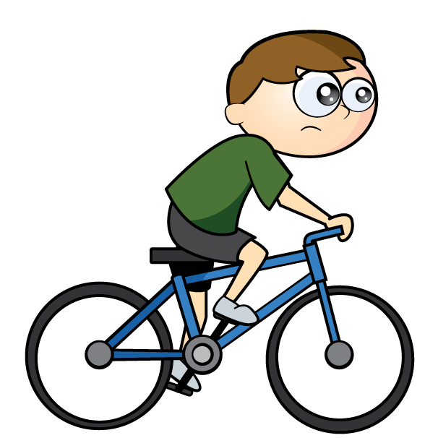

Which way are they going?
Jack is going forwards.
Eva is going forwards.
Forwards or backwards?
They are both going forwards!

Slide 14
Have a go at questions 3 and 4 on the worksheet

