Slide 1


Slide 3
1) What is half of 20?
2) A ______ is one of 4 equal pieces.
half quarter
3) What is this shape called?
4) What number is missing? 14, 16, 18, ___

Slide 4
1) What is half of 20?
2) A ______ is one of 4 equal pieces.
half quarter
3) What is this shape called?
4) What number is missing? 14, 16, 18, ___
10
quarter
triangle
20

Slide 6

Describe the turn
Three-quarter
turn
Half
turn
Full turn
Quarter turn

Slide 7
Have a go at question 1 on the worksheet

Slide 8

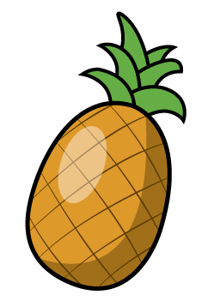
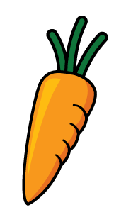

Which of these has made a full turn?
Have a think

Slide 9

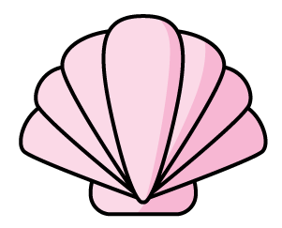

Which of these has made a half turn?
Have a think

Slide 10

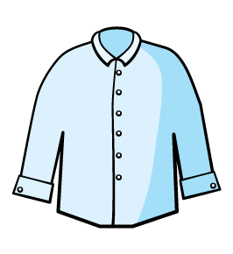

Which of these has made a
quarter turn?
Have a think

Slide 11
Have a go at questions 2 and 3 on the worksheet

Slide 12



Which of these has made a three- quarter turn?
Have a think

Slide 13
Have a go at question 4 on the worksheet

