Slide 2
Think about these questions and write a sentence to answer each.
How many different sharks did you see?
Which was your favourite shark and why?
Do you like sharks?

Slide 3
Watch this video
Video courtesy of Abi Haigh (@Youtube.com) - granted under creative commons licence - attribution

Slide 4
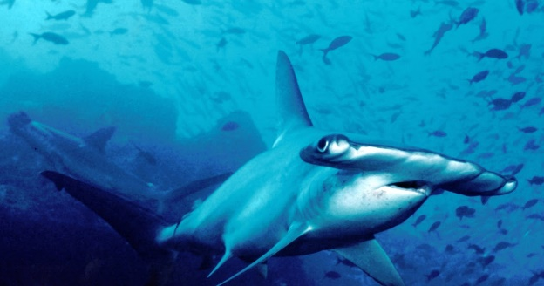
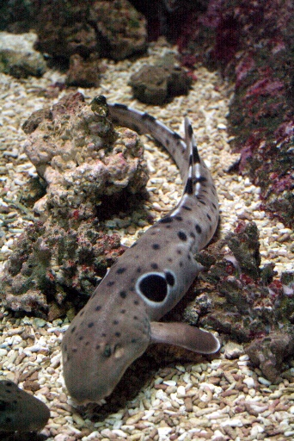
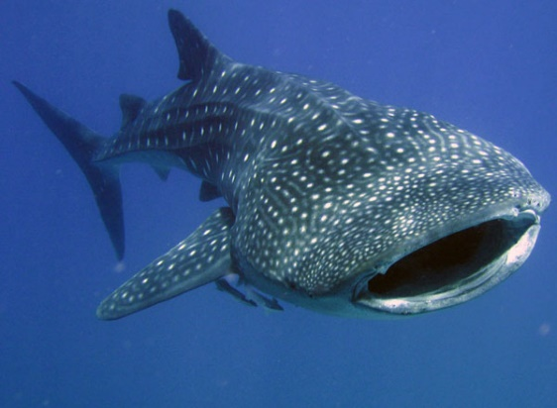
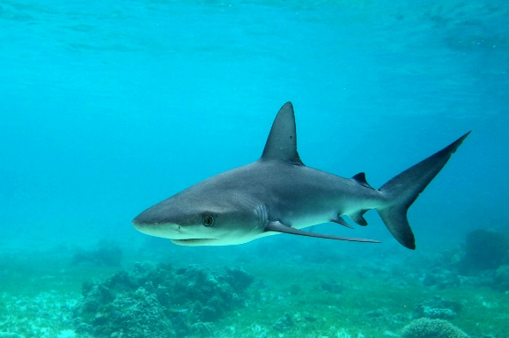
Which sharks did you see?
hammerhead shark
whale shark
walking shark
galapagos shark

Slide 5
LO: To write answers to questions
How many different sharks did you see?
Which was your favourite shark and why? Draw it in the box below.
Do you like sharks?

