Slide 2
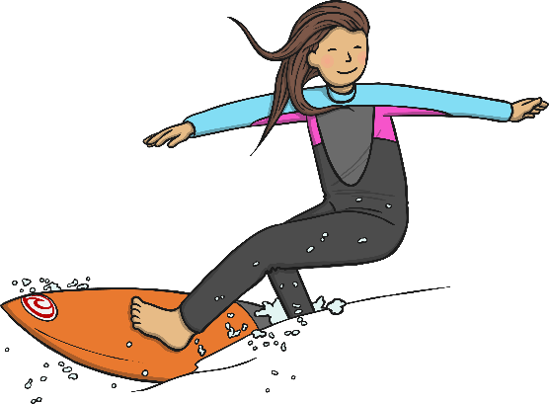
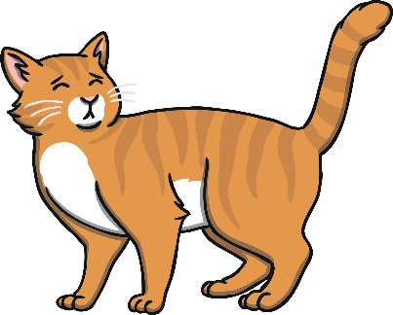
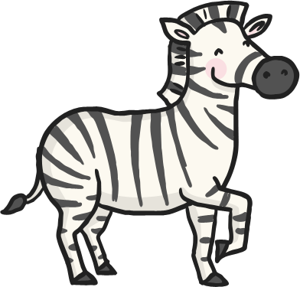

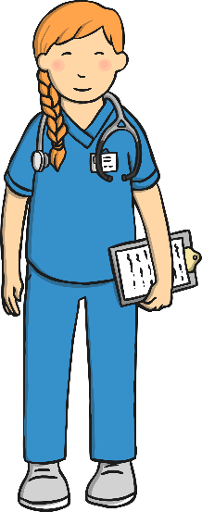

Click the pictures that contain the ‘ur’ sound to move them into the middle.
surf
ur
cat
zebra
burger
nurse
purple

Slide 3



ur
surf
cat
purple
zebra
burger
nurse

Slide 4
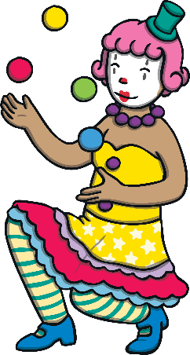
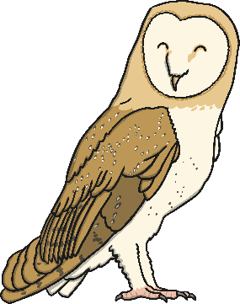

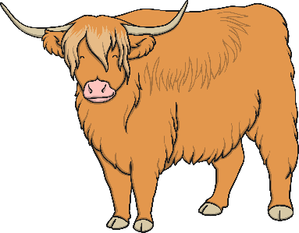

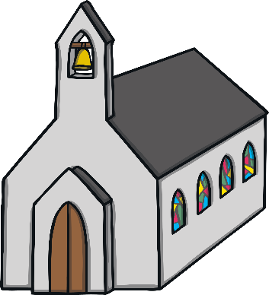
Click the pictures that contain the ‘ow’ sound to move them into the middle.
owl
clown
ow
bell
cow
crown
church

Slide 5



ow
owl
bell
cow
church
clown
crown

Slide 6

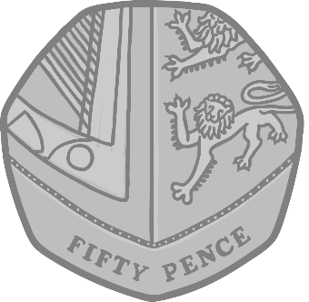

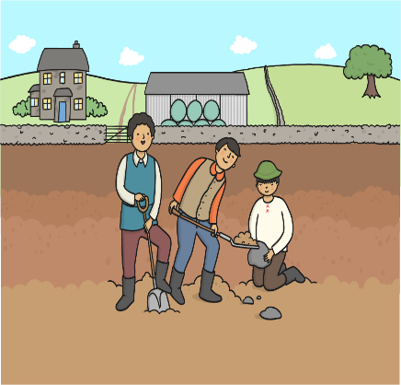


Click the pictures that contain the ‘oi’ sound to move them into the middle.
coin
fork
oi
soil
dig
poison
foil

Slide 7



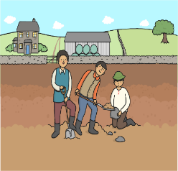
oi
coin
soil
fork
poison
foil
dig

Slide 8

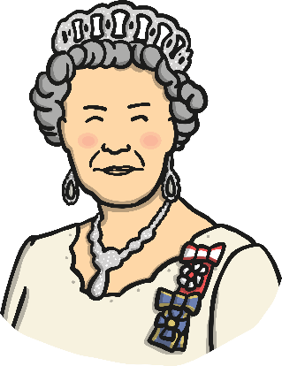


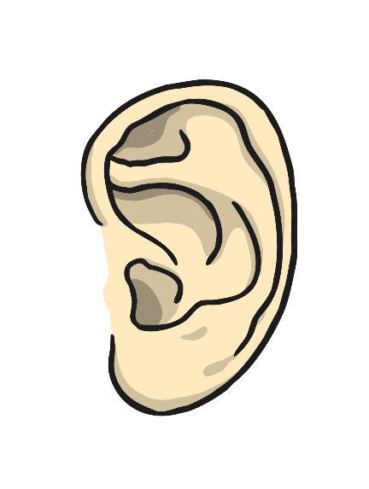

Click the pictures that contain the ‘ear’ sound to move them into the middle.
beard
queen
ear
gear
tear
ear
ring

Slide 9



ear
beard
gear
queen
ear
ring
tear

Slide 10

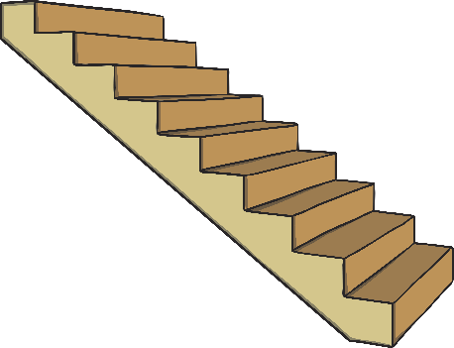
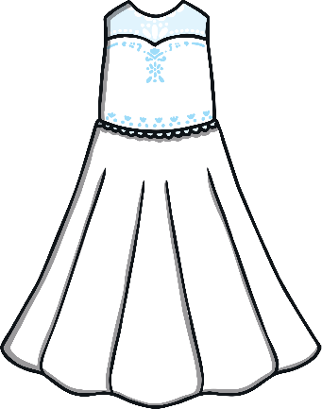
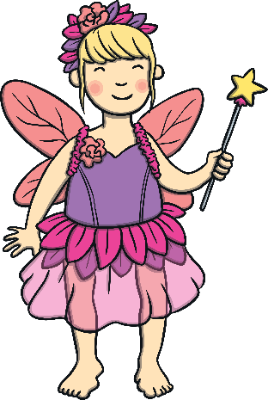

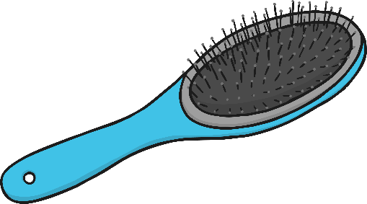
Click the pictures that contain the ‘air’ sound to move them into the middle.
stairs
chair
air
dress
fairy
ship
hairbrush

Slide 11



air
fairy
chair
dress
hairbrush
stairs
ship

Slide 12
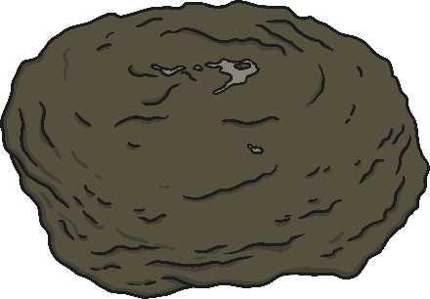





Click the pictures that contain the ‘ure’ sound to move them into the middle.
manure
rainbow
ure
vase
cure
shoes
secure

Slide 13



ure
manure
rainbow
vase
cure
shoes
secure

Slide 14

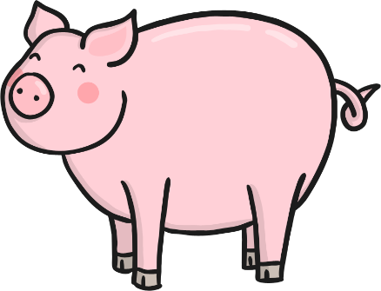

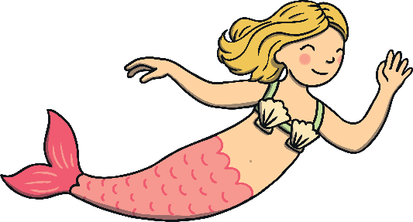
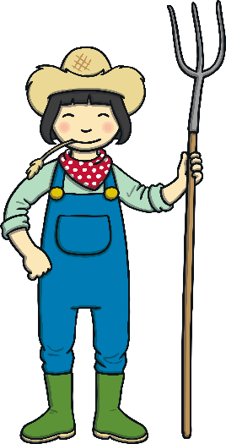

Click the pictures that contain the ‘er’ sound to move them into the middle.
ladder
pig
er
hammer
mermaid
frog
farmer

Slide 15



er
ladder
frog
mermaid
hammer
pig
farmer

Slide 16







ur
oi
air
er
ow
ear
ure

