Slide 1


Slide 3



1) On a number line, what number goes to the left of 31?
2) What number goes to the right of 31?
3) What hand do you draw with?
4) What shape is to the left of the cube?
31

Slide 4
1) On a number line, what number goes to the left of 31?
2) What number goes to the right of 31?
3) What hand do you draw with?
4) What shape is to the left of the cube?
30
31
32
right? left?
cone

Slide 6



How else can we describe position?
above
left
right
below

Slide 7





above
left
right
below

Slide 8
Have a go at question 1 on the worksheet

Slide 9



There is a balloon
above the bear.
Here is a bear.
There is a barrel
below the bear.

Slide 10

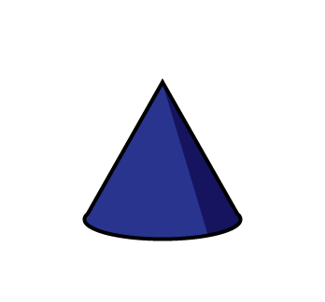

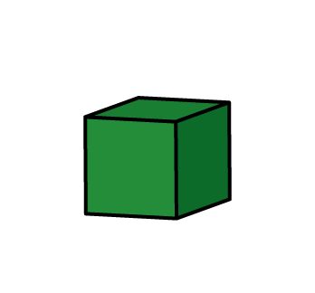
Have a think
The is above the
The is above the
The is below the
The is below the

Slide 11
Have a go at questions 2 and 3 on the worksheet

Slide 12
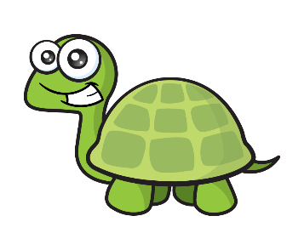

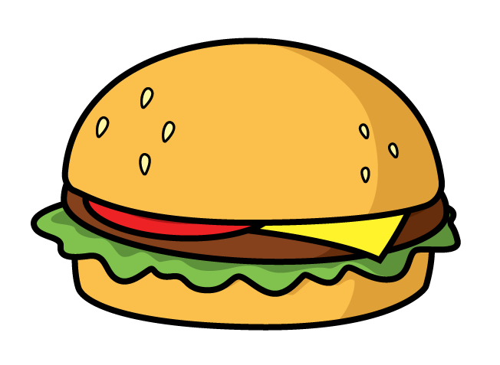


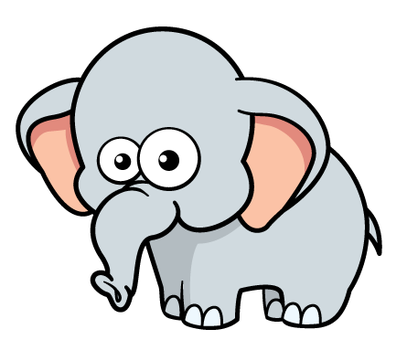
Have a think

Slide 13
Have a go at question 4 on the worksheet

