Slide 1
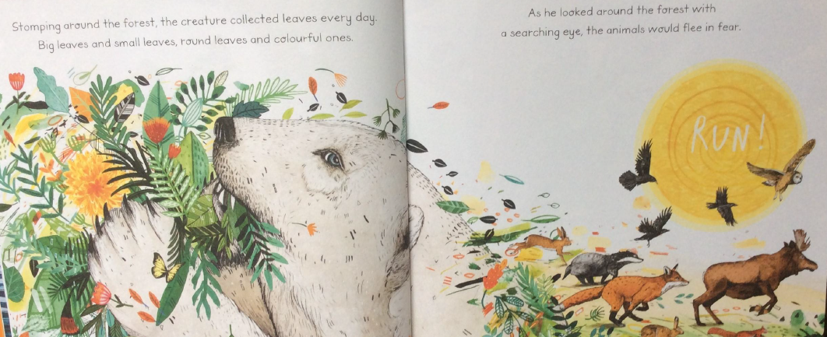
Leaf by Sandra Dieckmann
L.O. To answer questions about a story using evidence from the text and illustrations.
Read the extract from the book below.
Stomping around the forest, the creature collected leaves everyday. Big leaves and small leaves, round leaves and colourful ones. As he looked around the forest with a searching eye, the animals would flee in fear.
What word is used to describe how Leaf moves?
2. What adjectives (describing) words does the author use to describe the leaves?
3.How do you think Leaf felt when the animals ran away from him? Can you explain why?

