Slide 1
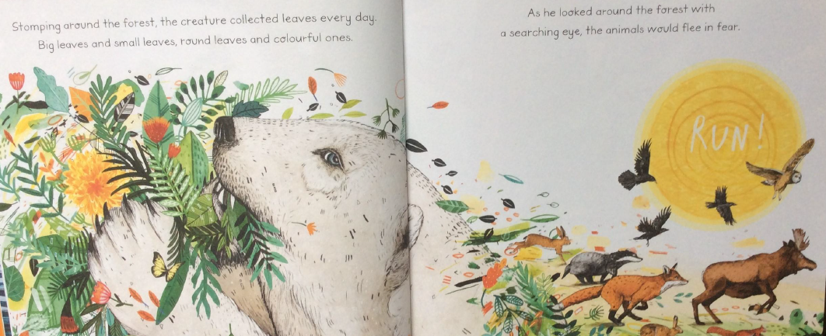
Leaf by Sandra Dieckmann
L.O. To answer questions about a story using evidence from the text and illustrations.
Read the extract from the book below.
Stomping around the forest, the creature collected leaves everyday. Big leaves and small leaves, round leaves and colourful ones. As he looked around the forest with a searching eye, the animals would flee in fear.
1.Why do you think the animal was collecting leaves?
2.What adjectives (describing words) does the author use to describe the leaves?
3.What word in the text tells you that the animals were running away from Leaf?

Slide 2
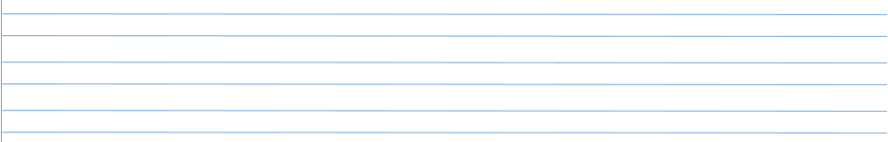
4. Why do you think the animals ran away from leaf?
5. What word in the text describes how Leaf moves around the forest?
6. How do you think Leaf felt when the other animals ran away from him?

