Slide 1


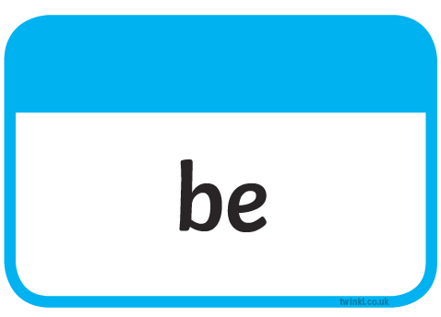
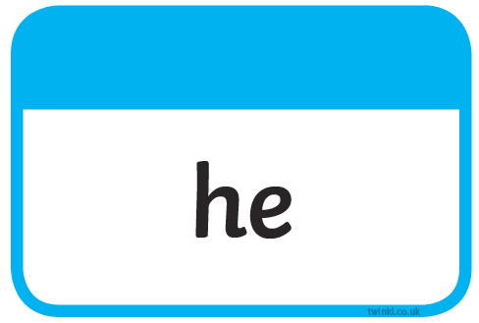





Slide 2
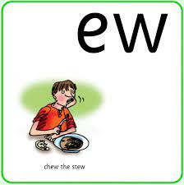
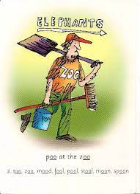
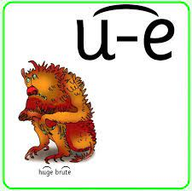
too
tune
chew
food
brute
grew

Slide 3
Our Set 3 phoneme for today is….ew
straw yawn
saw
claw
crawl
dawn

Slide 4

LO: To create language in the landscape of the mountains.
Wednesday
19th May 2021

Slide 5
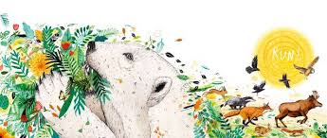
Let’s finish the story…
Leaf

Slide 6
An adjective is a describing word.

Slide 7

There was a spider in the bathroom.
+ adjectives =
There was a huge, hairy spider in the bathroom.

Slide 8

A slug was in my kitchen.
+ adjectives =
A slimy, sticky slug was in my kitchen.

Slide 9
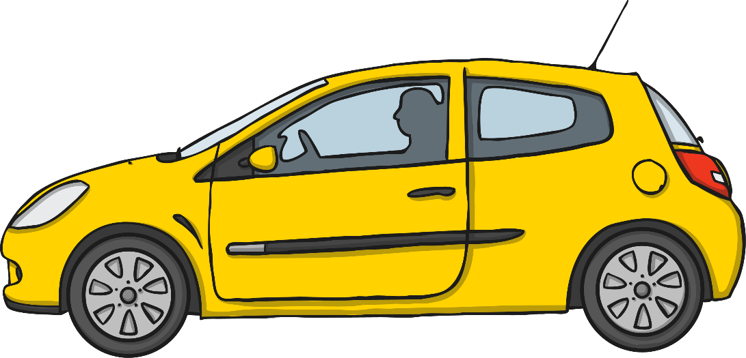
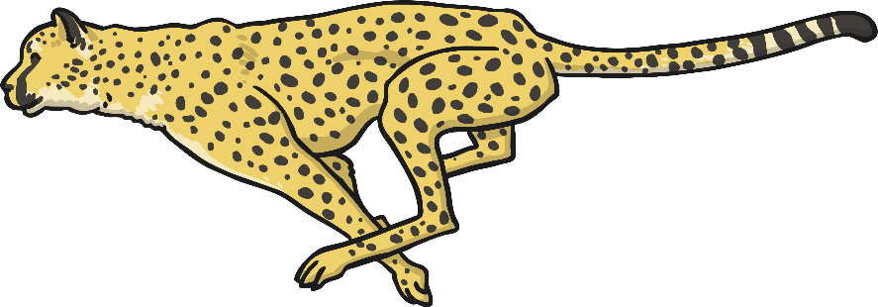
Simile Reminder
A simile is a way of describing something by comparing it to something else using ‘like’ or ‘as’.
Her eyes are like stars and her lips are like roses.
The car was as fast as a cheetah

Slide 10

Now you try…
Finish the similes:
The night was as black as ….
The fireworks were colourful like …
The book was as exciting as…
Greece was hot like …
The doll’s face was as smooth as …

Slide 11
Metaphor
Figurative – using or containing a non-literal sense of a word or words.
x
figurative
Metaphor is the device that compares something directly with something else in order to create a .
resemblance.
x
Resemblance – similar in appearance or quality to somebody or something else.

Slide 12
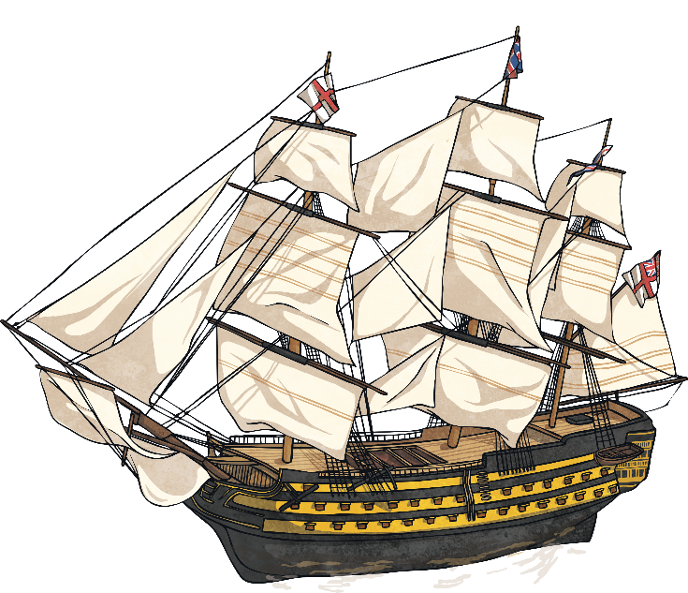
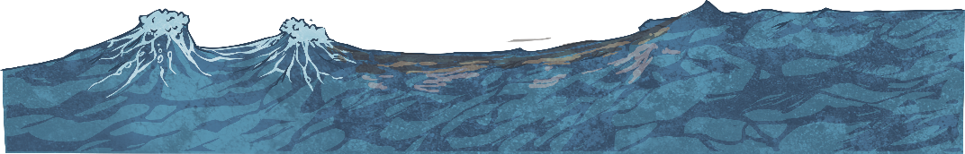
What Is It?
“The moon was a ghostly galleon, tossed upon cloudy seas.”
‘The Highwayman’, Alfred Noyes.
ghostly galleon
x
Image – a picture of something.
We know that a ship can’t be a ghost, but using this metaphor forms the eerie that Alfred Noyes wanted to create for the reader.
image

Slide 13
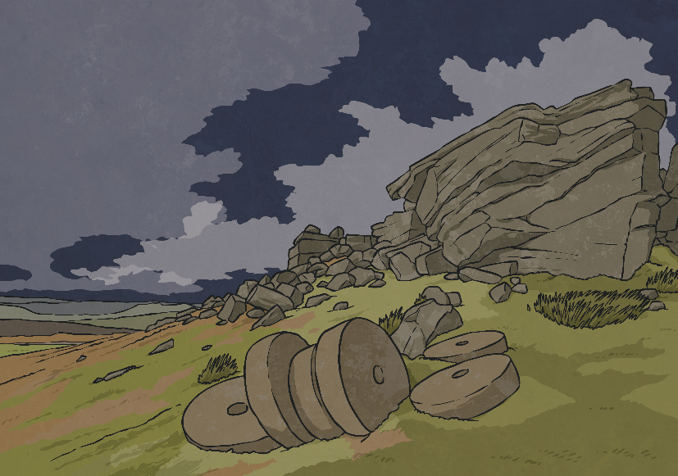
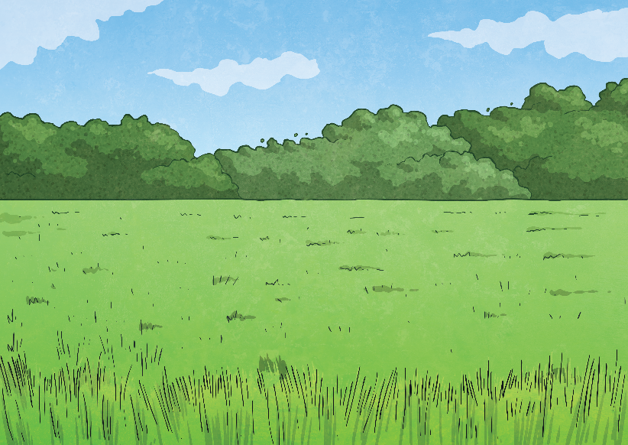
Why Use It?
Powerfully – able to produce a strong effect on people’s ideas or emotions.
Using metaphors enables the writer to and add description to something
economically
powerfully
specific.
Specific – exact and detailed.
Economically – efficiently, briefly or carefully.
What image does this extract from The Highwayman create for you: A or B? Tell me why.
“The road was a ribbon of moonlight over the purple moor,”
A
B

Slide 14
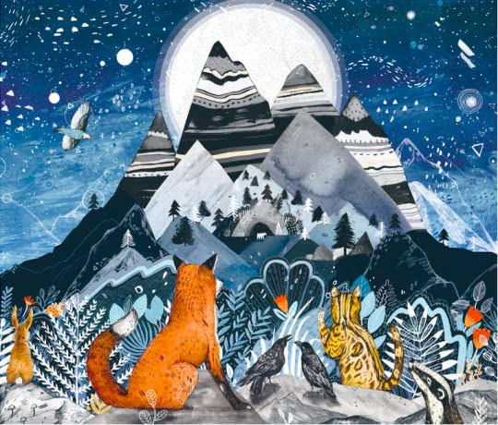
Let’s think about where Leaf sees the mountains.
What similies (comparing words using as / like) can you use to describe these things?
What nouns (things) can you see in this picture?
What adjectives (describing words) can you use to describe these things?
What metaphors (comparison words) can you use to describe these things?

Slide 15
Your
The beautiful stars were shining brightly (adjective)
The mountains were sharp as nails. (simile)
The black sky had lovely stars. (adjectives)
The prickly fir trees were tall. (adjectives)
The moon was a saucer of light above them. (metaphor)

Slide 16
Your task
1 Star – To write captions using adjectives to describe nouns in the picture.
2 Star – To write captions using adjectives AND similes to describe the nouns in the picture.
3 Star – To write captions using adjectives, similes and metaphors to describe the nouns in the picture.

