Slide 1
LO: To make a fairy door
Tuesday 18th May 2021

Slide 2
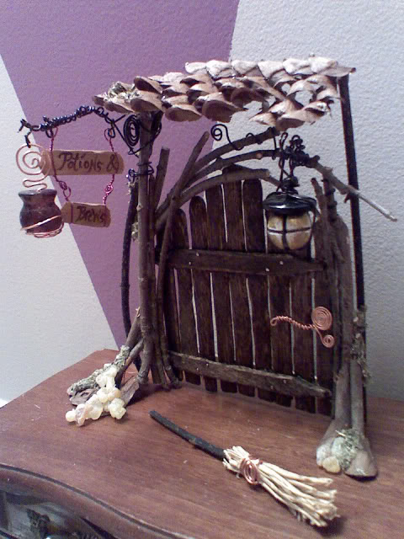
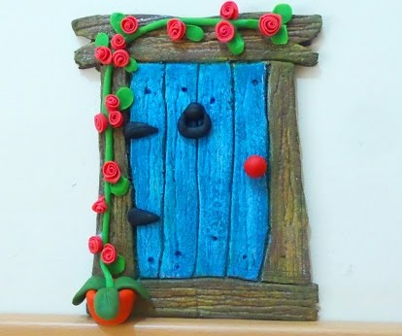
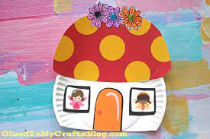
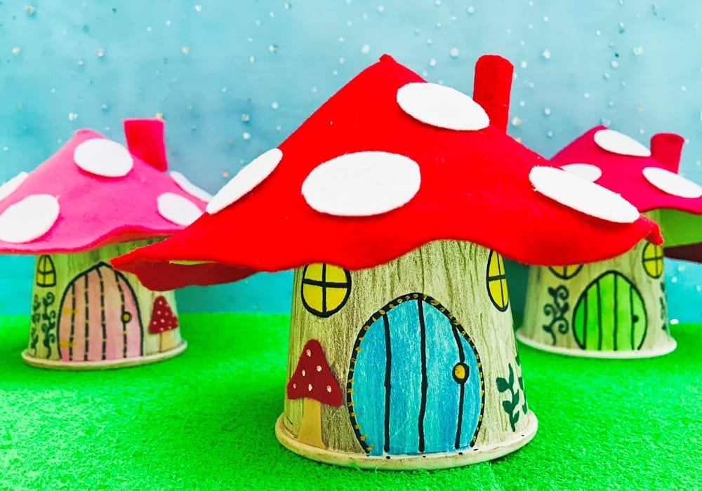
Today we will be making a fairy door!
Fairy doors allow fairies to visit you using the door. Doors can be made from different materials.
Natural materials such as wood.
Clay
Paper and card
Plastic (cup) and felt

Slide 3
Once you have made a fairy door there are a few things you can …
Leave miniature presents and letters for your fairy.
Make a fairy garden next to the door to attract the fairies.
You could leave your teeth next to the door to make it easier for Tooth Fairy to take them.
Tell the fairies your worries and they will listen.
NEVER EVER try to film, photograph or capture a fairy as they will become very, very angry.

Slide 4
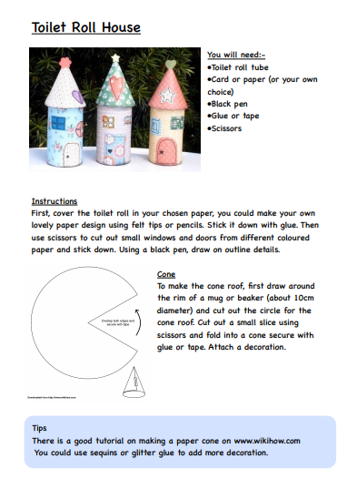
You can either make a toilet roll fairy house using the instructions on the sheet shown below which will be on the home learning page for today or follow the instructions to make a paper plate door.

Slide 5
Step 1:
Take 2 paper plates. Using a ruler draw a line at the bottom of one plate to make the main part of the house and half way through the second plate to make the roof.

Slide 6
Step 2:
Using scissors cut along the lines that you have drawn with pencil.

Slide 7
Step 3:
After that decorate the roof of the house using either paint, felt tips or coloured paper. Once decorated, you can stick the roof to the main part of the house. Make sure that you have left enough space for a door and some windows.

Slide 8
Step 4:
Next take some coloured card to make your fairy door. If you want the door to open fold a piece of card and attach it to the back of the door and the paper plate to make a hinge.

Slide 9
Step 5:
Finally you are ready to decorate your house by adding windows and flowers. Perhaps you could even draw a few fairies and hopefully you will meet a few real ones too.

