Slide 1
LO: To find out about Fairy Folk who live in the wood.
Monday 17th May 2021

Slide 2
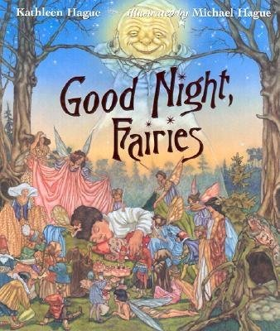
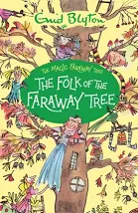
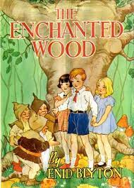
There are many stories about Fairy Folk who live in woodlands…

Slide 3
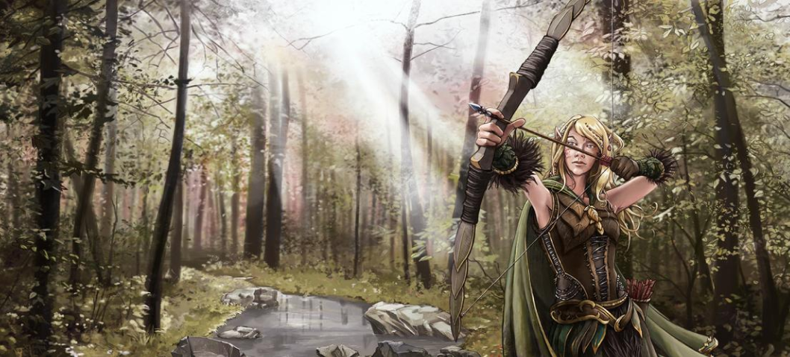
There are different types of fairy folk who live in woodlands.
Elves
The Elves were the fairest creatures in the woodland. They were a far more beautiful race than humans, and generally tall (about six feet). Elves had keener senses than Men. They were slender, graceful yet strong.

Slide 4
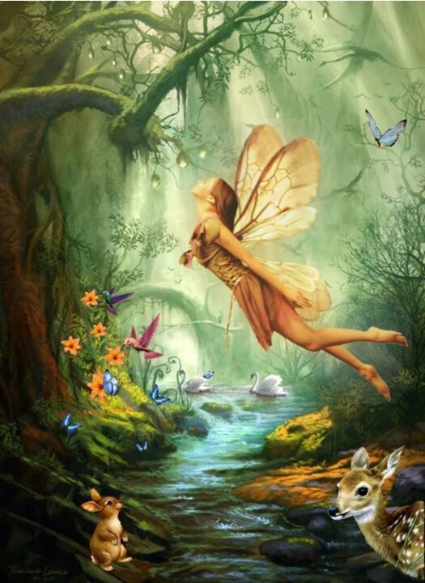
There are different types of fairy folk who live in woodlands.
Fairies
A fairy is a mythical, magical creature. Most fairies in stories are described as looking like tiny humans with wings.
Fairies are usually kind and lovely creatures with magical powers, although sometimes fairies are mischievous or even spiteful.

Slide 5
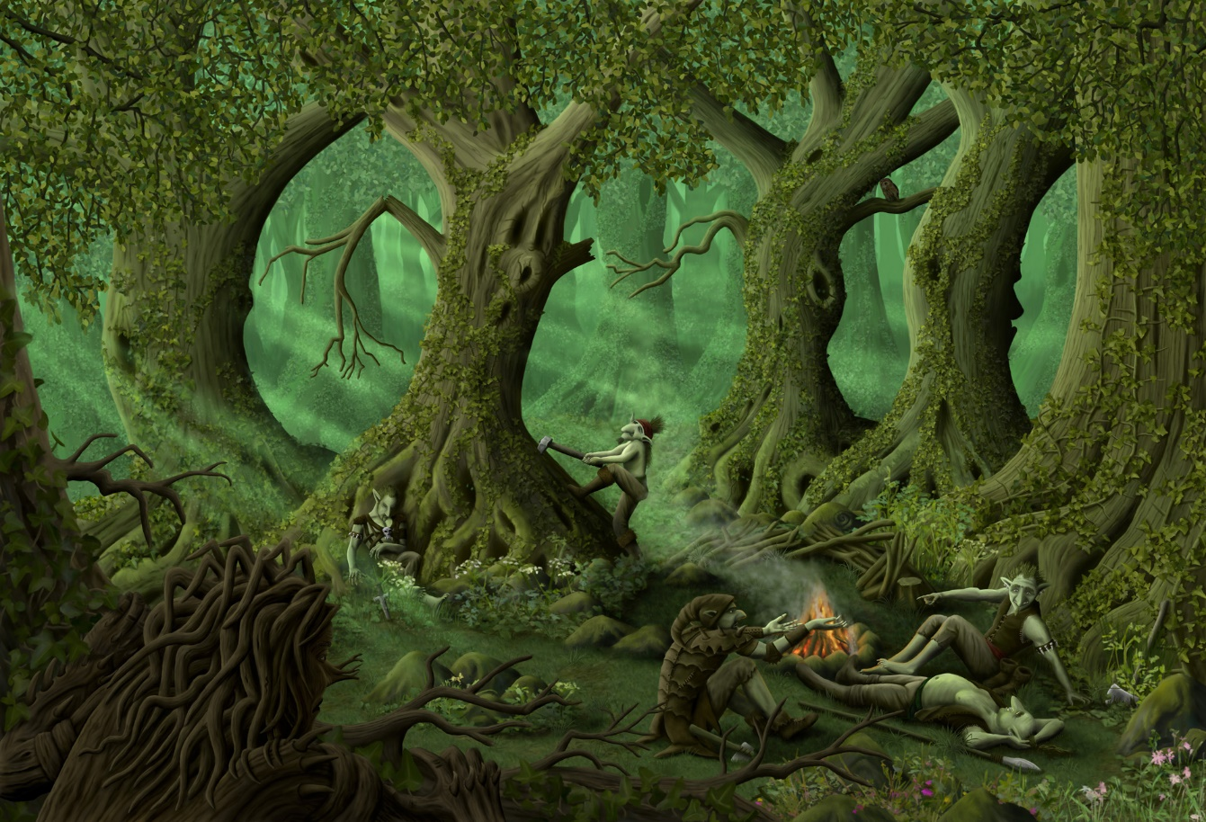
There are different types of fairy folk who live in woodlands.
Goblins
They are almost always small and grotesque, mischievous or outright malicious, and greedy, especially for gold and jewelry. They often have magical abilities similar to a fairy or demon.

Slide 6
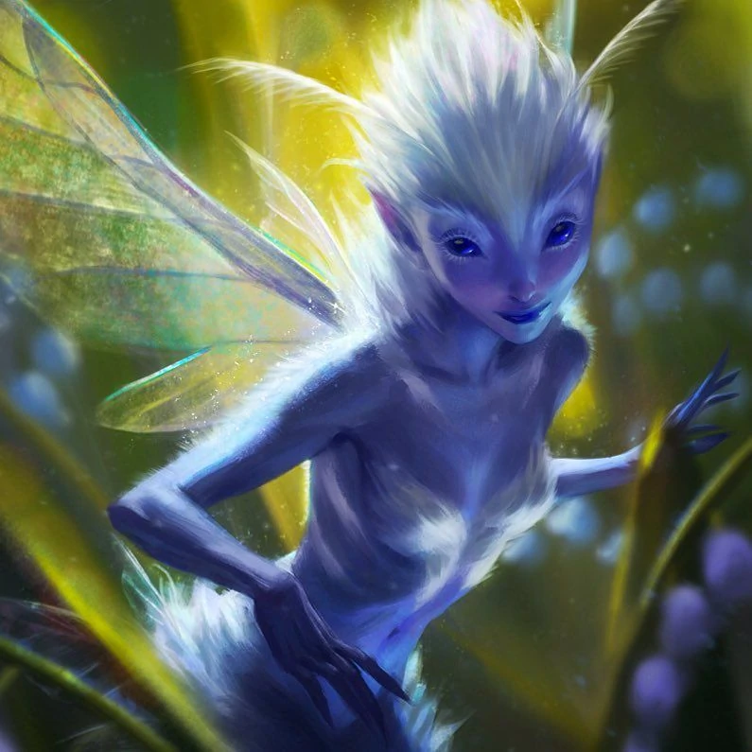
There are different types of fairy folk who live in woodlands.
Pixies
A pixie is a mythical creature that resembles a mischievous fairy. If you spy some adorable little sprites sneaking around the woods, you can bet that they're pixies.

Slide 7
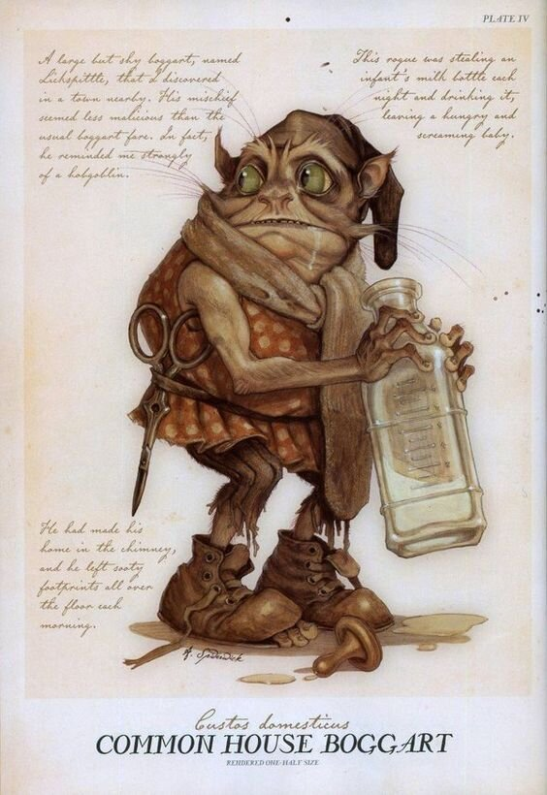
There are different types of fairy folk who live in woodlands.
Boggart
A Boggart is a shape-shifting creature that will assume the form of whatever most frightens the person who encounters it. Boggarts particularly like confined spaces, but may also be found lurking in woods and around shadowy corners. The more generally fearful a person is, the more susceptible they will be to Boggarts.

Slide 8
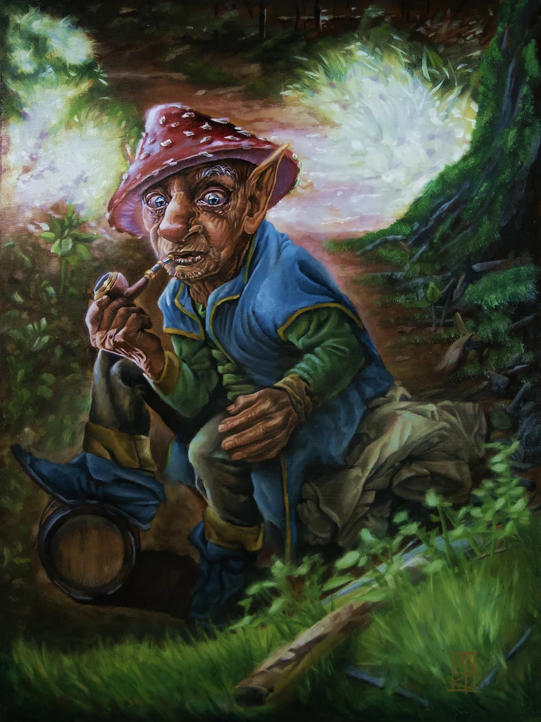
There are different types of fairy folk who live in woodlands.
Gnome
Gnome, in folklore is a dwarfish, earth spirit who guards mines of precious treasures hidden in the earth.
He is shown in mythologies as a small, physically deformed (usually hunchbacked) creature resembling a dry, gnarled old man.

Slide 9
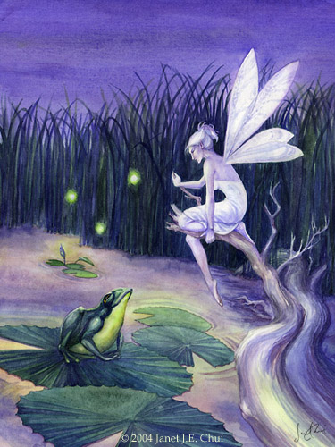
There are different types of fairy folk who live in woodlands.
Water Sprite
A sprite believed to inhabit or haunt water it can be called a water nymph too.

Slide 10
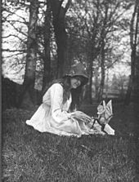
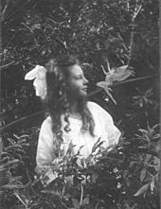
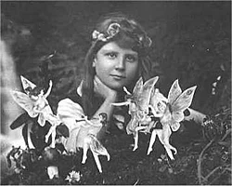
The Cottingley Fairies are in a series of five photographs taken by Elsie Wright and Frances Griffith.
They were two cousins who lived in Cottingley, near Bradford in England.
In 1917, when the first two photographs were taken, Elsie was 16 years old and Frances was 9.

Slide 11
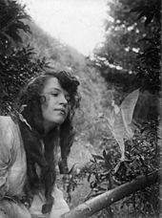
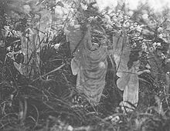
People din’t know whether to believe these pictures. What do you think?

Slide 12
In your pairs talk about if you believe these photos?
Do you think ‘woodland folk’ exist?

Slide 13
Your Task:
To write about whether you believe in the fairy photos.
Can you explain why you believe or not?
I believe the photos are real because…
I don’t believe the photos are real because…

