Slide 1


Maths
Addition and Subtraction
Year One
Maths | Addition and Subtraction | Exploring Number Facts | Lesson 1 of 8: Find and Recall Number Facts up to 4

Slide 2
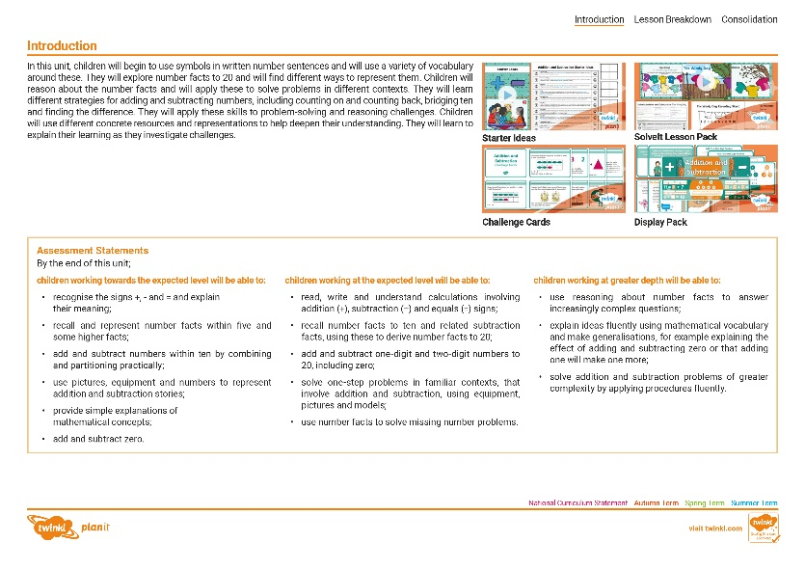
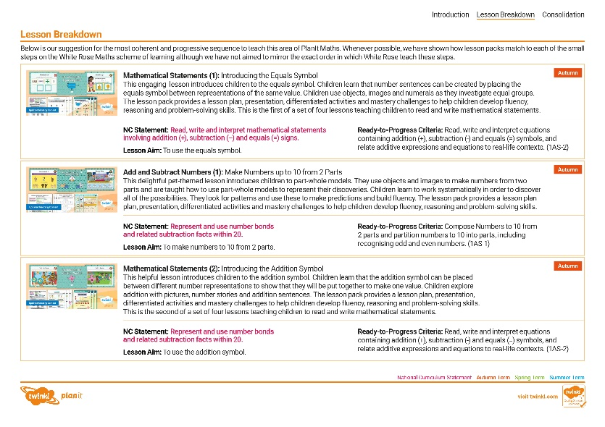
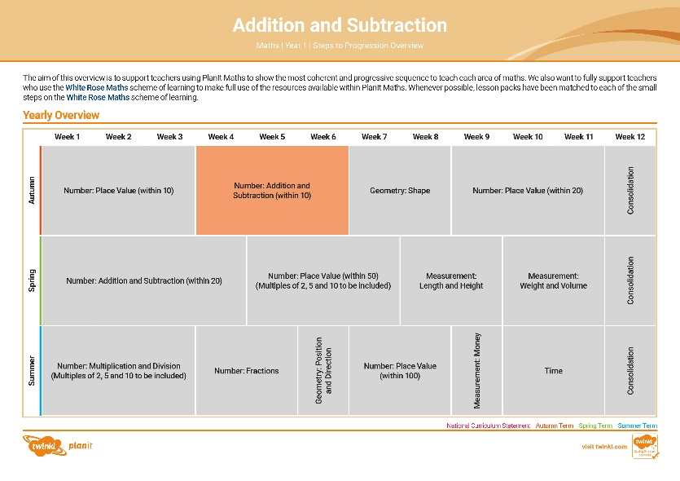

Need a coherently planned sequence of lessons to complement this resource?
See our Addition and Subtraction Steps to Progression document.
Twinkl PlanIt is our award-winning scheme of work with
over 4000 resources.

Slide 4
Aim
To find and recall number facts up to 4.
Success Criteria
I can find number facts up to 4 by adding 2 numbers.
I can recall number facts up to 4.
I can work systematically to find all possibilities.

Slide 5



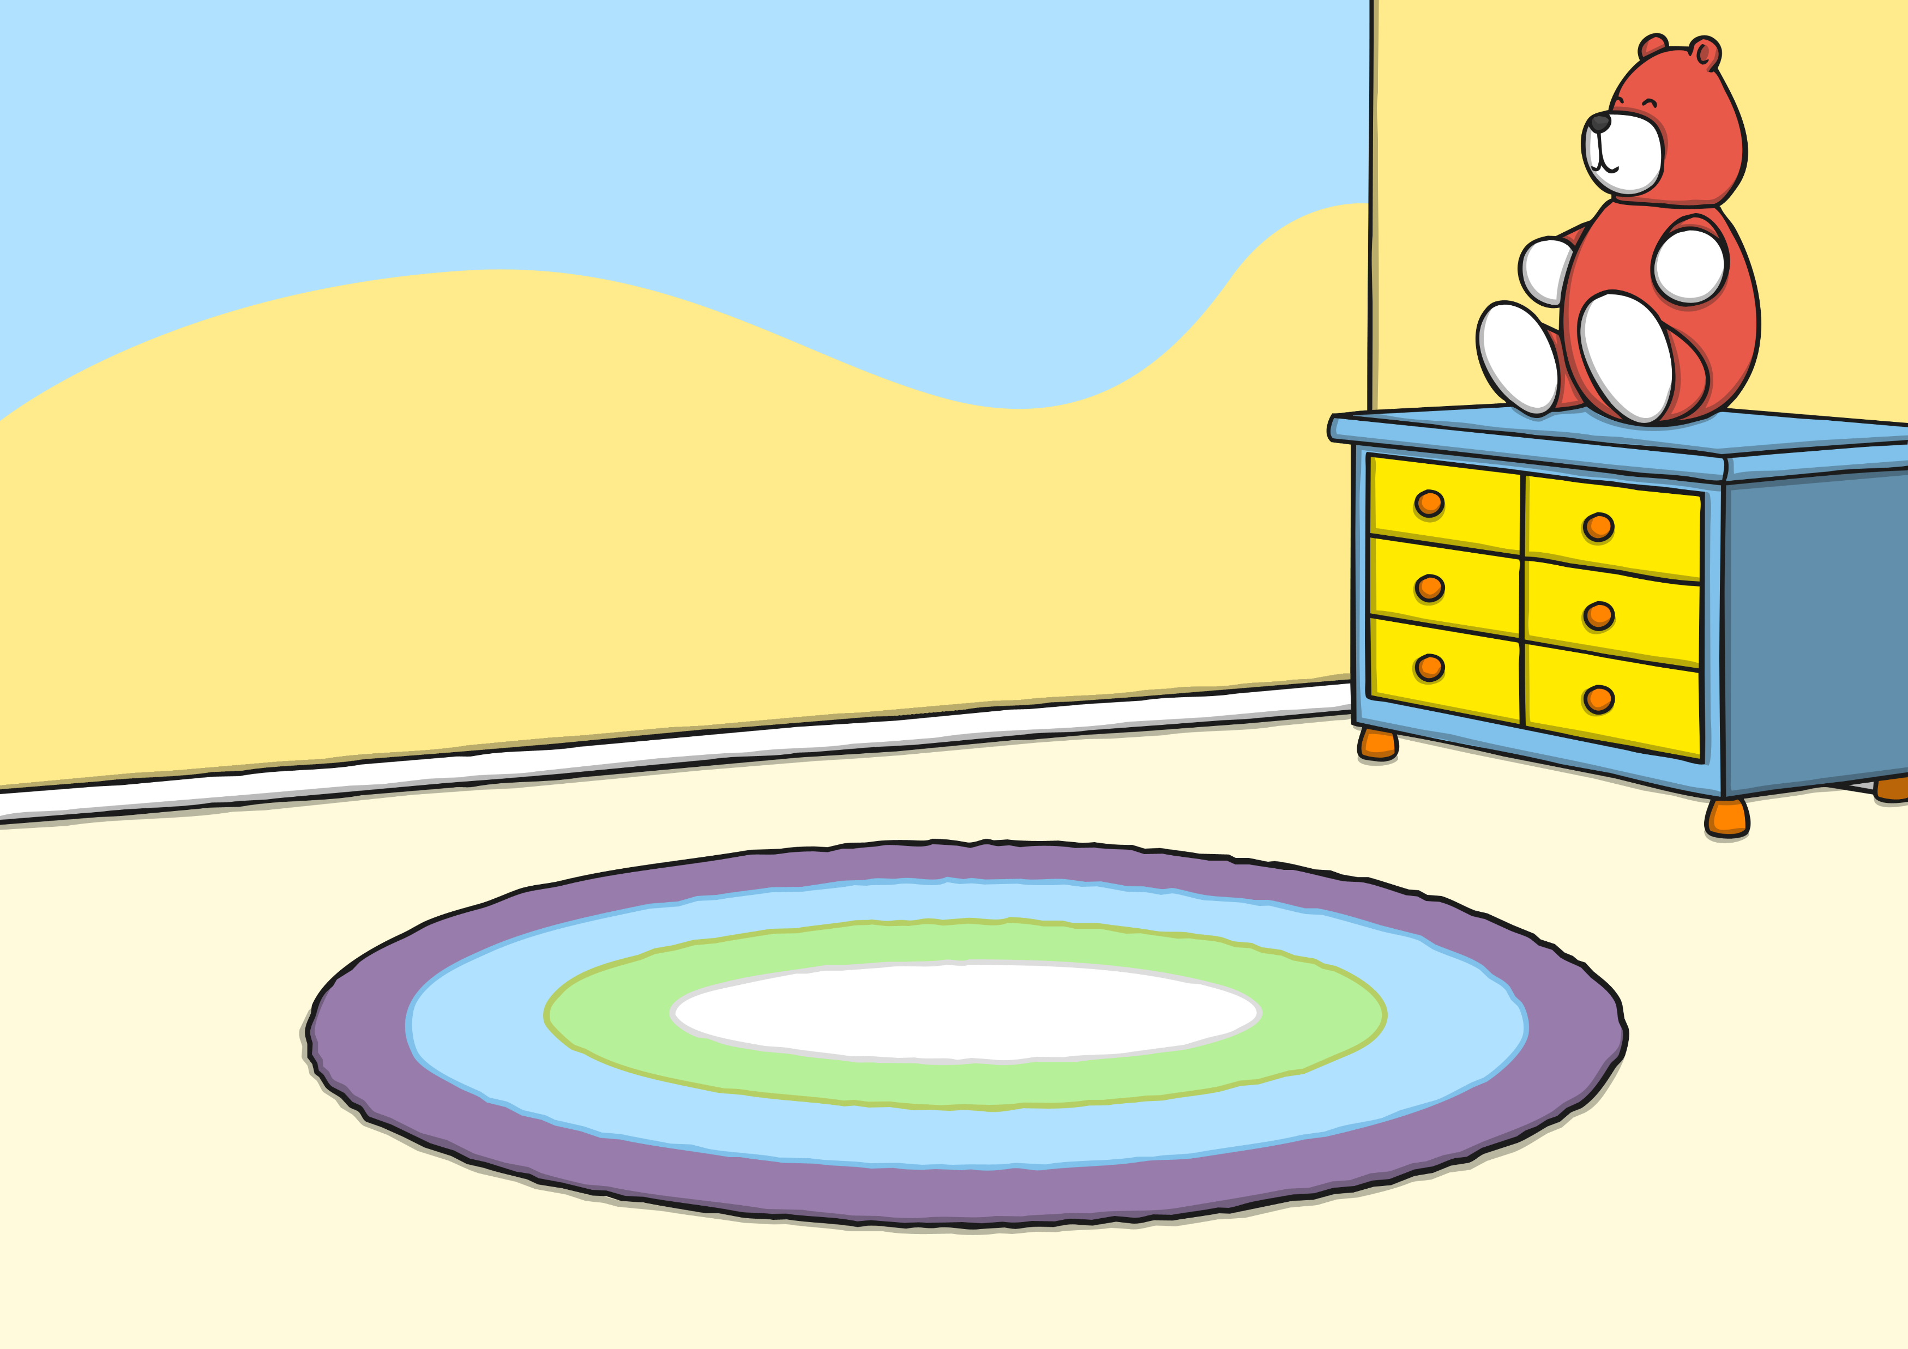



Remember It
When you see a numeral, hold up the correct number of fingers.
2
Here are some different ways to show the same number.

Slide 6


Remember It
When you see a numeral, hold up the correct number of fingers.
4
Can you find another way to show 4 fingers?

Slide 7

Remember It
When you see a numeral, hold up the correct number of fingers.
0
Did we catch you out?

Slide 8


Remember It
When you see a numeral, hold up the correct number of fingers.
3
Which fingers did you use?

Slide 9
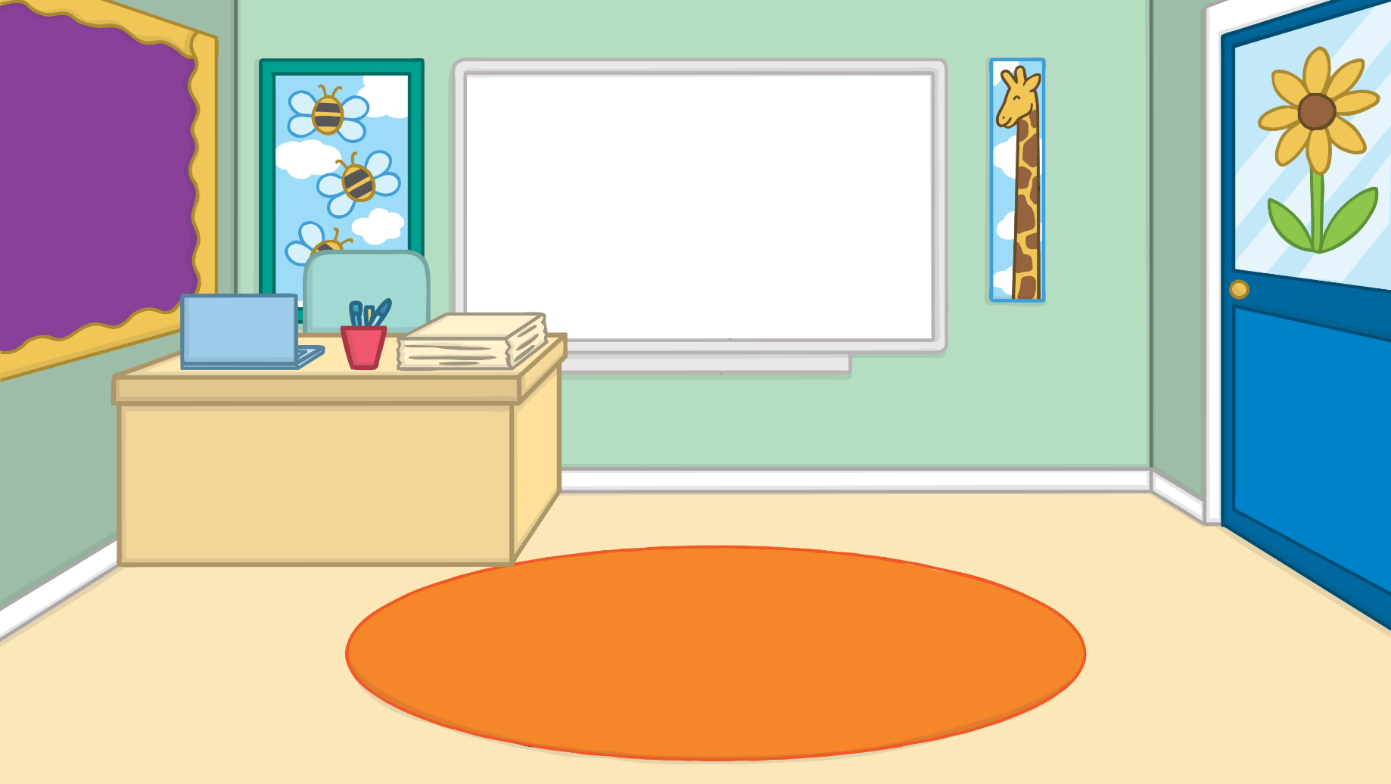


Remember It
The hand will show a number.
Write the matching numeral on your board.
0

Slide 10
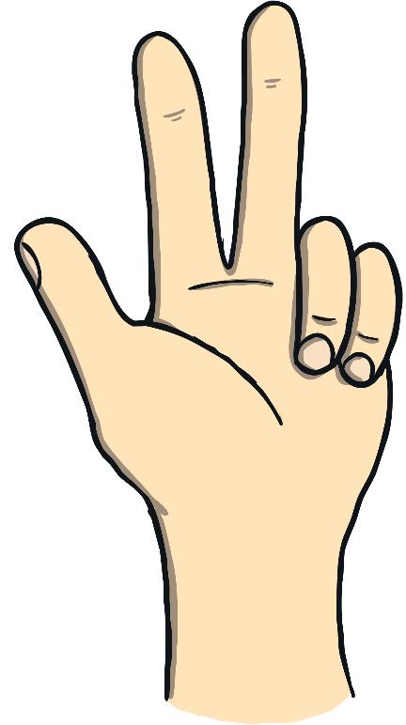
Remember It
The hand will show a number.
Write the matching numeral on your board.
3

Slide 11

Remember It
The hand will show a number.
Write the matching numeral on your board.
4

Slide 12


Remember It
The hand will show a number.
Write the matching numeral on your board.
2

Slide 13
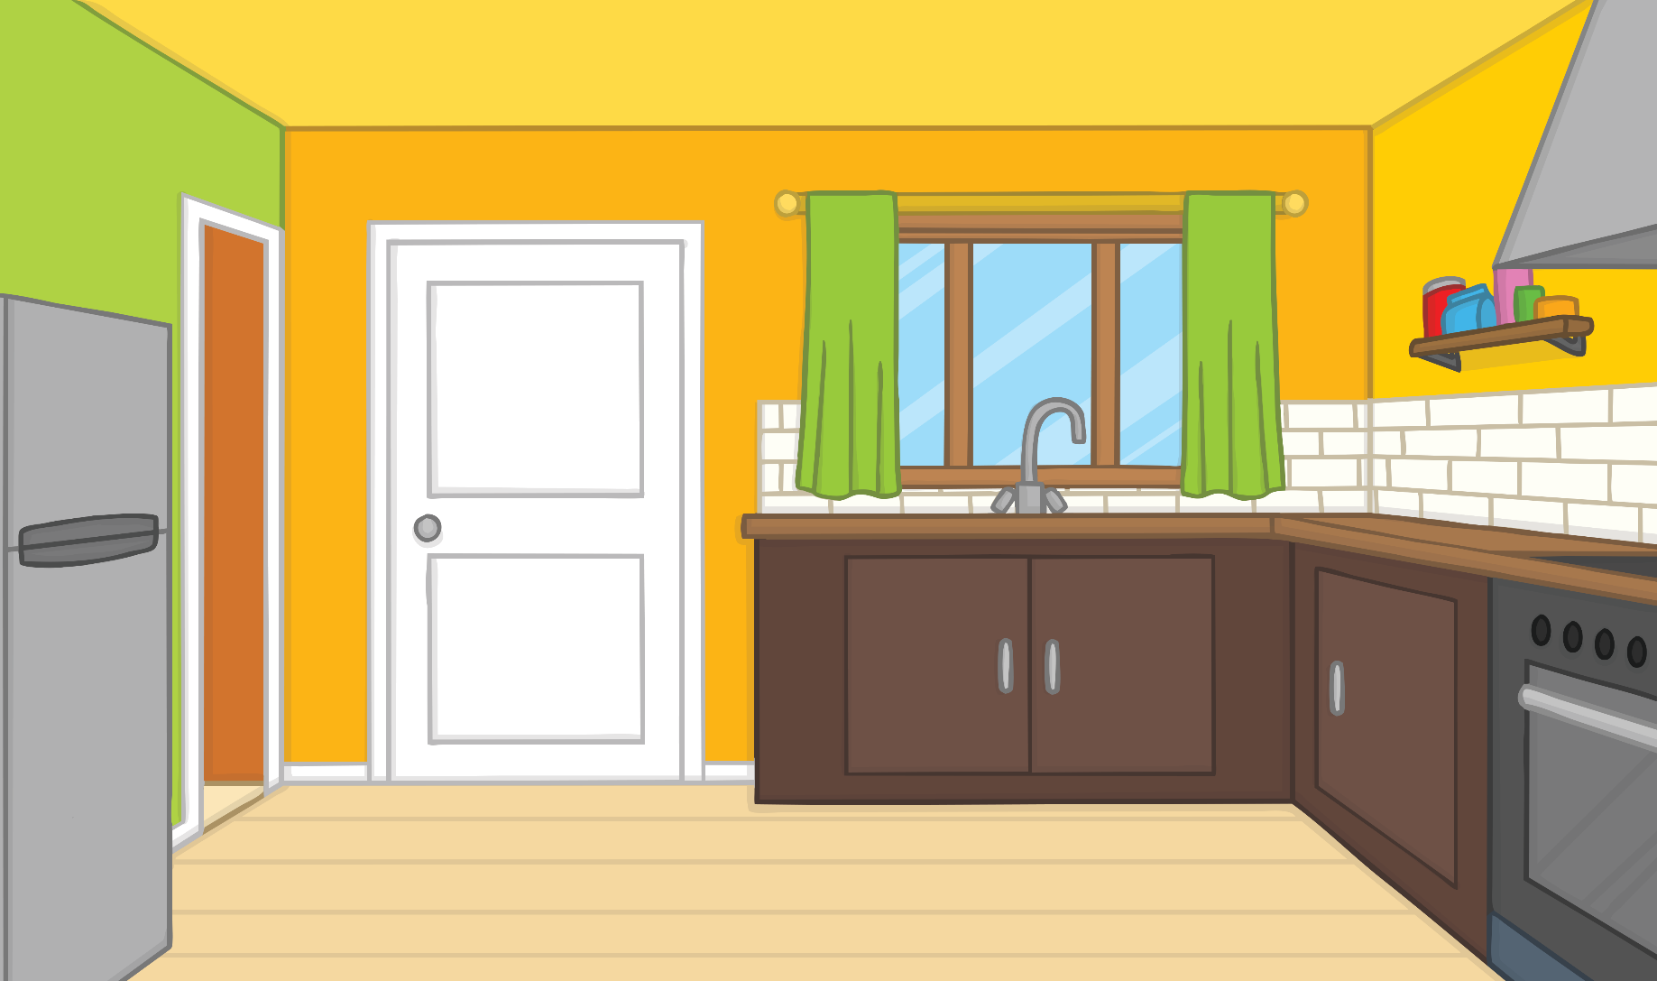
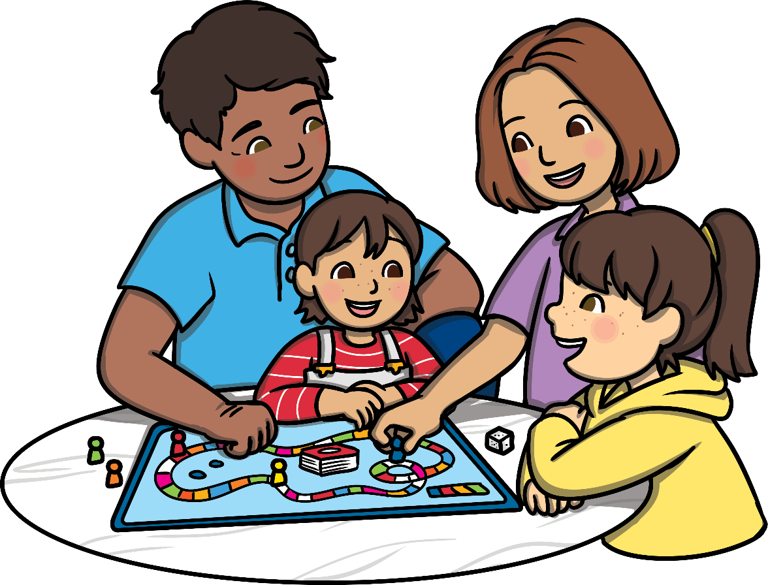
Spin to Win
I need to move 1 space to win the game.
I need to move 2 spaces to win.
I need to move 3 spaces to win.
I need to move 4 spaces to finish the game.

Slide 14



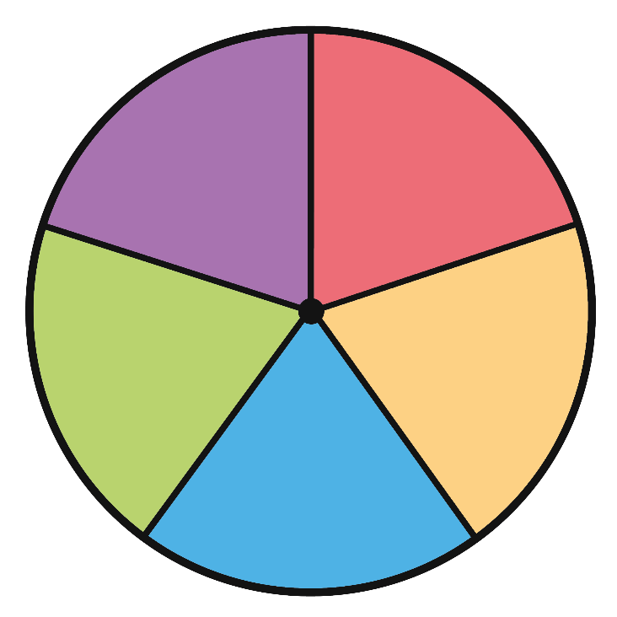
Spin to Win
How can I make 1 from 2 spins?
1 + 0 = 1
0 + 1 = 1
What do you notice about the numbers?
1 + 0 have swapped over to 0 + 1

Slide 15

Spin to Win
I can make the number 1 from 2 parts like this.
1 + 0 = 1
0 + 1 = 1

Slide 16
Spin to Win
That’s just 1 number fact to remember.
Because 1 + 0 is the same as 0 + 1.
1 + 0 = 1
1
1
0

Slide 17
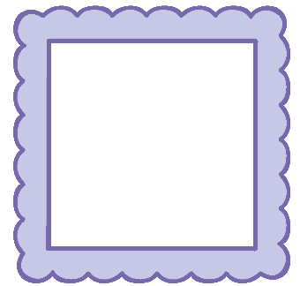

Spin to Win
How can I make the number 2 from 2 spins?
2 + 0 = 2
1 + 1 = 2
0 + 2 = 2
What do you notice about the numbers?
2 + 0 has swapped over to 0 + 2

Slide 18
Spin to Win
I can make the number 2 from 2 parts like this.
2 + 0 = 2
0 + 2 = 2
1 + 1 = 2

Slide 19
Spin to Win
That’s just 2 number facts to remember.
Because 2 + 0 is the same as 0 + 2.
2 + 0 = 2
1 + 1 = 2
2
2
0
2
1
1

Slide 20


Spin to Win
How can I make the number 3 from 2 spins?
3 + 0 = 3
2 + 1 = 3
1 + 2 = 3
0 + 3 = 3
What number patterns can you see?

Slide 21


Spin to Win
I can make the number 3 from 2 parts like this.
3 + 0 = 3
2 + 1 = 3
1 + 2 = 3
0 + 3 = 3

Slide 22
Spin to Win
That’s just 2 number facts to remember.
Because 3 + 0 is the same as 0 + 3 and 1 + 2 is the same as 2 + 1
3 + 0 = 3
2 + 1 = 3
3
3
0
3
1
2

Slide 23

Spin to Win
How can I make the number 4 from 2 spins?
4 + 0 = 4
3 + 1 = 4
2 + 2 = 4
1 + 3 = 4
0 + 4 = 4
The word systematic means a system or pattern
has been used. Has a system or pattern been used here?

Slide 24

Spin to Win
I can make the number 4 from 2 parts like this.
4 + 0 = 4
3 + 1 = 4
2 + 2 = 4
1 + 3 = 4
0 + 4 = 4
Working in a systematic way can help us find all the possible answers. It makes it easier to check our work too.

Slide 25
Spin to Win
That’s just 3 number facts to remember.
Because 4 + 0 is the same as 0 + 4 and 1 + 3 is the same as 3 + 1
4 + 0 = 4 3 + 1 = 4 2 + 2 = 4
4
4
4
0
4
1
3
2
2

Slide 26

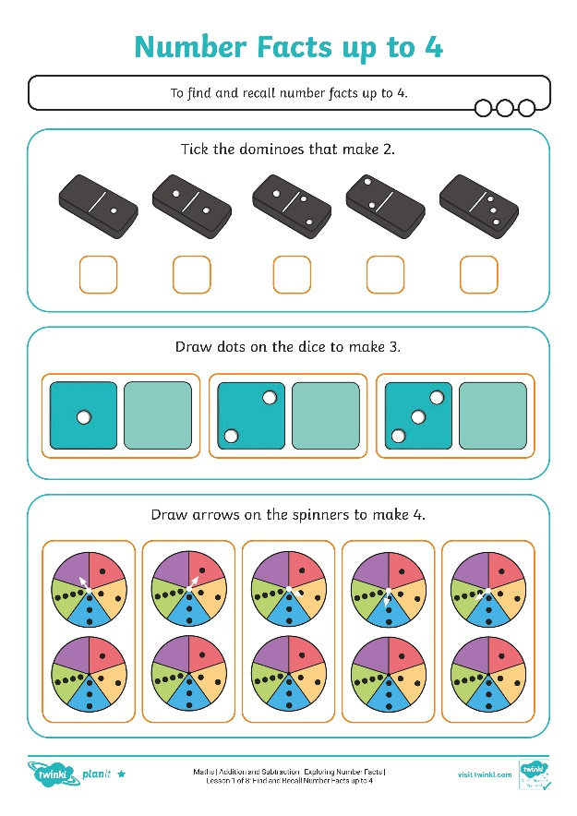
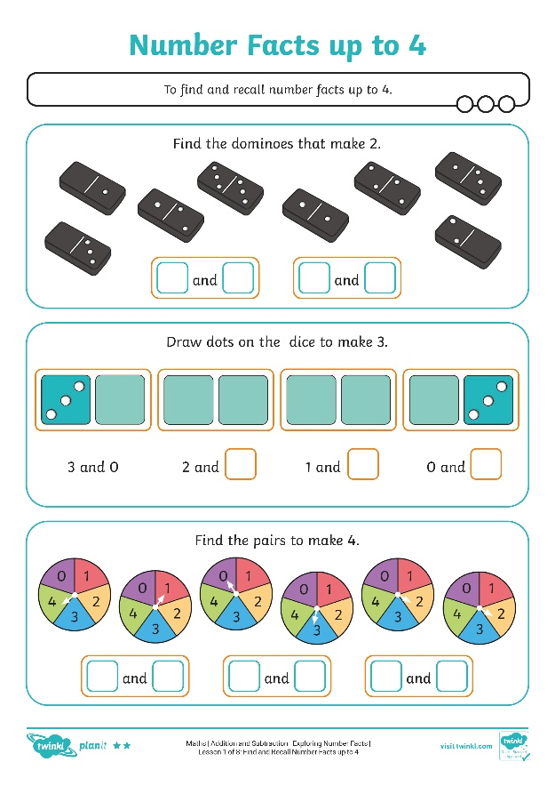
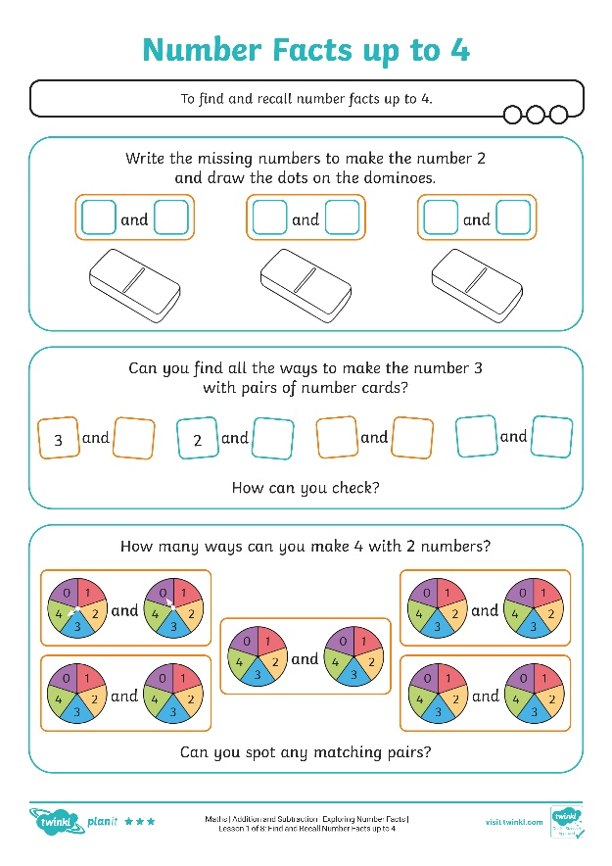
Number Facts up to 4
Find different ways to make numbers up to 4 from 2 parts.

Slide 27

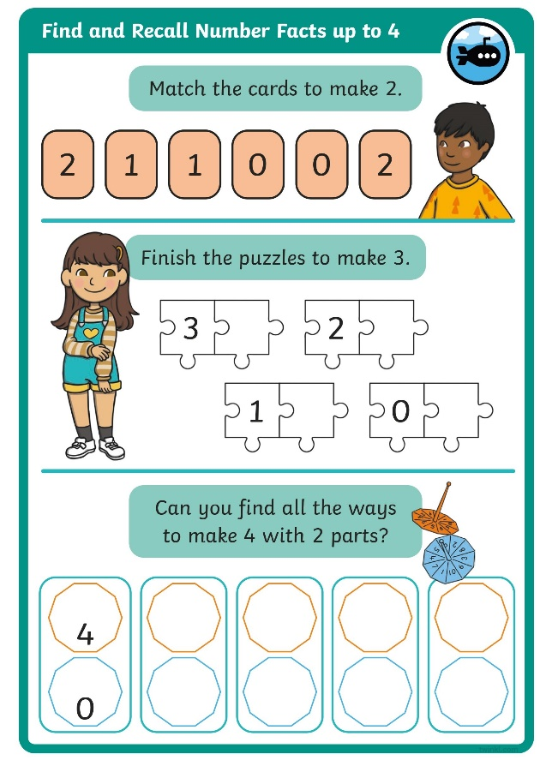
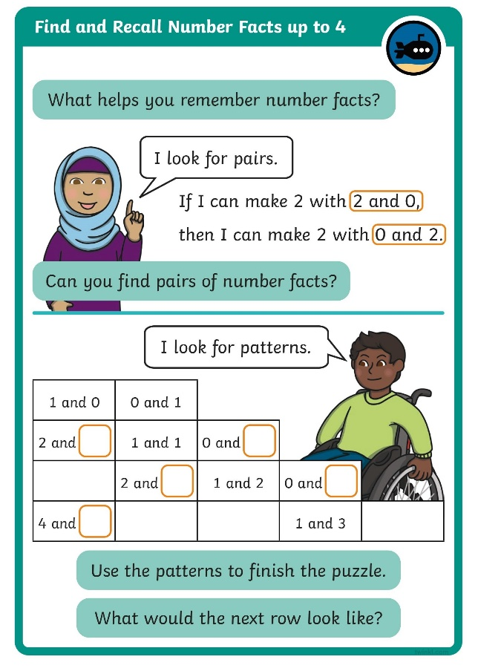
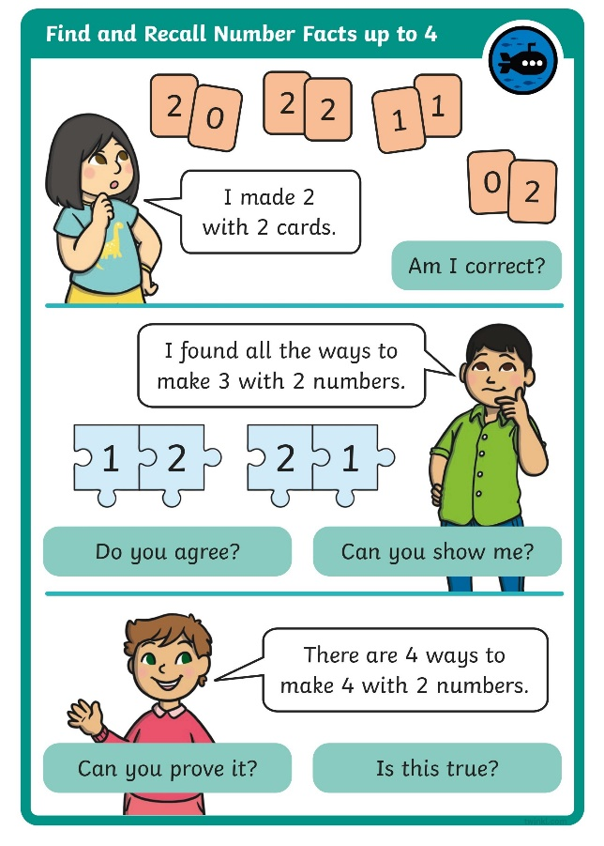
Diving into Mastery
Dive in by completing your own activity!

Slide 28

Fact Finder
Can you remember how to make the number 1 from 2 parts?
Jot your ideas on a whiteboard.
1 + 0 = 1

Slide 29
Fact Finder
How do you make the number 2 from 2 parts?
Jot your ideas on a whiteboard.
2 + 0 = 2
1 + 1 = 2

Slide 30


Fact Finder
How do you make the number 3 from 2 parts?
Jot your ideas on a whiteboard.
3 + 0 = 3
2 + 1 = 3

Slide 31

Fact Finder
Can you remember how to make the number 4 from 2 parts?
Jot your ideas on a whiteboard.
4 + 0 = 4
3 + 1 = 4
2 + 2 = 4

Slide 32

Super Spin
When the spinner points to a number,
show the number of fingers you need to add to it to make 4.
0
4 + 0 = 4
Click to spin!
number
fingers
calculation
Spin again!

Slide 33

Super Spin
When the spinner points to a number,
show the number of fingers you need to add to it to make 4.
2
2 + 2 = 4
Spin again!
number
fingers
calculation

Slide 34

Super Spin
When the spinner points to a number,
show the number of fingers you need to add to it to make 4.
3
1 + 3 = 4
Spin again!
number
fingers
calculation

Slide 35

Super Spin
When the spinner points to a number,
show the number of fingers you need to add to it to make 4.
1
3 + 1 = 4
Finish!
number
fingers
calculation

Slide 36
Aim
To find and recall number facts up to 4.
Success Criteria
I can find number facts up to 4 by adding 2 numbers.
I can recall number facts up to 4.
I can work systematically to find all possibilities.

