Slide 1
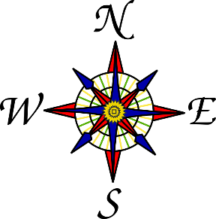


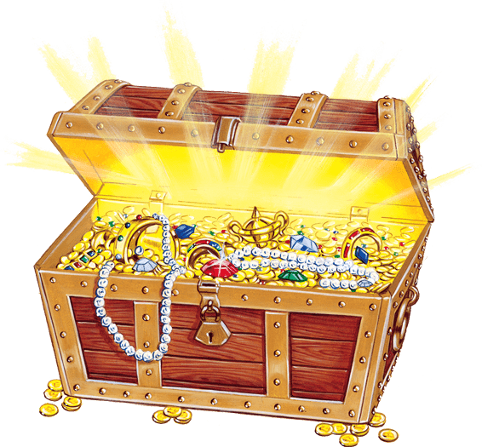

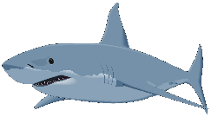
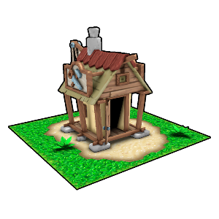
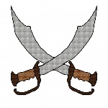

forwards
turn
backwards
steps
pirate ship
treasure chest
palm tree
shark
pirate shack
pirate swords
parrot

Slide 2
Position and Direction
Draw an outline of an island within the boxes, make sure you leave space around the side for sea objects.
Draw 5 objects onto the map including the chest.
Think about how you could direct someone to the chest from the starting point of Pirate Sam.
Write your instructions using the terms steps, turn, forwards and backwards to get to the chest.
Use the directional language North, South, East and West.

