Slide 1


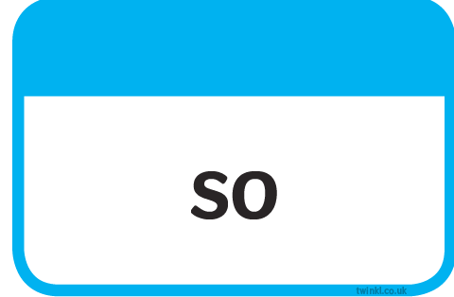








Slide 2
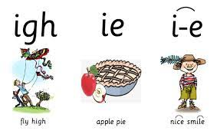
slight
spice
tied
bride
slide
fried
sighed
pride

Slide 3
LO: To act out the Market Scene from the play.
Wednesday 30th June 2021

Slide 4
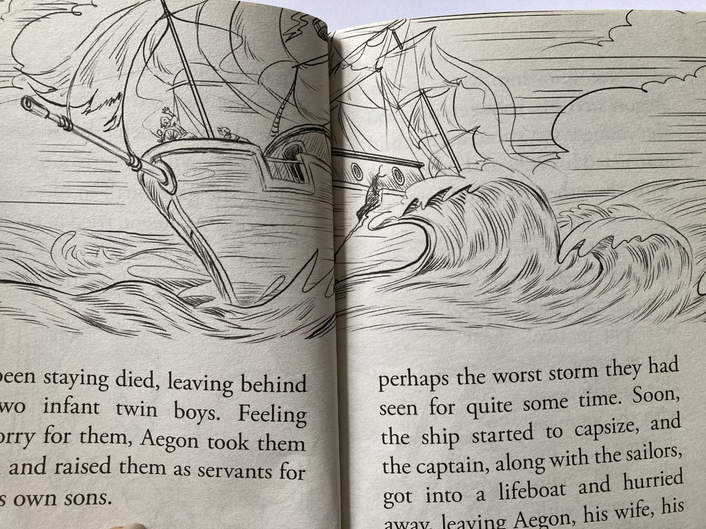
First let’s read about what happens to the two sets of twins.
Read to p.21.
The two sets
of twins were
separated from
each other in
a storm.
Then read to p.31

Slide 5

You will be acting out the ‘Market’ scene.
You will be put into groups to act out parts of the scene.
You will need to read your ‘lines’ from a script, taking it in turns to hear what the other says and then saying your line back.
You will be asked to try to learn these as best you can ready for your ‘performance’ tomorrow.

Slide 6
What is a script?
This is how ‘scripts’ work.
Group 1 Child 1: FIRST MERCHANT
Say that you are from Epidamnum, or you will be killed. A man from Syracuse was arrested for coming here. Here is the money you asked me to get for you.
Which characters can you see are in this scene?
Group 1 Child 2: ANTIPHOLUS OF SYRACUSE
Dromio, take this money to the Inn and wait there until I come. I go for a walk and then come for lunch. I’m stiff and tired from all this travel. Get going now.
What does ‘exits’ mean?
Group 1 Child 3: DROMIO OF SYRACUSE
Most men would run away with all this money.
DROMIO OF SYRACUSE exits.

Slide 7
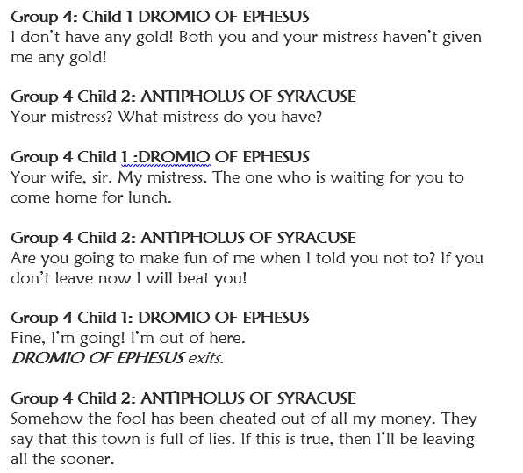
You will be given a script with your lines highlighted.
You will be told which group you are in.
If you are an ‘extra’ it means that you need to pretend to be someone working or shopping at the market.

Slide 8
Let’s see how your scenes are going!
You will need to use a lovely clear voice.
Can you make sure you move your hands and arms for effect?
Can you say your line at the right time?
How might you improve your acting skills?

Slide 9
LO: To act out the whole Market scene as a class.
Thursday 1st July 2021

Slide 10
Thursday 1st July 2021
Today you will be continuing working in your groups to practise your scene.
Then…
Your groups will join with the other groups to create a full ‘production’ of the Market scene.

Slide 11


