Slide 1


Slide 2
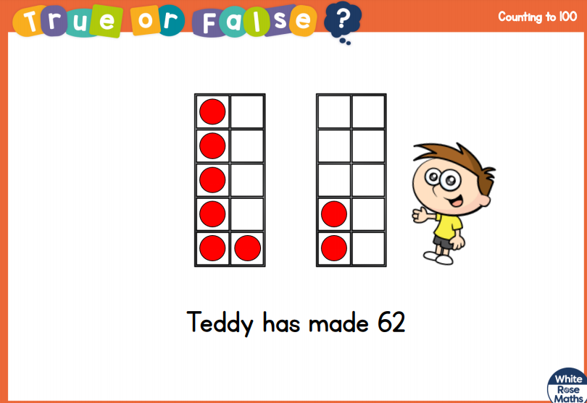

Slide 3
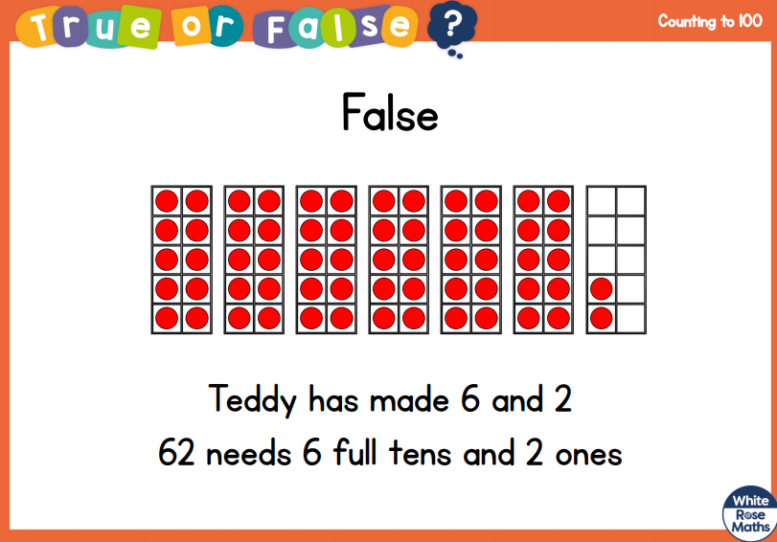

Slide 5


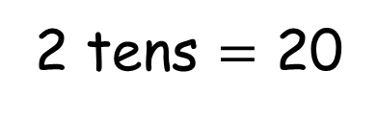


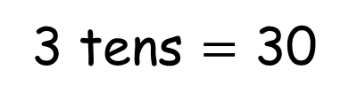
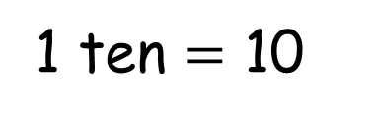
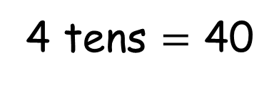
Let’s count in 10s
Have a think
1 ten $=$ 10
2 tens $=$ 20
3 tens $=$ 30
4 tens $=$ 40
I can see a
pattern!
I know that
5 tens = 50

Slide 6
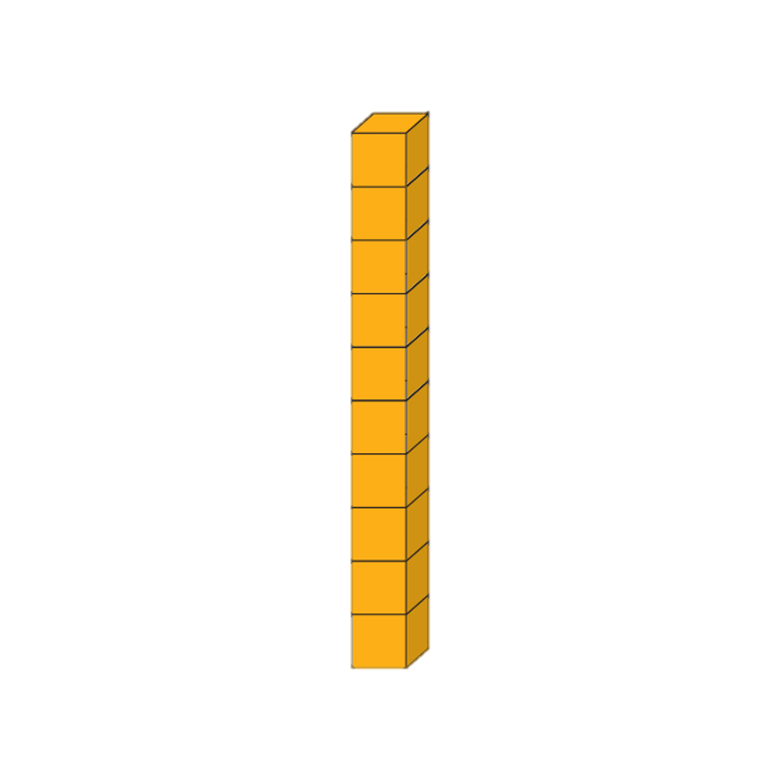
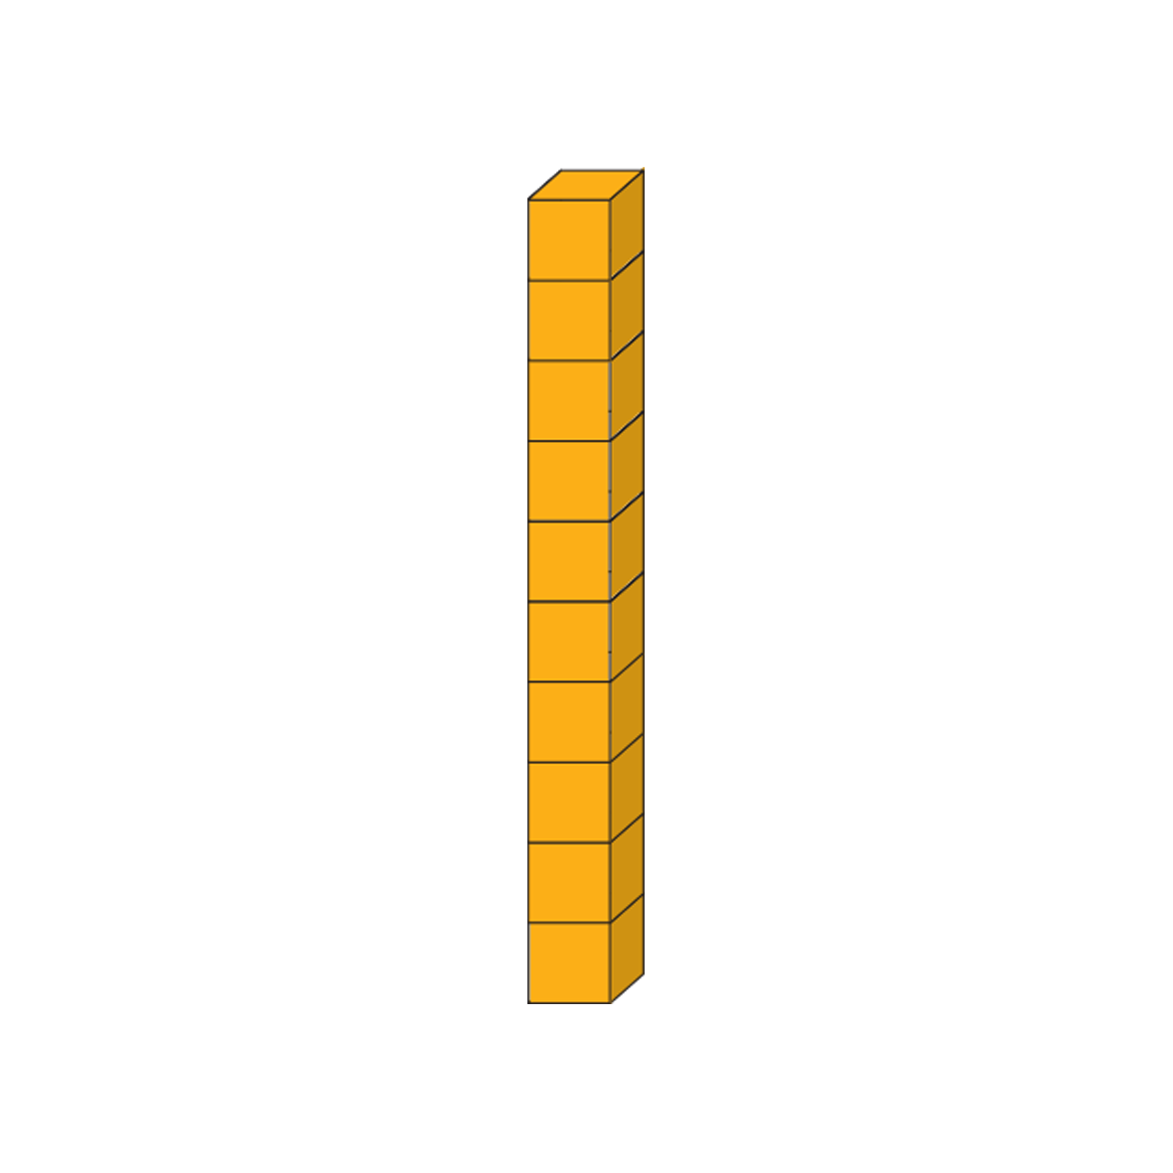
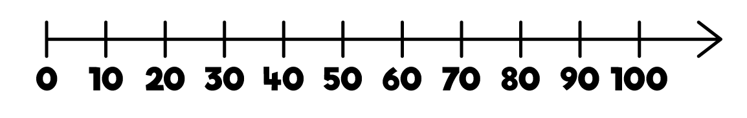
Have a think
I think I need to practice counting forwards and backwards in 10s.

Slide 7
Have a think
Will you practice with me?

Slide 8
You can go back and practice counting with Tiny!

Slide 9



Have a think
10
20
30
40
50
60
70
71, 72, 73, 74

Slide 10






Have a think
I am going to make groups of 10!

Slide 11
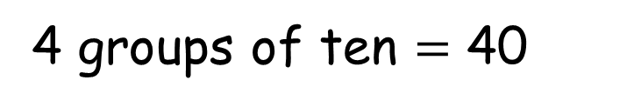
Have a think
4 groups of ten $=$ 40
1 group of 3
Let’s count!
10, 20, 30, 40,
41, 42, 43.
10
30
41, 42, 43
20
40

Slide 12
Why don’t you try grouping counters in 10s and counting on?

