Slide 1









Slide 2
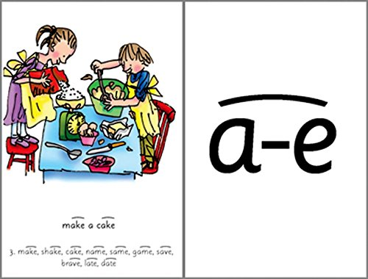
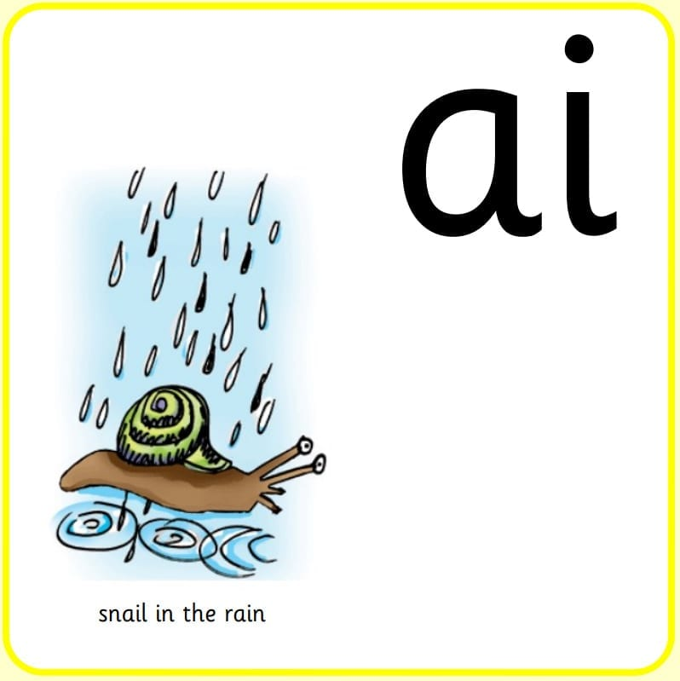
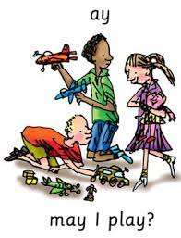
trails
tray
stains
brave
blame
trains

Slide 3
LO: To demonstrate twins using mirroring
Monday 28th June 2021

Slide 4
About this story.
Have you heard of The Comedy of Errors? No?
This is a famous play written by William Shakespeare.
It’s about two sets of identical twins who were separated at birth.
Years later fate brings them to the same city and lots of exciting things happen caused by mistaken identities!

Slide 5

Who is in our story?
Antipholus of Ephesus (rich merchant married to Adriana)
Antipholus of Syracuse (looking for his brother and mother)
Dromio of Ephesus (funny servant of Antipholus of Ephesus)
Dromio of Syracuse (funny servant of Antipholus of Syracuse)

Slide 6
Your Task:
Firstly, we will be thinking about what it means to be a twin. How they can look the same and even act the same.
You will work in pairs to create a routine based on mirroring.

Slide 7
Let’s watch
Mirroring Routine
First of all, you need to think about movements. How will you and your partner move? How will you change position? Make sure you move at the same time and take it slowly.
We will look at your finished routine in 15 minutes!

Slide 8
Now…
Your job now is to think of sounds you can both make, words, sentences, jokes and expressions.
How will you and your partner say things? How will you change the pitch of your voice? Make sure you say things at the same time and take it slowly.
We will look at your finished routine in 15 minutes!

Slide 9
How did you do?
How did you feel the first task went?
What was the easiest thing to do?
How did you feel the second task went?
What was the hardest thing to do?

