Slide 1
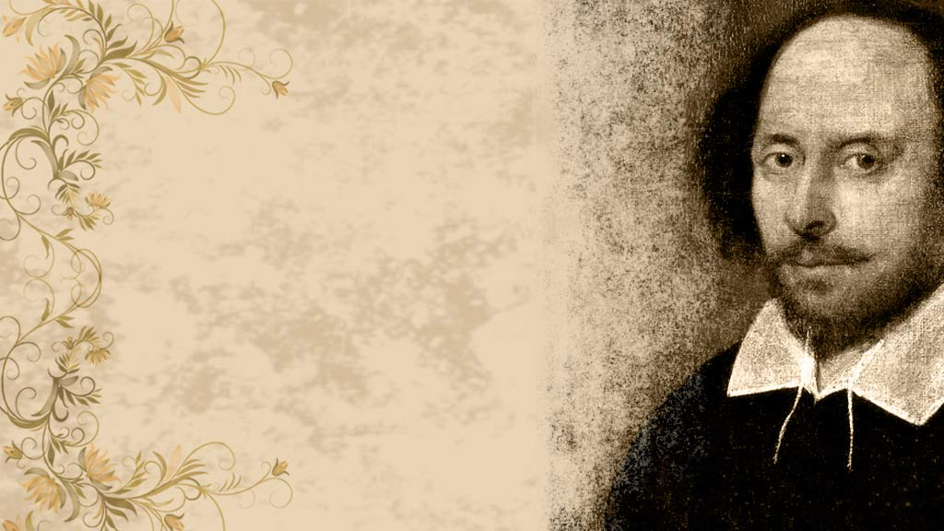
Tuesday 29th June 2021
LO: To learn about Shakespearean theatre.

Slide 2
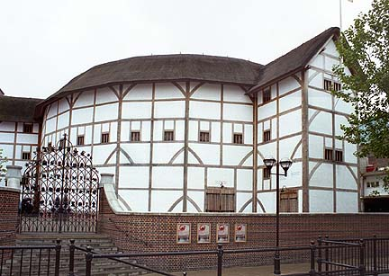
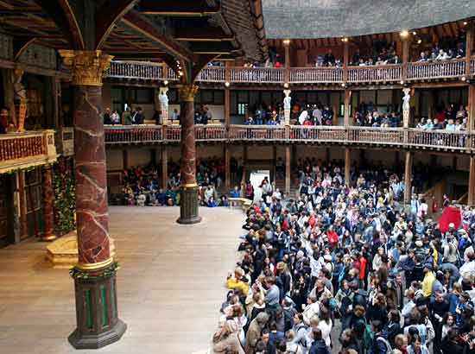
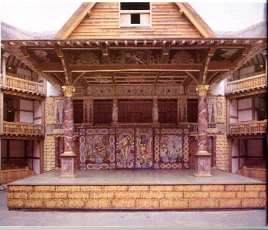
The Theatre
The Globe was built by carpenter Peter Smith and his workers, in 1597 -1598. This theatre could seat 3000 people.
The Globe theatre had an open roof. Most plays were performed during the day, in the afternoon, because, of course, there was no artificial lighting.

Slide 3
The Actors
Shakespearean Actors only got their lines as the play was in progress.
Parts were often allocated on the day of the performance.
Many times the actors didn't even get their own lines. They did “cue acting”.
All actors were male. Women were not allowed to act until much later in the 17th century. This meant that even if the role was a girl e.g. Cleopatra, that it would be played by a male actor.

Slide 4
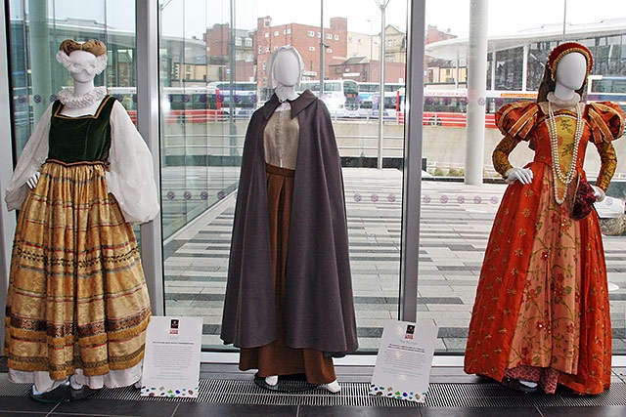
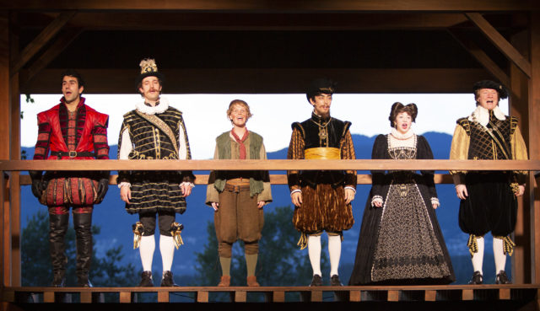
Costumes
In Shakespeare’s time, clothes reflected a person’s status in society – there were laws controlling what you could wear.
As plays had kings, queens and wealthy people in them, the actors’ costumes reflected their characters social status. So for less important roles, actors might wear their own clothes.
However, for a play set in ancient Greece or Rome, the company might try for an ‘ancient’ look for the important characters by giving the main characters togas over their normal clothes.
The company reused costumes if they could – changing a cloak, or putting on some expensive lace. Sometimes they had to have a new costume made. A company probably spent about £300 a year on costumes, which in todays money would be over £35,000!

Slide 5
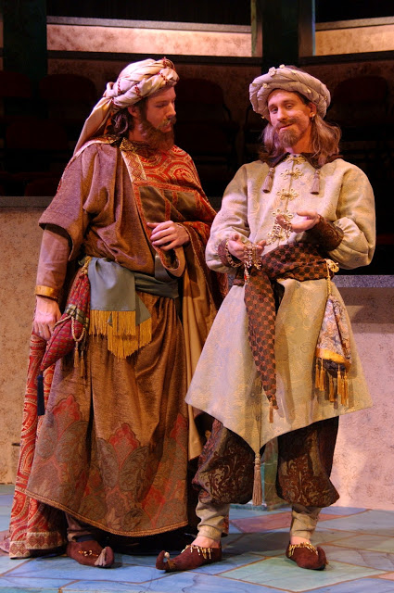
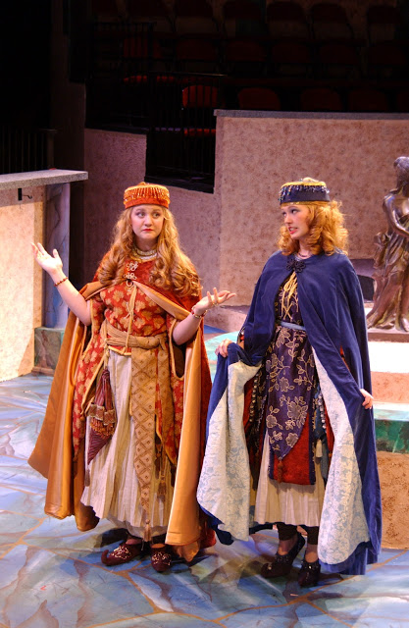
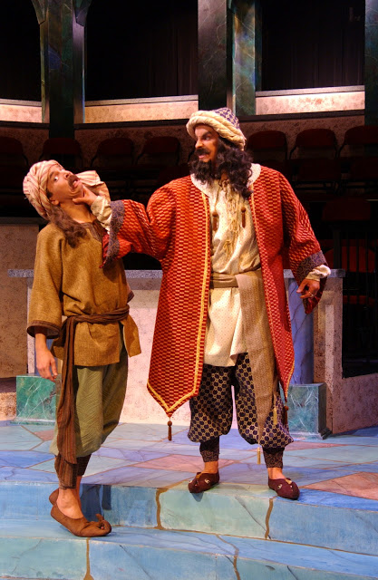
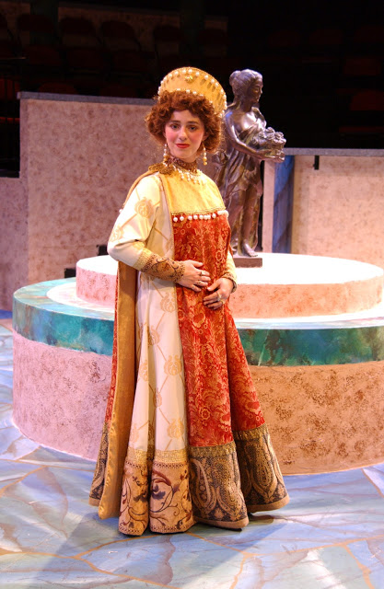
We are currently learning about the play ‘The Comedy of Errors’ here are some of the costumes

Slide 6
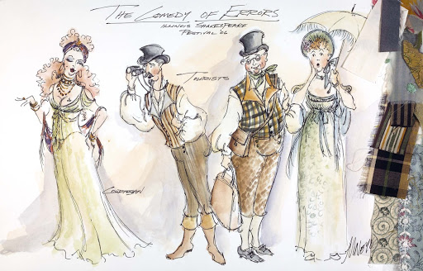
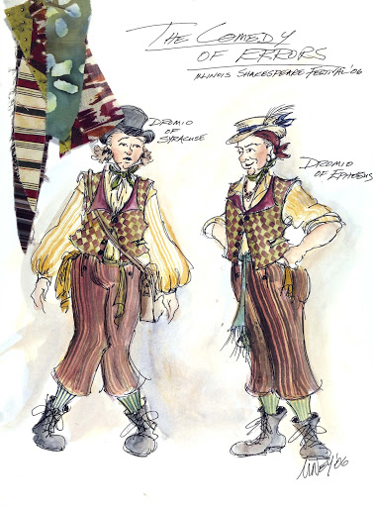
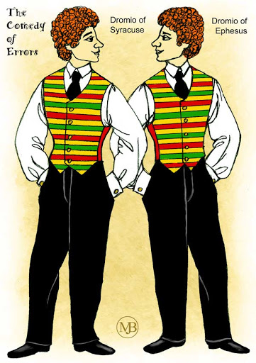
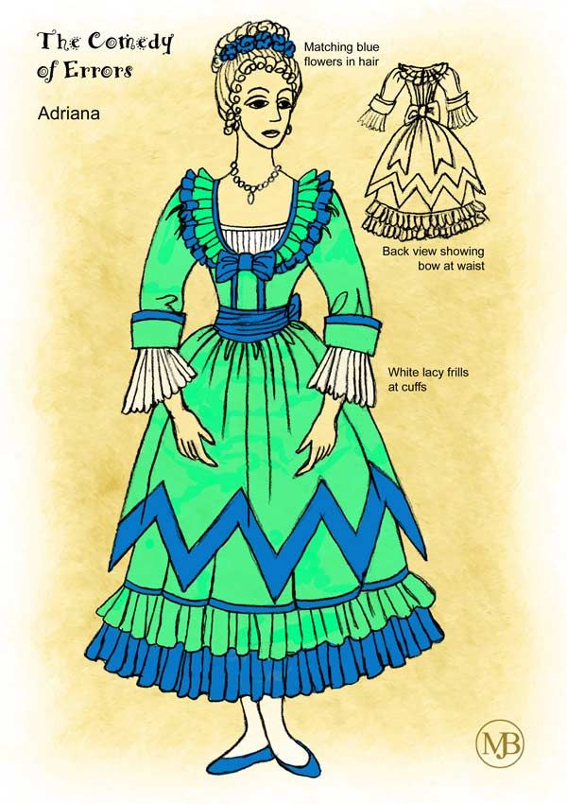
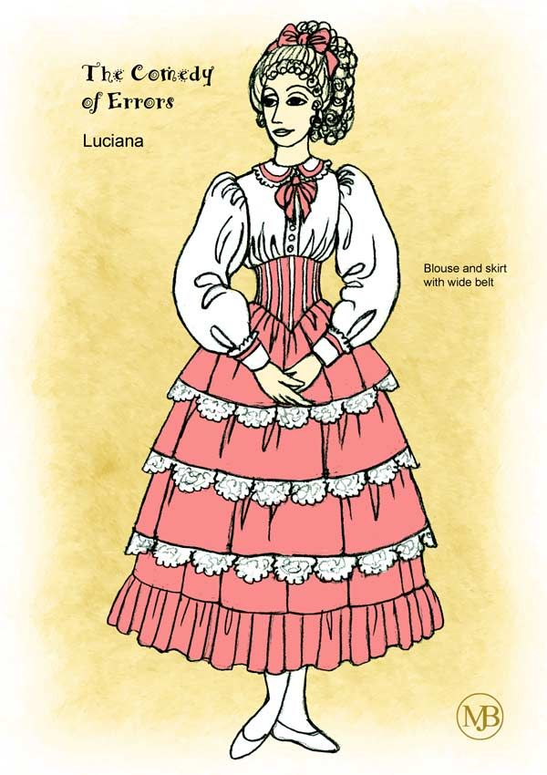
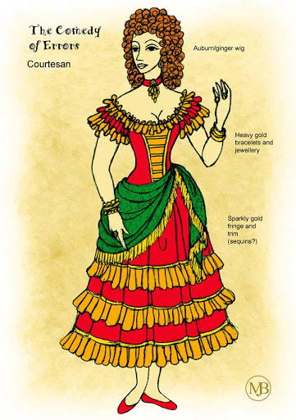
Your task today is to design a costume you think of one the characters could wear in the play.

