Slide 1


Slide 3



1) What number is missing? 50, 40, 30, ___
2) What number is missing? 40, 50, 60, ___
3) How old will you be in ten years?
4) What shape is to the right of the cube?

Slide 4
1) What number is missing? 50, 40, 30, ___
2) What number is missing? 40, 50, 60, ___
3) How old will you be in ten years?
4) What shape is to the right of the cube?
20
70
????

Slide 6



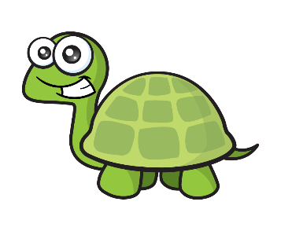
Counting to 100
How many straws?
24
I am going to make groups of 10!
10, 20, ….
21, 22, 23, 24

Slide 7
Counting to 100
How many straws?
36
10, 20, 30, ….
I am going to make groups of 10!
31, 32, 33, 34, 35, 36

Slide 8
Have a go at questions 1 and 2 on the worksheet

Slide 9



How many sweets?
Have a think
85
10
10
10
10
10
10
10
10
There are 8 tens and 5 ones.
There are 85 sweets.

Slide 10


Counting to 100
Have a think
There are 4 tens and 3 ones.
There are 43 counters.

Slide 11


Counting to 100
Have a think
There are 2 tens and 7 ones.
There are 27

Slide 12
Have a go at question 3 on the worksheet

Slide 13

Counting to 100
40 | 41 | 42 | 43 | 44 | 45 | 46 | 47 | 48 | 49

Slide 14
Have a go at question 4 on the worksheet

