Slide 1


Slide 3




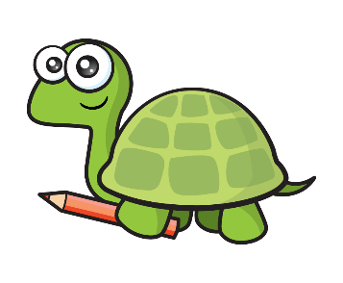
1) How many straws?
2) How many counters?
3) What is one more than 49?
4) Tiny has coloured in a ______

Slide 4
1) How many straws?
2) How many counters?
3) What is one more than 49?
4) Tiny has coloured in a ______
41
19
50
quarter

Slide 6


Counting forwards
60 | 61 | 62 | 63 | 64 | 65 | 66 | 67 | 68 | 69

Slide 7
Counting backwards
60 | 61 | 62 | 63 | 64 | 65 | 66 | 67 | 68 | 69

Slide 8
Have a go at questions 1 and 2 on the worksheet

Slide 9

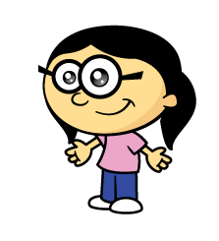
Have a think
Counting forwards on a
number track
What numbers did I hide?
37 | 38 | 39 | 40 | 41 | 42 | 43 | 44 | 45 | 46

Slide 10
Have a think
Counting backwards on a
number track
What numbers did I hide?
77 | 76 | 75 | 74 | 73 | 72 | 71 | 70 | 69 | 68

Slide 11
Have a go at question 3 on the worksheet

Slide 12
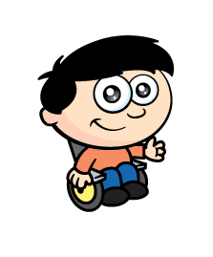
Have a think
Counting on a number line
What numbers are missing?
23
24
25
26
27
28
29
30
31
32
33
34

Slide 13
Have a go at question 4 on the worksheet

Slide 14
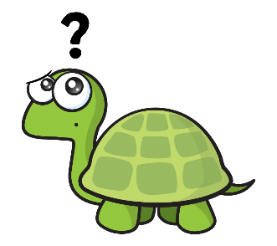
Have a think
90
88
89
91
93
94
92
Join the dots

Slide 15
Have a go at questions 5 and 6 on the worksheet

