Slide 1
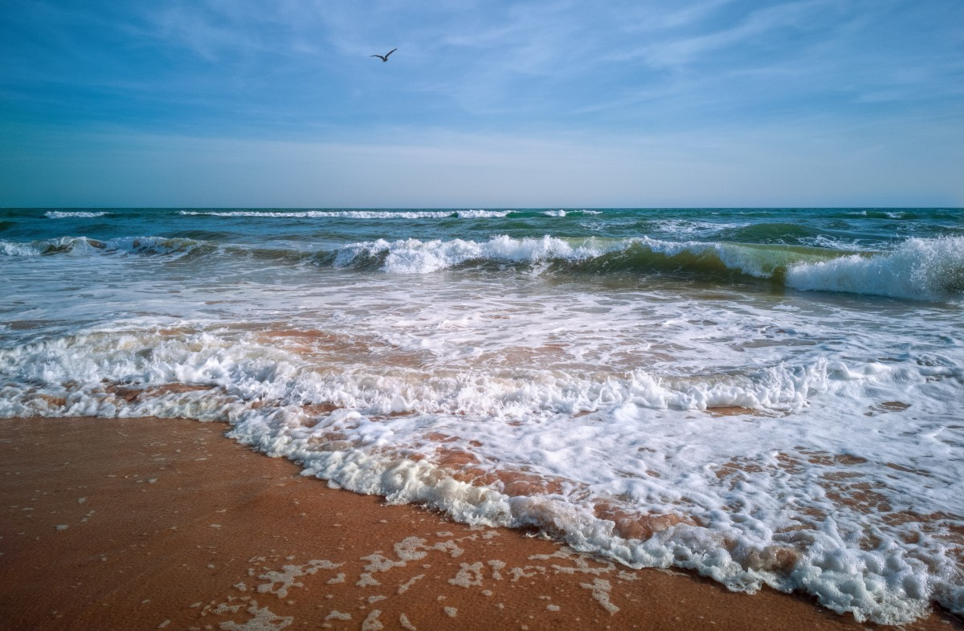
Music
Friday 25th June
L.O. To listen to two pieces of music inspired by the sea.
Compare the different pieces of music.

Slide 2
We are going to listen to two different songs about being by the sea.
When we have listened, we will think about
How the music made you feel
Did you like the music?
Which song is faster, which is slower?
Could you hear any instruments that you know?
Could you hear the sea or waves in the music?
Can you hear any lyrics (words in the song) that talk about the sea?

Slide 3
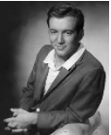

Beyond the Sea by Bobby Darin.
This song was written in 1946. That is 75 years ago.
https://www.youtube.com/watch?v=m8OlDPqYBLw
The Sea by Morcheeba
This song was written in 1998. That is 23 years ago, so it is not as old.
https://www.youtube.com/watch?v=zWHXPz6qF7g

Slide 4
Friday 25th June Music: To compare and appraise two pop songs inspired by the sea.
Beyond the sea by Bobby Darin
The Sea by Morcheeba

