Slide 1
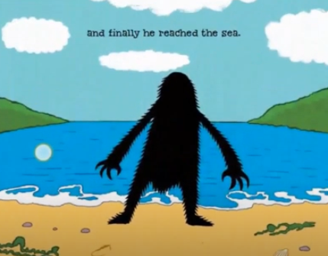
He reached the sea and started to swim.
Adjective : __________________________
Adjective : __________________________
Adjective : __________________________
Adjective : __________________________
Adjective : __________________________
Adjective : __________________________
Adjective : __________________________
Adjective : __________________________

Slide 2
He reached the sea and started to swim.
Time Word: _____________________
Adjective : __________________________
Time Word: _____________________
Adjective : __________________________
Time Word: _____________________
Adjective : __________________________
Time Word: _____________________
Adjective : __________________________
Time Word: _____________________
Adjective : __________________________
Time Word: _____________________
Adjective : __________________________
Time Word: _____________________
Adjective : __________________________
Time Word: _____________________
Adjective : __________________________

Slide 3



