Slide 1


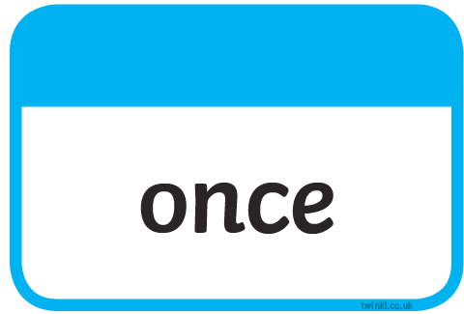






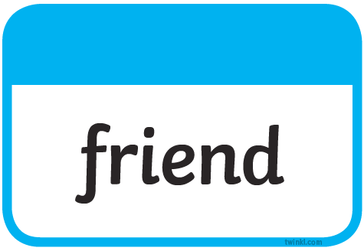


Slide 2

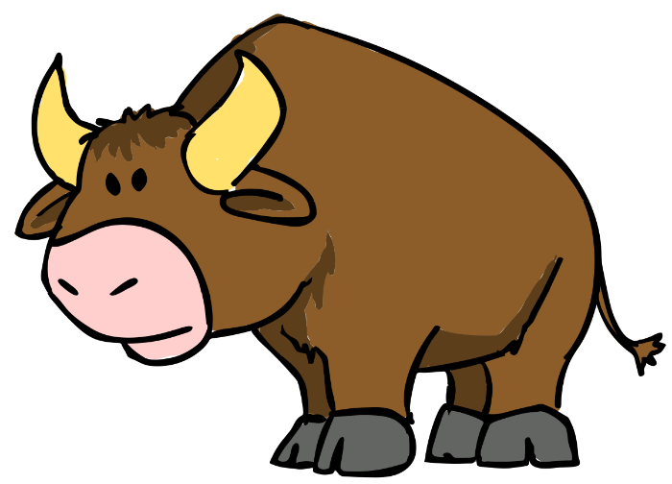
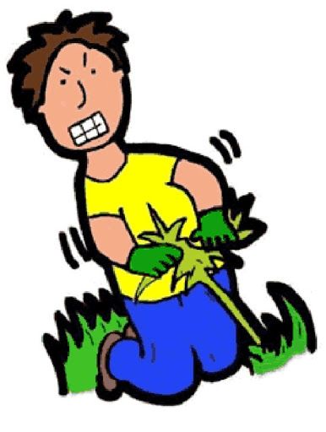
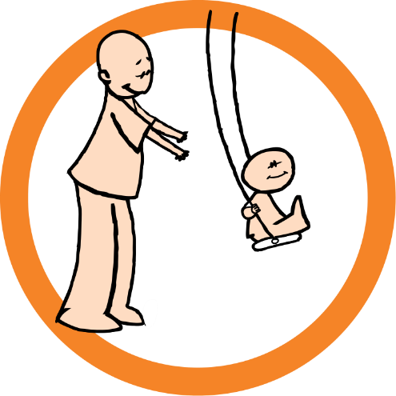
Our Set 3 phoneme for today is….u says oo
bush
full
pull
The bull has horns.
bull
He pushed her on the swing.
My glass is full.
push
pull a bush

Slide 3
LO: To create a story map.
Tuesday 22nd June 2021

Slide 4
About this story.
Have you heard of the Beasts? No. not many have. That’s because they are very rare. This is the tale of one such beast. Whose determination to overcome his loneliness leads him to undertake a daring and dangerous quest to find others like him.

Slide 5
Your Task
After you watch the video of the story, I will ask you to create a story map about the Beast’s journey underwater.
You will have to think about what time sequencing words you could use and adjectives to describe the creatures he sees.

Slide 6
Let’s watch
His adventures… (video to 3:50)
What do you think the Beast will see, hear, feel and smell, while he travels through this amazing place.

Slide 7
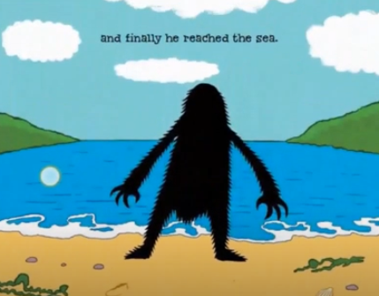
Our story map will begin from when he enters the sea…
First he arrived at the sea and started to swim.

Slide 8
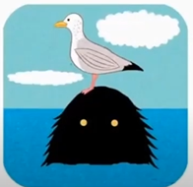
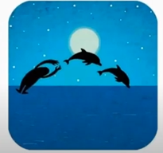
What did he do at the start of his journey?
How could we describe the dolphins?
How could we describe the seagull?
Then a seagull rested on his head…
After that he played with some dolphins.

Slide 9
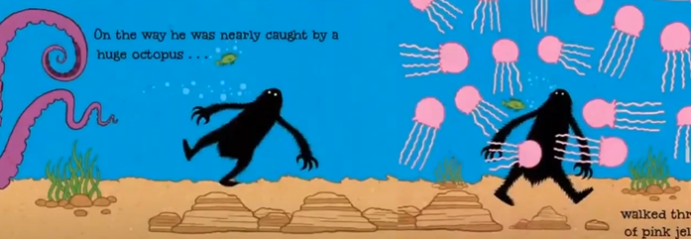
Just then he walked through a garden of jellyfish.
How could we describe the jellyfish?
Next he was nearly caught by a huge octopus.
What word describes the octopus?

Slide 10
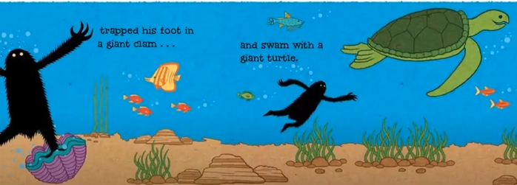
What word describes the turtle?
What word describes the clam?
Suddenly he trapped his foot in a giant clam.
After that he swam with a giant turtle.

Slide 11
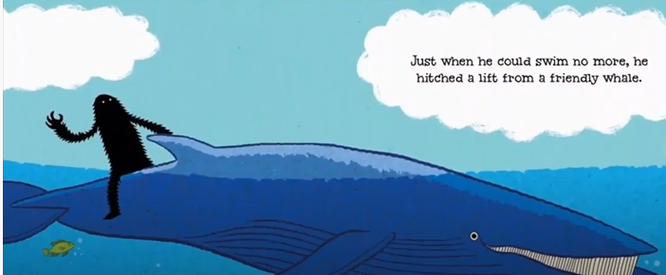
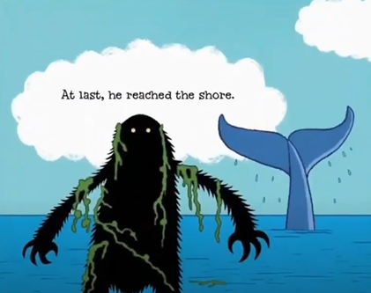
What word describes the whale?
Just when he could swim no more he hitched a lift from a friendly whale.
At last he reached the shore.

Slide 12
How can we order the events?
Remember to use the time words …
  First
  Then
  After that
  Next
  Just then
  Suddenly
  After that
  Just when
  At last

Slide 13
Your Task:
Option 1 – create your story map and for each creature think of an adjective.
Option 2 - create your story map and for each creature think of an adjective and write a time word for each event.

