Slide 1


Slide 2
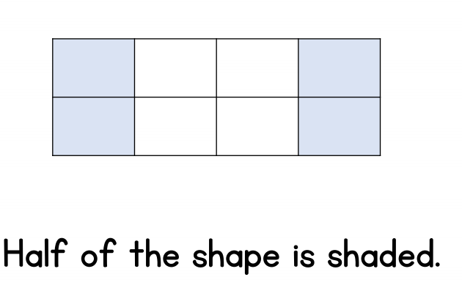

Slide 3
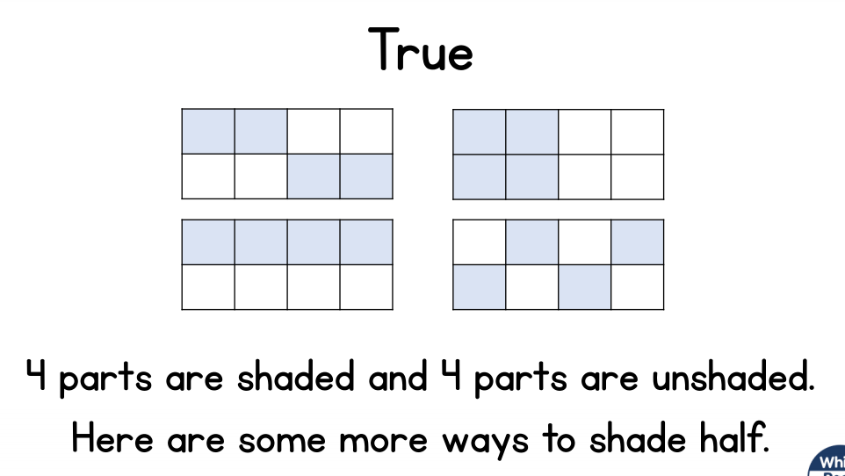

Slide 5



Making a half means sharing equally between 2 people.
One donut can be cut into 2 equal pieces.

Slide 6



We can make a quarter by sharing equally between 4 people.
One tart can be cut into
4 equal pieces.
Each piece is one quarter.

Slide 7







We need to make 4 equal pieces.
But that’s not sharing equally!
Is that
better?
Yay! I get the bigger quarter!
Each piece is one quarter.

Slide 8



What is a half?
What is a quarter?
1
2
1
3
4
2
Have a think

Slide 9
If you cut circles into 4 equal pieces, each piece is one quarter.

Slide 10

Making a quarter of a square
Have a think
Here is
a quarter for you.
I can see another way to make quarters!


Slide 11
Making a quarter of a square
Have a think


Slide 12
Can you find a square piece of paper, fold it into 4 equal pieces and colour in one quarter.

Slide 13
Which shapes are NOT
easy to find a quarter?
Have a think

Slide 14
Which shapes are NOT
easy to find a quarter?
Have a think

Slide 15
Can you draw lines in the squares to prove these are quarters?
Have a think

Slide 16
Can you draw shapes that are NOT easy to find a quarter of?

