Slide 1


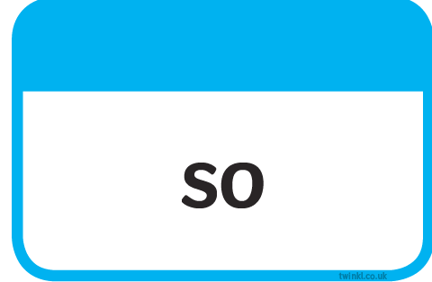








Slide 2
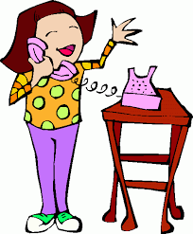


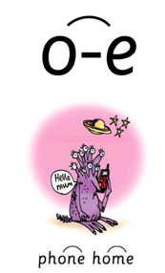
Our Set 3 phoneme for today is….o-e
broke
home
I want to go home.
hope
The man spoke to us.
spoke
She spoke on the phone.
phone

Slide 3
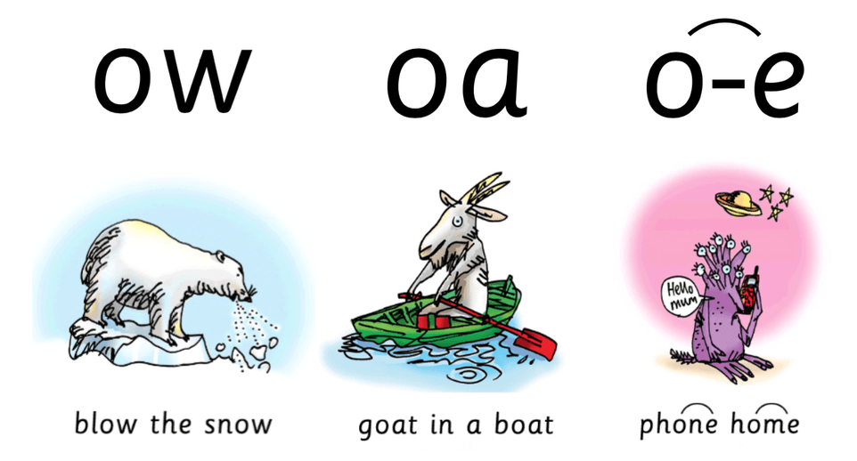
snow
flow
hope
throat
toast
phone

Slide 4
Monday 21st June 2021
LO: Make predictions based on the illustration.

Slide 5
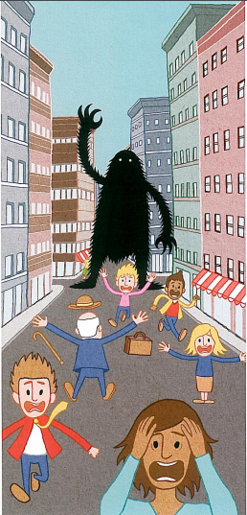
Look at this illustration
Talk to the person next to you about 5 things you notice

Slide 6
What is happening?:
Think of words and phrases to describe what you see and hear as a person that lives here.
What emotions are experienced in this picture?:
Think of words to describe these...

Slide 7
What words would you use to describe the main character?

Slide 8
Your task:
Make a prediction about what you think is happening in the story.
Use the conjunction because to explain you reason.

Slide 9
Example:
I think that the big fuzzy monster is trying to ask the people for directions on how to get to a shop but the people are all running away from it because they are scared the monster is going to eat them.

