Slide 1


Slide 3




1) A half means ___ equal pieces.
2) A quarter means ___ equal pieces.
3) Half of 20 is ___
4) These shapes are all

Slide 4
1) A half means ___ equal pieces.
2) A quarter means ___ equal pieces.
3) Half of 20 is ___
4) These shapes are all
2
4
10
cylinders

Slide 6


Find a quarter.
Have a think
Half of 8 is
4
2
A quarter of 8 is

Slide 7
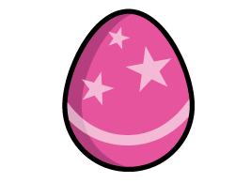
Can you find a quarter of the Easter eggs?
12
Half of 24 is
6
A quarter of 24 is
Have a think

Slide 8



Find a quarter.
Have a think
Start with finding a half.
A quarter is half
of a half!
Half of 20 is
10
5
A quarter of 20 is

Slide 9
Have a go at question 1 on the worksheet

Slide 10
Have a think
Half of 20 is
10
A quarter is half
of a half!
A quarter of 20 is
5
Half of 4 is
2
A quarter of 4 is
1
Half of 8 is
4
A quarter of 8 is
2

Slide 11
Have a go at question 2 on the worksheet

Slide 12



If this is a quarter, what is the whole?
Have a think
A quarter of is
8
2
A half of is
8
4
The whole is
8

Slide 13
Have a go at question 3 on the worksheet

