Slide 1
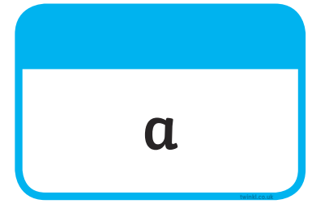







Tricky Words

Slide 2
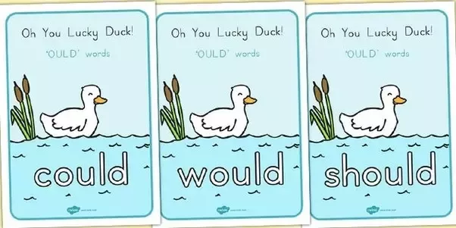
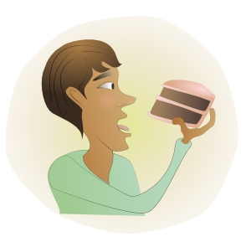

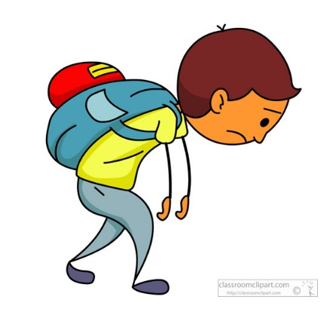
Our Set 3 phoneme for today is….ou says oo
should
could
would
He could eat the cake.
Oh You Lucky Duck
She would love the gift.
He should go home.

Slide 3
LO: write a description of the Beast’s journey under the sea.
Wednesday 23rd June 2021

Slide 4
About this story.
Have you heard of the Beasts? No. not many have. That’s because they are very rare. This is the tale of one such beast. Whose determination to overcome his loneliness leads him to undertake a daring and dangerous quest to find others like him.

Slide 5
Your Task
You have sequenced the story already and thought of time words you can use and adjectives to describe the creatures he meets.
Today you will be writing about his journey from his viewpoint. Use I (the first person)

Slide 6




You will need to use ‘ing’ endings on your verbs.
What do each of the creatures do? How do they move? How do they act?
flapping
gliding
holding
closing
stinging
swirling
coasting
adventuring

Slide 7
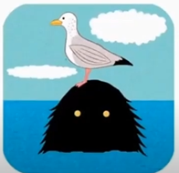
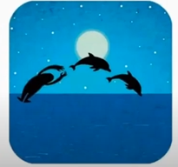
Look at these examples.
How could we describe the dolphins?
How could we describe the seagull?
First a naughty seagull was flapping around my head.
Then some sleek dolphins were jumping in the water with me.

Slide 8
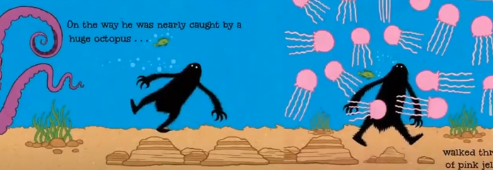
How could we describe the jellyfish?
Next a purple octopus was creeping towards me.
Next a purple octopus was creeping towards me.
What word describes the octopus?
After that some slimy jellyfish were stinging me!

Slide 9
How can we order the events?
Remember to use the time words …
  First
  Then
  After that
  Next
  Just then
  Suddenly
  After that
  Just when
  At last

Slide 10
Your Task:
Option 1 – Use adjectives and verbs with ‘ing’ endings.
Option 2 – Use time words to order events, adjectives and ‘verbs with ‘ing’ endings.

