Slide 2
Knowledge recap
What are the four countries that make up the United Kingdom?
Can you remember any of the capital cities of those countries?

Slide 3


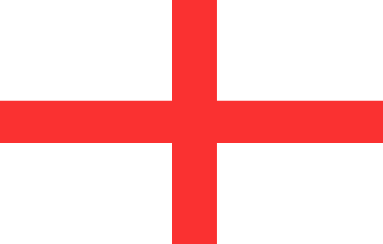

Geography
The United Kingdom of Great Britain and Northern Ireland (also referred to as the UK) is made up of four countries:
Scotland
Northern Ireland
England
Wales

Slide 4
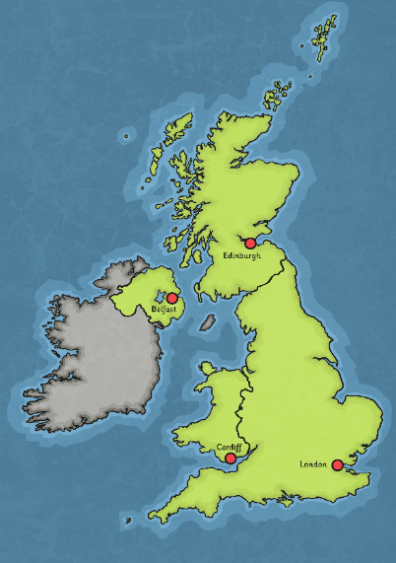
Geography
The capital city of the United Kingdom is London. In addition, Scotland, Wales and Northern Ireland each have their own capitals (the capital city of England is also London).
The capital city of Scotland is Edinburgh.
The capital city of Northern Ireland is Belfast.
The capital city of Wales is Cardiff.
The capital city of England is London.

Slide 5
The seas/oceans that surround the UK.
Do you know any of the oceans/seas that are around the United Kingdom?
Use Google Earth to take a look at some of the seas/ oceans around the UK.
https://www.google.co.uk/intl/en_uk/earth/

Slide 6
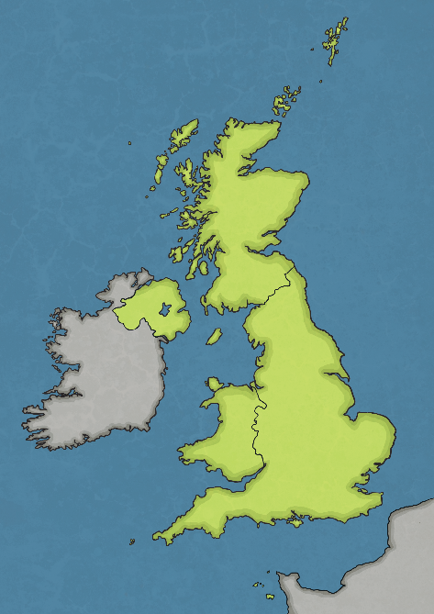
Surrounding Waters
Atlantic Ocean – The entire Atlantic Ocean covers one-fifth of the planet.
North Sea – The North Sea can be stormy and foggy, making it dangerous to cross.
Atlantic Ocean
The Channel – The English Channel separates England and France. People have swum this route.
North Sea
Irish Sea
The
Channel
Irish Sea – The Irish Sea separates Ireland and Great Britain. Great Britain is made up of England, Scotland and Wales.
The English Channel, the North Sea and the Irish Sea are all part of the Atlantic Ocean.

Slide 7
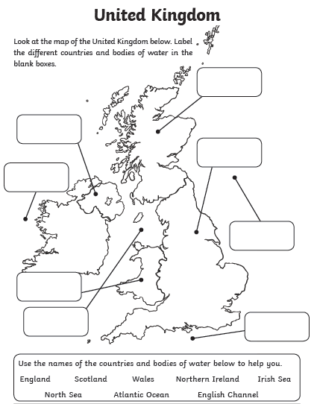
Your Task
Locate and label the countries of the UK using the word bank below.
Then label the oceans/seas that surround the UK.

