Slide 1


Slide 3
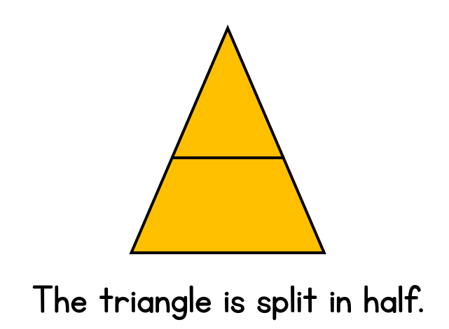

Slide 4
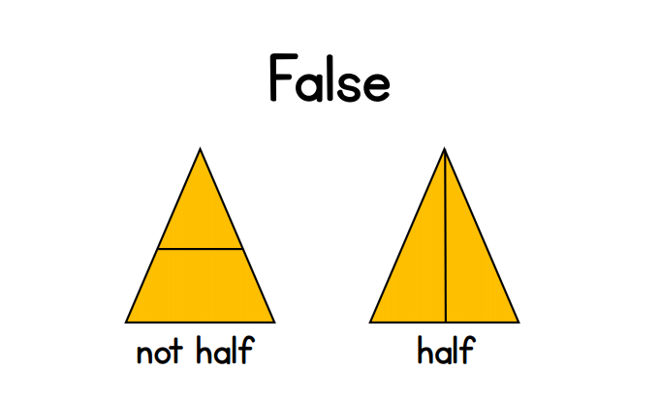

Slide 6

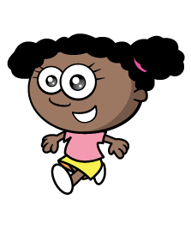

Making a half means sharing equally.
One donut can be cut into 2 equal pieces.

Slide 7
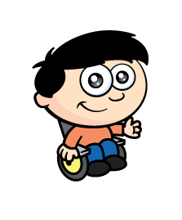
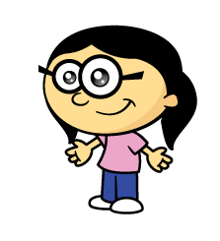

Making a half means sharing equally.
One tart can be cut into 2 equal pieces.

Slide 8

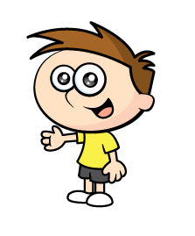

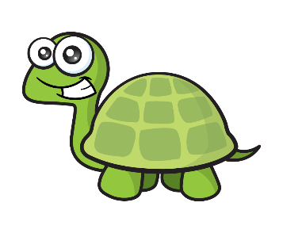

Yay! I get the bigger half!
But that’s not sharing equally!
Tiny, is that
better?
Making a half means sharing equally.

Slide 9
When you share equally with one other person, you get half!

Slide 10

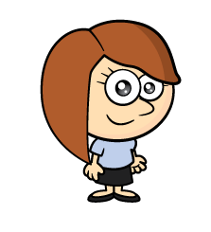
Making a half of a square
Have a think
I can see another way to make half!


Slide 11
Making a half of a square
Have a think


Slide 12
Can you find a square piece of paper, fold it in half and colour in one half.

Slide 13


Have a think
Half
Half
Half
Half
Half
Half
I think I can show a half of each shape!

Slide 14
Have a think
Half
Half
Half
Half
Half
Half
I think I can show a half of each shape a different way!

Slide 15
Have a think
Which shapes are NOT
easy to find half?

Slide 16
Have a think
Which shapes are NOT
easy to find half?

Slide 17
Can you draw shapes that are NOT easy to find half of?

