Slide 1
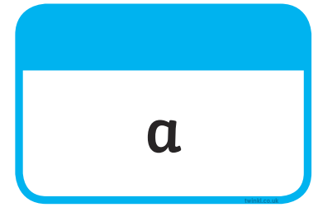







Tricky Words

Slide 2
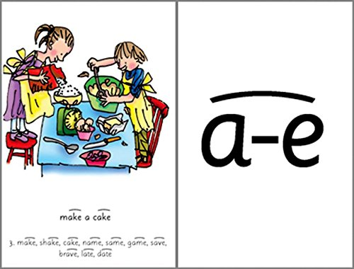
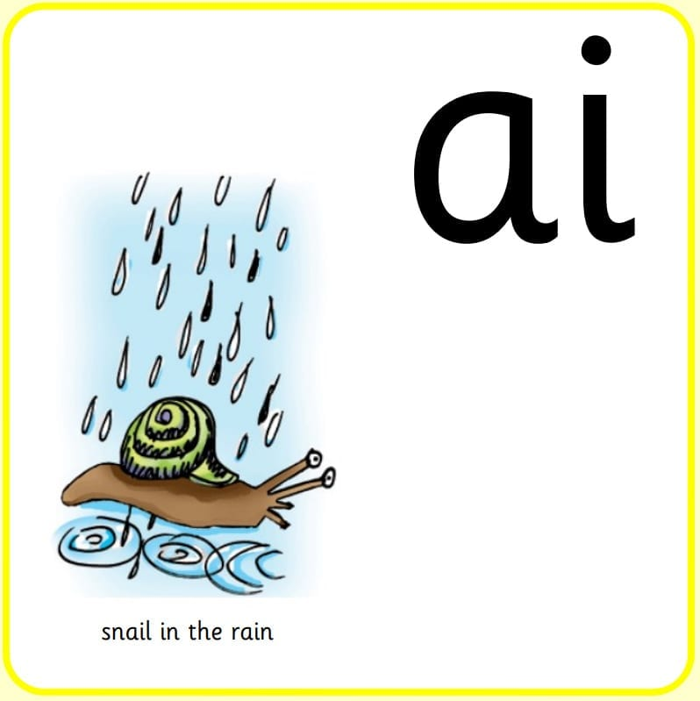

snail
play
paint
brave
name
paint

Slide 3

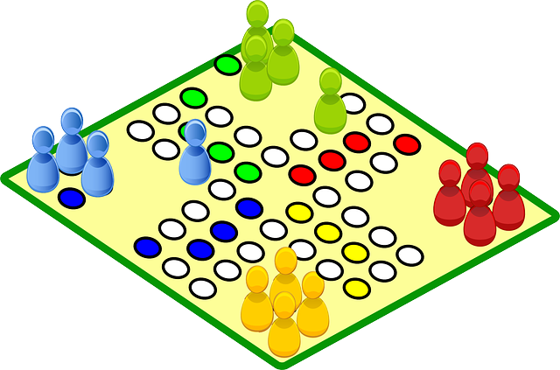

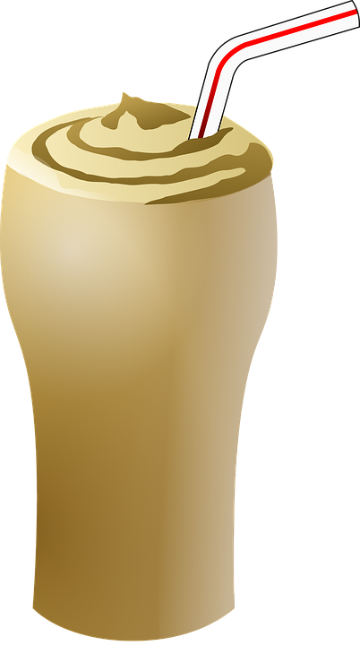
Our Set 3 phoneme for today is….a-e
pale make
shake
same
game
brave
Shall we play a game?
I am very brave.
flake
We are the same.
I had a milk shake.

Slide 4
LO: To write the first two sections of a travel journey from the viewpoint of the snail.
Monday 14th June 2021

Slide 5
Your Task
When the snail and the whale go on their adventures, they see some fantastic places.
Today you will be writing a travel journal about what the snail experiences.

Slide 6
Your Task
The first two main places they visit are the incredible tropical islands with volcanoes.
They then journey on to the freezing Antarctic, where she experiences a whole new environment.

Slide 7
Let’s watch
Their adventure begins…
What do you think the snail will see, hear, feel and smell, while she travels through these amazing places.

Slide 8
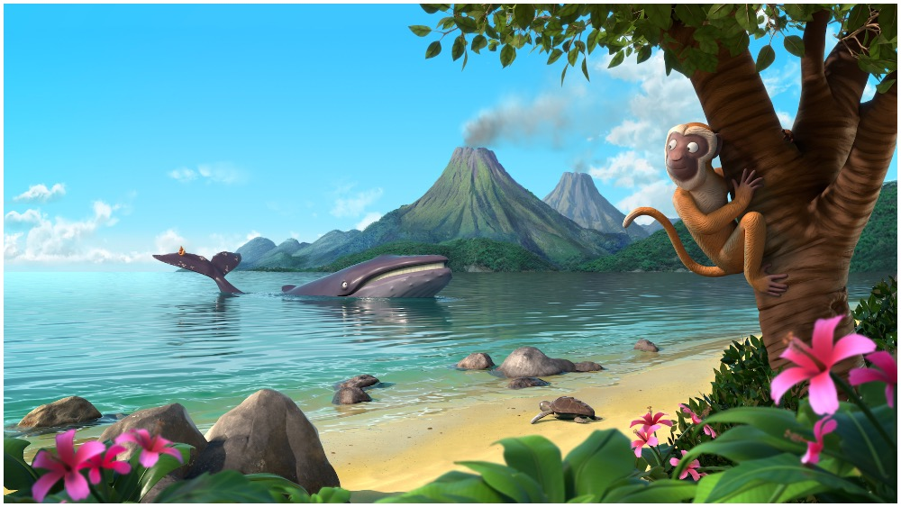
Here is the incredible tropical island.
smoking volcanoes
cheeky chattering monkeys
crystal clear water
soft yellow sand
fantastic pink flowers

Slide 9
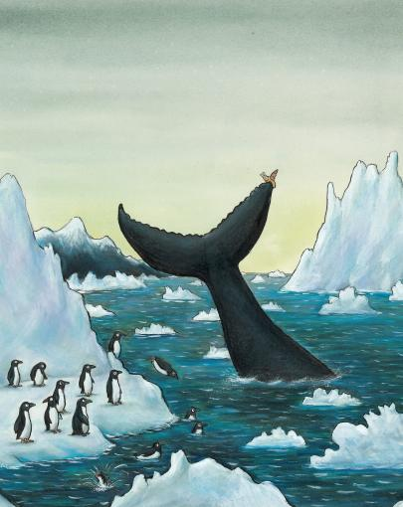
Here is the incredible tropical island.
cold crisp air
towering white cliffs
cold dark seas
squawking sliding penguins
soft shivery snow

Slide 10
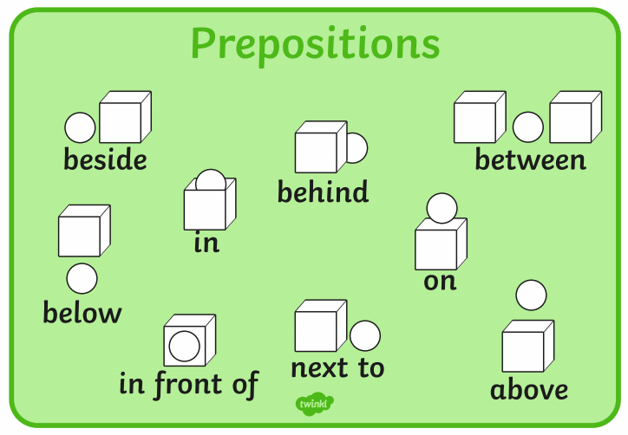
What might the snail write about her journey so far?
Remember to use the PAST tense…
  there was
  there were
  I saw
  I looked
  I smelled
  I heard
Harder!
Where were things that the snail could see?
  Use prepositions…

Slide 11
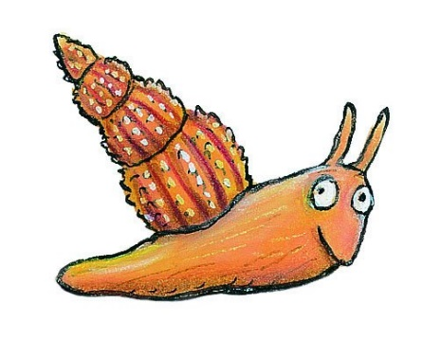
Look at this example
Easy:
I saw the lovely island and I heard a chatty monkey in a tree. I saw lovely flowers and soft sand.
Harder:
We arrived at a wonderful tropical island. Around me, the water was warm and clear. In front of me, I saw a chatty monkey in a palm tree and soft sand. Between the rocks, were lovely pink flowers with butterflies on them.

Slide 12
Your Task:
Option 1 – To write complete sentences using adjectives (describing words).
- Use the conjunctions ‘and’
Option 2 - To write compound sentences.
Use the conjunctions ‘and’
Use adjectives (describing words) for effect.
Use prepositions for location.

