Slide 1
PSHE
The Boy who cried wolf.
Tuesday 15th June 2021

Slide 2
Let’s look at the story of The Boy Who Cried Wolf.
The story
What did the boy do to stop him being bored?
Do you think what he did was right?
Have you ever told a lie?

Slide 3
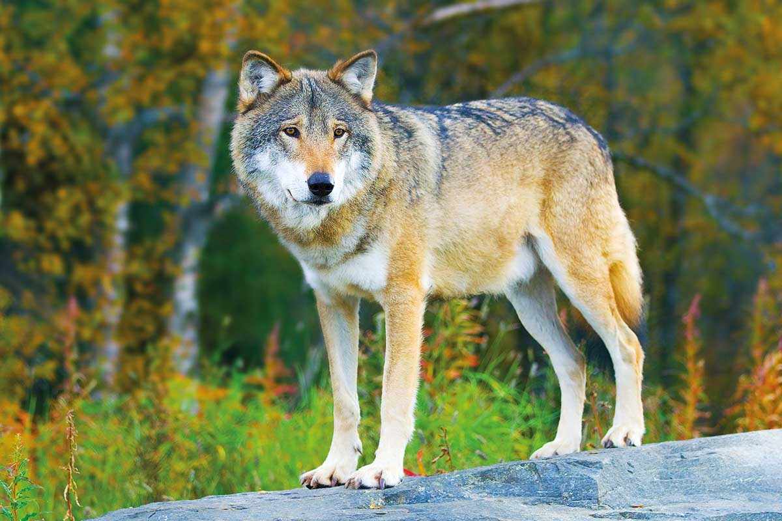
Why do people lie?
Are there any reasons that make lying OK? Discuss this with your partner.
People might lie to:
avoid hurting someone’s feelings – this sort of lie is often called a ‘white lie’.
make a story more exciting
cover something up so they don’t get into trouble
get something they want – for example, ‘Mum lets me have lollies before dinner
experiment – for example, by pretending something that happened in a story was real
get attention or make themselves sound better

Slide 4
It is best to tell the truth…
Why is telling the truth the best choice?
If you own up to doing something wrong it is good. For example, your grown up might say…‘I’m so glad you told me what happened. Let’s work together to sort things out’
Telling the truth makes people trust what you say in the future.
Think about lying and telling the truth. For example, ‘How would mum feel if dad lied to her?’ or ‘What happens when you lie to a teacher?
Have a think about something you may have fibbed about…
How did you feel after?
Do you think you will change what you say after this lesson?

