Slide 1


Slide 3

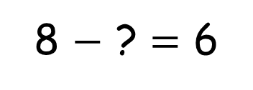
1) How do you spell 9 ?
2) What number is this? Thirty
3) What shape is this?
4) What is the missing number?
8 $−$ ? = 6

Slide 4
1) How do you spell 9 ?
2) What number is this? Thirty
3) What shape is this?
4) What is the missing number?
nine
30
cone
2
8 $−$ ? = 6

Slide 6


Make a half
half
half
Ready!
Stop!

Slide 7
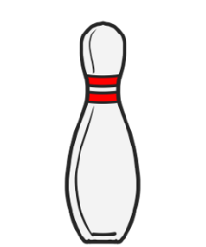
Make a half
half
half
Ready!
Stop!

Slide 8



Have a think
Find a half
half
half
half
half
half
half

Slide 9
Have a go at questions 1 and 2 on the worksheet

Slide 10
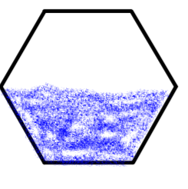




Have a think
Who coloured in one half?
half
half

Slide 11
Have a go at questions 3 and 4 on the worksheet

Slide 12




Have a think
Which shapes show one half?

Slide 13
Have a go at question 5 on the worksheet

Slide 14
Have a think
Match the halves to make a whole.

Slide 15
Have a go at question 6 on the worksheet

