Slide 1









Slide 2

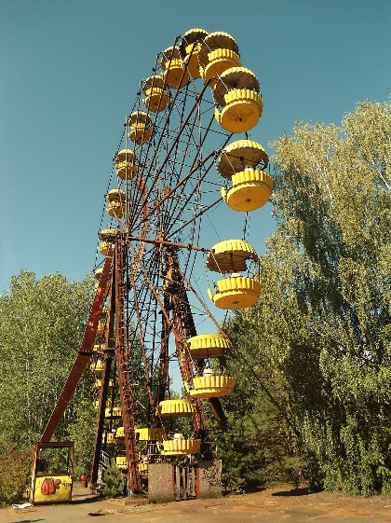
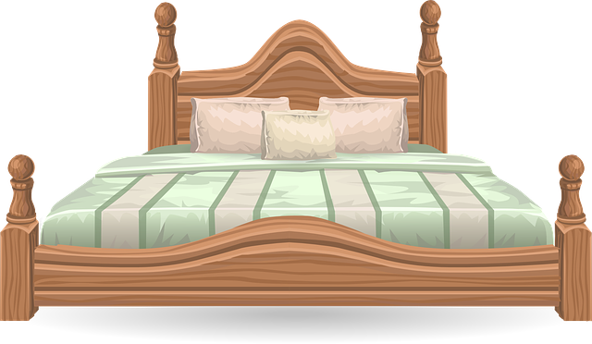
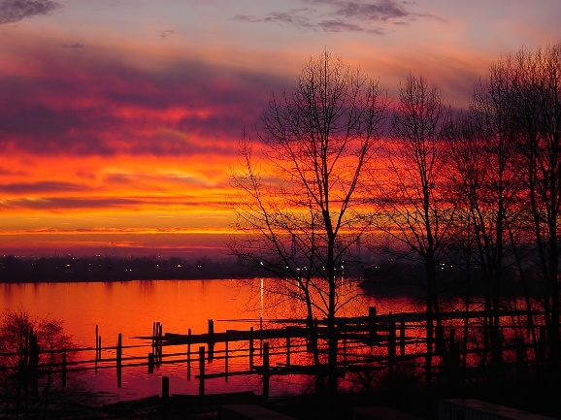
Our Set 3 phoneme for today is….e-e
theme these
delete
evening
complete
swede
I went to a theme park.
I like these sheets.
What a nice evening.

Slide 3
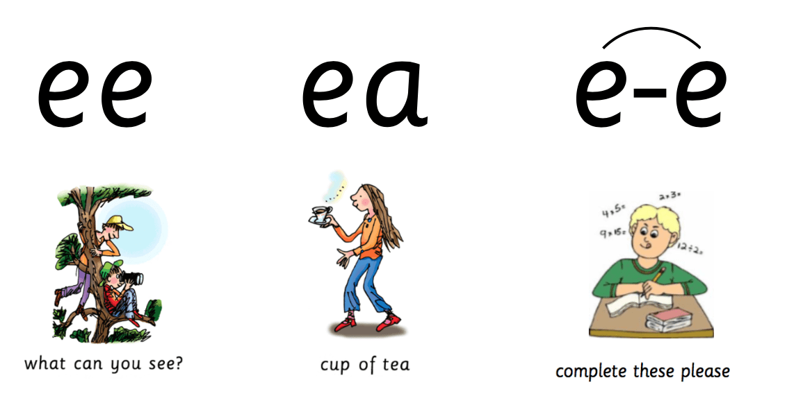
sleep
these
leap
creep
theme
cream

Slide 4
LO: To write the first two sections of a travel journey from the viewpoint of the snail.
Tuesday 15th June 2021

Slide 5
Your Task
When the snail and the whale go on their adventures, they see some fantastic places.
Today you will be continuing your writing about what the snail experiences.

Slide 6
Your Task
The last main place they visit is the stunning lakes and mountains.

Slide 7
Let’s watch
Their adventure begins…
What do you think the snail will see, hear, feel and smell, while she travels through this amazing place?

Slide 8
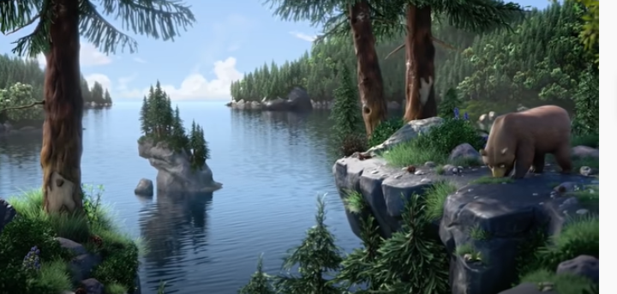
Here is the incredible forest and mountain.
huge mountains
deep dark forests
strong brown bear
tall pine trees
hard grey rocks

Slide 9
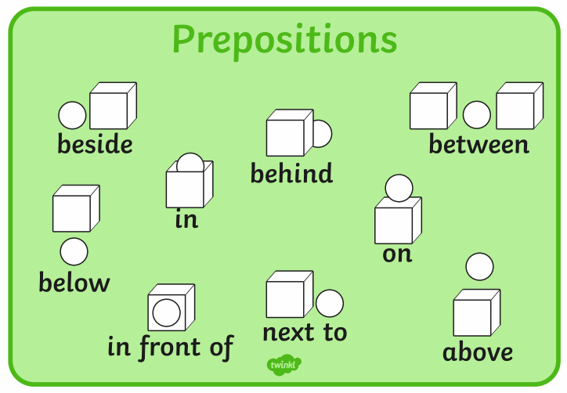
What might the snail write about her journey so far?
Remember to use the PAST tense…
  there was
  there were
  I saw
  I looked
  I smelled
  I heard
Harder!
Where were things that the snail could see?
  Use prepositions…

Slide 10
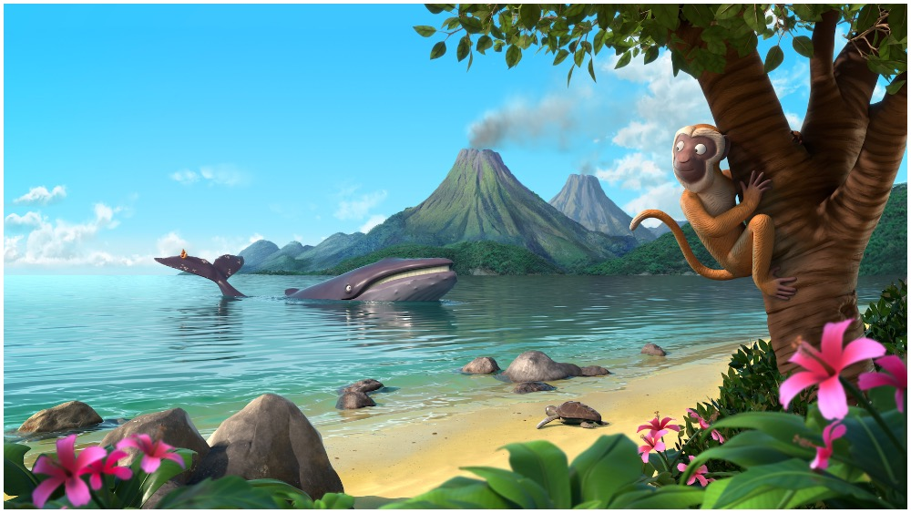

Look at this example
Easy:
I saw the huge mountains and I heard a brown bear roar. I saw tall trees and clear water.
Harder:
We arrived at a beautiful mountain range. Around me, the mountains were huge and rocky. In front of me, I saw a brown bear roaring and an eagle calling. Between the rocks, were lush green plants and tall trees.

Slide 11
Your Task:
Option 1 – To write complete sentences using adjectives (describing words).
- Use the conjunctions ‘and’
Option 2 - To write compound sentences.
Use the conjunctions ‘and’
Use adjectives (describing words) for effect.
Use prepositions for location.

